Slide 1
New Paradigm in
Journal Reference Management
Enhancing Research Efficiency with Web 2.0 Technology
Casey Chan MD
Victor Lin

Slide 2
Key Challenges to Research Efficiency
Manage references
Locate full-text articles (PDF)
Share references and PDF
Notes:
Patent document management can be generalised to journal articles

Slide 3
Identity Crisis
Multiple databases
Non-uniform data structure
Numerous URIs for each publication
Varying publication names
Notes:
Uniform Resource Identifier consists of a string of characters used to identify or name a resource on the Internet. Such as http linkage.
What is meant by different publication name?

Slide 5




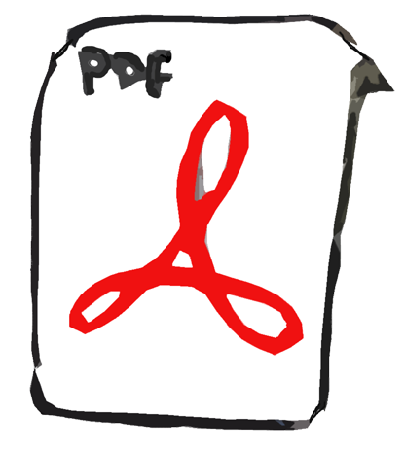

Reference Management Workflow
Title: Hemorrhagic Fever
Author: KM Larrick
Journal of Biochemistry, 10(6) p111-115, 2008
Pubmed
Publisher

Slide 6
What lessons can we learn from managing MP3 Files?
Notes:
This a a major distinguishing factor that allows for file sharing

Slide 7
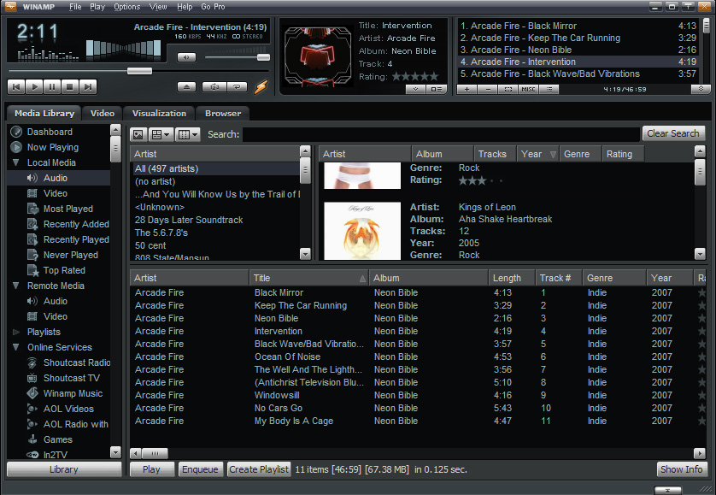

Slide 8
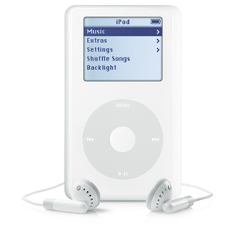




Managing MP3 Files
Music Metadata
Database
No
Metadata
1. Rip
Abba – Super
Trooper
MP3
2. Hash
Hash Title Length
45E365 Take on Me 3:25:00
56GG81 Sergeant Pepper 4:00:10
23SD19 Summer Rain 4:11:12
56SN45 Love Takes Time 3:12:13
09BS23 Super Trooper 3:45:12
HASH Abba’s Hits Song Length 3:45:12
Metadata 09BS23 Abba SuperTrooper
3. Metadata
09BS23 Super Trooper 3:45:12
4. Transfer MP3
Abba – Super
Trooper
Notes:
Gracenote, Inc., formerly called CDDB (Compact Disc Data Base), is a company that maintains and licenses an Internet-accessible database containing information about the contents of audio compact discs and vinyl records. WinAmp and iTunes use their database.

Slide 9



Metadata, Bibliography and Label
Label
Product Name
Manufactured by
Ingredients
Manufacturing Date
Expiry Date
Unlabelled Can
Tomato Soup
MP3 File
Metadata provides detailed information about MP3 file
Title: Maggie Mae
Artist: Rod Stewart
Genre: Pop
Album: Gasoline Alley
Year: 1972
Studio: EMI
PDF Journal Article
Limited fields
Incomplete
Non-descriptive
Filename: 876gdty.pdf
Author:
Title:
Notes:
when without label, people will write the minimum amount of information on it
Pdf is not labeled, small space to label which doesn’t include all metadata
Not all publishers include full metadata
We want an automatic process of labelling

Slide 10
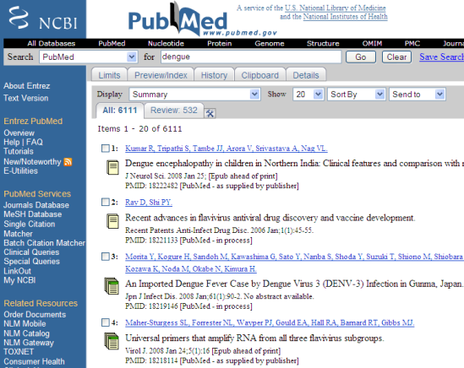


Managing Journal Articles like MP3s
Publisher
Source of Bibliographic Data
Bibliographic data
Bibliographic data
Author: Taylor, H.
Author: Taylor, H.
Title: A review of…
Title: A review of…
Signature
Download
Bibliographic data
Sharing

Slide 11
Reference Management Workflow
Title: Hemorrhagic Fever
Author: KM Larrick
Journal of Biochemistry, 10(6) p111-115, 2008
Pubmed
Publisher

Slide 12
Improved Reference Management Workflow
Title: Hemorrhagic Fever
Author: KM Larrick
Journal of Biochemistry, 10(6) p111-115, 2008
One Click

Slide 13
Improved Reference Management Workflow
Title: Hemorrhagic Fever
Author: KM Larrick
Journal of Biochemistry, 10(6) p111-115, 2008
Title: Hemorrhagic Fever
Author: KM Larrick
Journal of Biochemistry, 10(6) p111-115, 2008
Title: Hemorrhagic Fever
Author: KM Larrick
Journal of Biochemistry, 10(6) p111-115, 2008
Title: Hemorrhagic Fever
Author: KM Larrick
Journal of Biochemistry, 10(6) p111-115, 2008

Slide 14
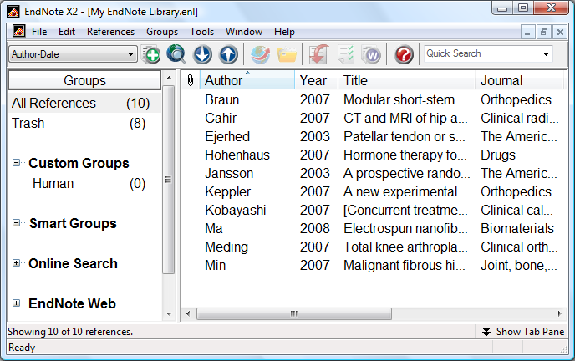
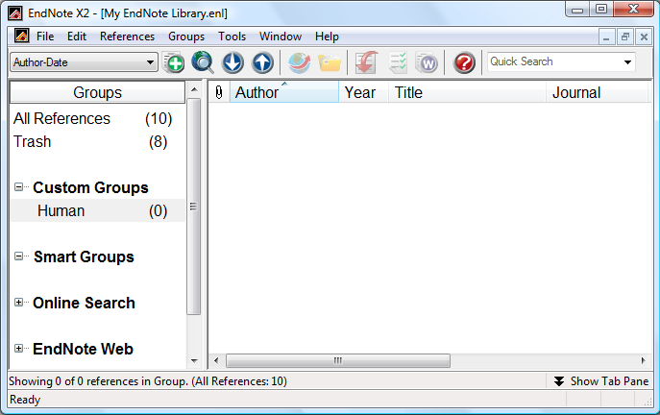
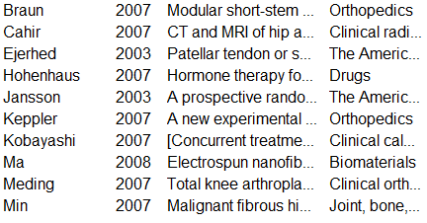



X
Susan
Michael

Slide 15


PDFs and Metadata
WizFolio
Researcher
Metadata
Author, Title,
Journal
pubget
Colleagues
Web-based
Zotero
Desktop
Metadata
Author, Title,
Journal
EndNote
Metadata
Author, Title,
Journal
Shortcut
Notes:
Endnote and Zotero doesn’t allow sharing

Slide 16
pubget
PDF Search Engine
Notes:
Pubget is basically a PDF search engine which allows you to locate PDF easily. Let me give you some demo.

Slide 17
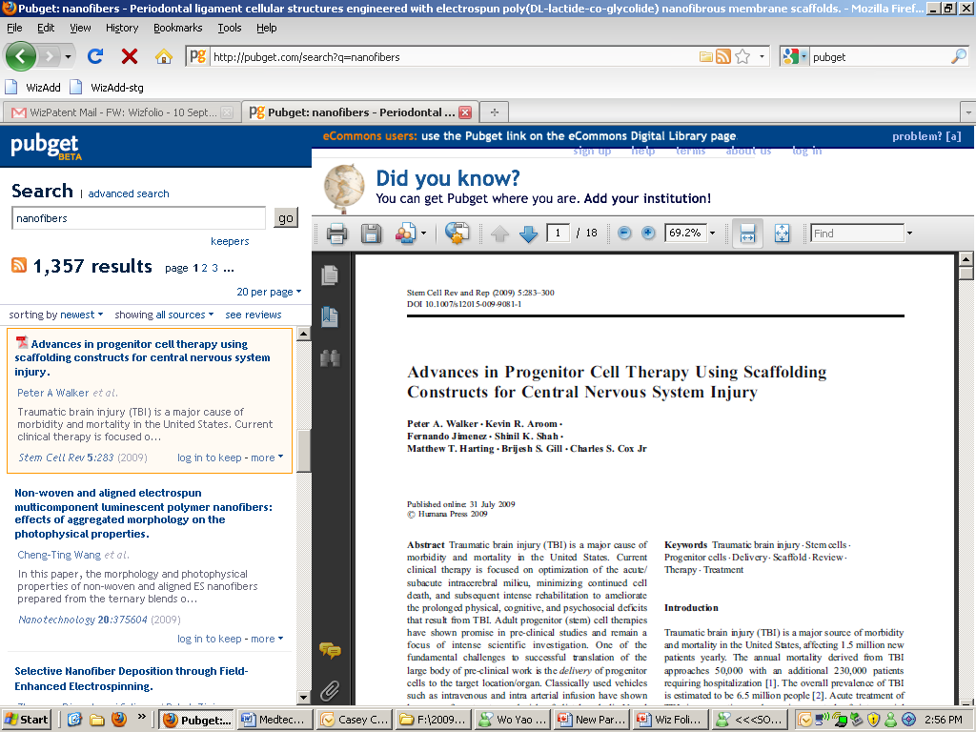
PDF
Metadata
Notes:
PDFS taken from Arxiv and MedLine. Life Science Articles only.

Slide 18

PDF and Metadata Manager
Notes:
Pubget is basically a PDF search engine which allows you to locate PDF easily. Let me give you some demo.

Slide 19
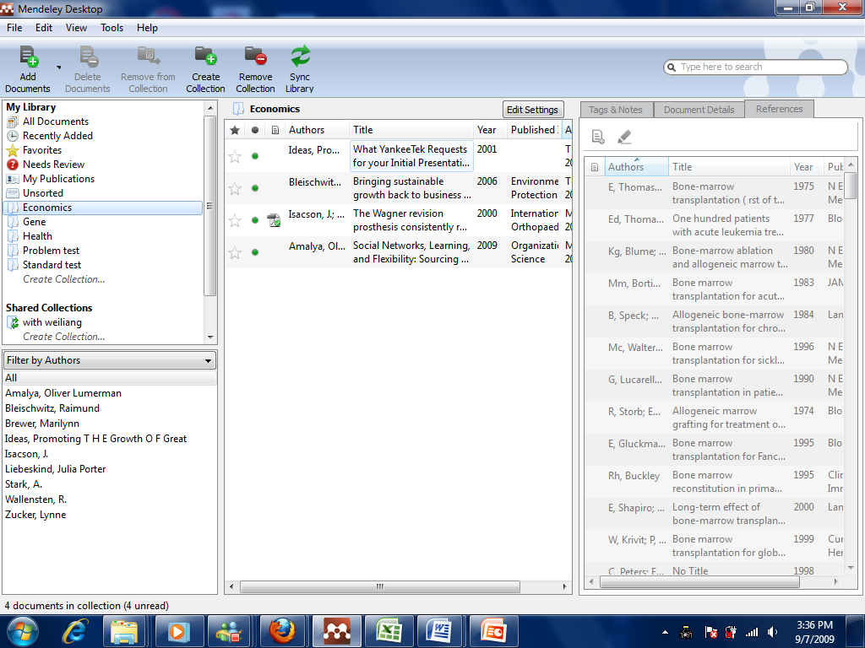

Slide 20
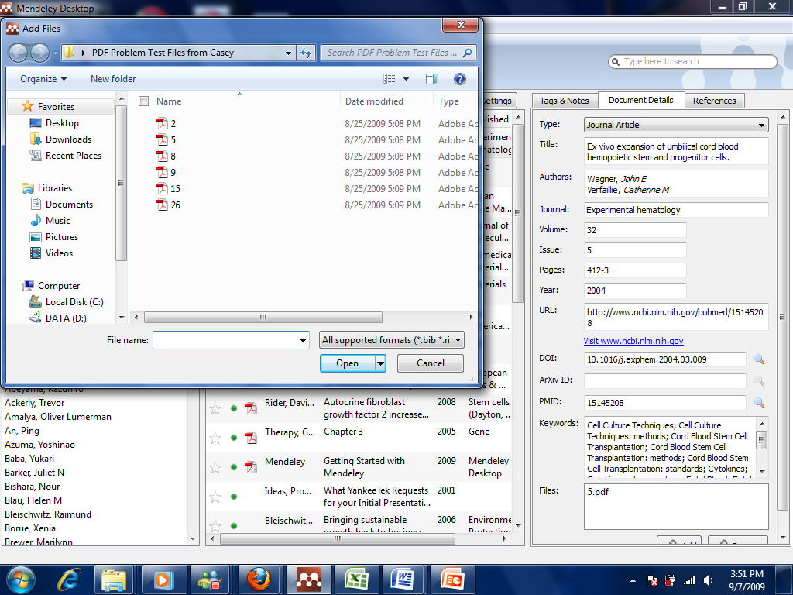

Slide 21
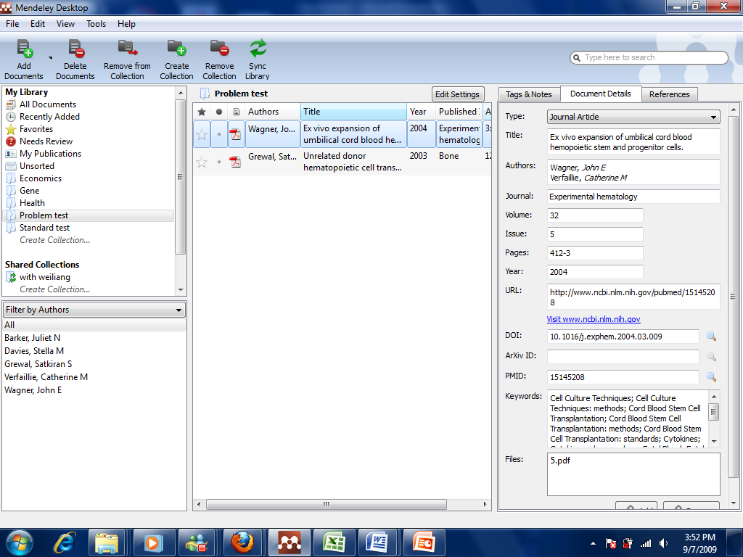

Slide 22
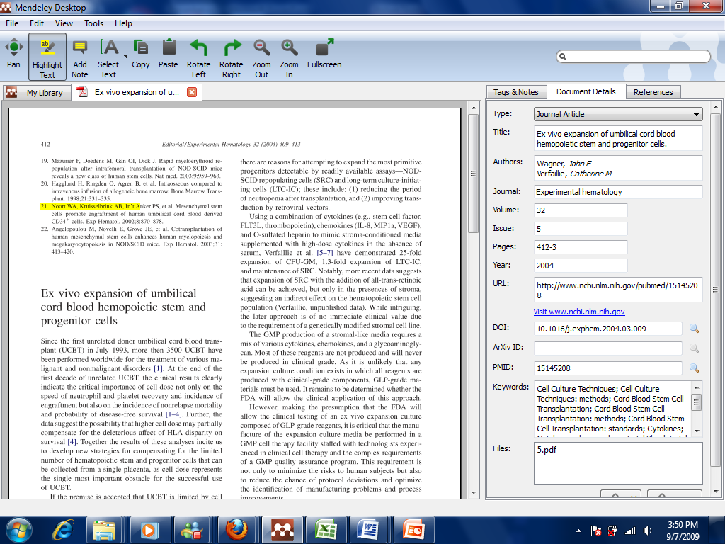

Slide 23

PDF and Metadata Manager

Slide 24
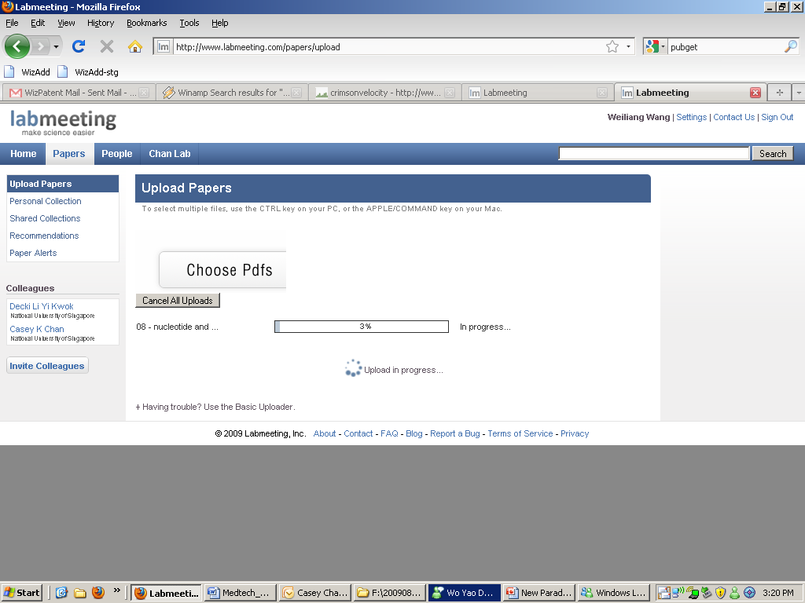
Notes:
Upload PDFs and find metadata from pubMed. However uploading is slow

Slide 25
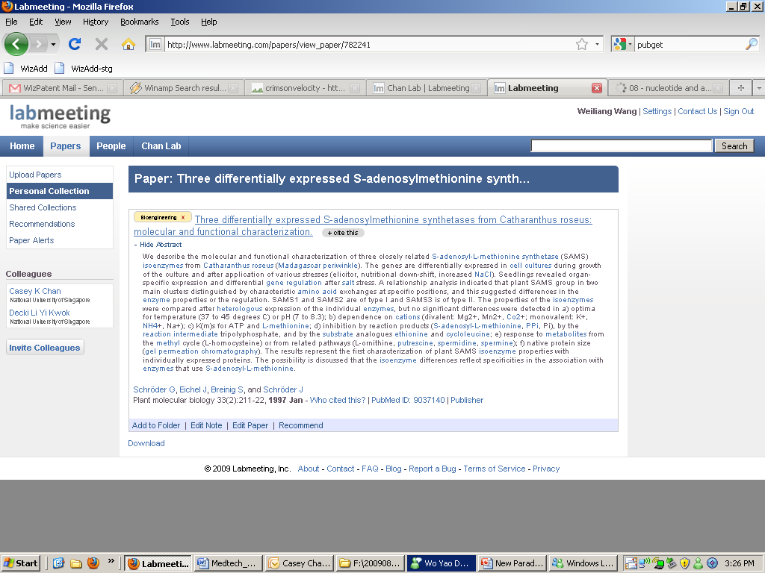
Notes:
You can save your articles online but to view each item requires you to click on individual item that is stored on different page – no ability to drag and drop between folders

Slide 26
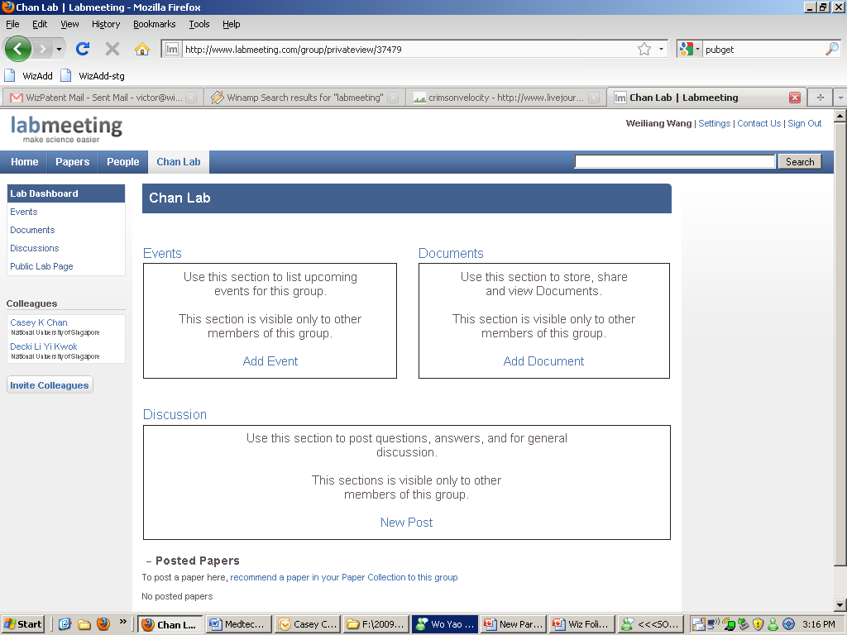
Notes:
Tagged on is additional group features like share documents and include alerts to members and post discussions. No real citation tool.

Slide 27
WizFolio Web 2.0
Online reference manager

Slide 28

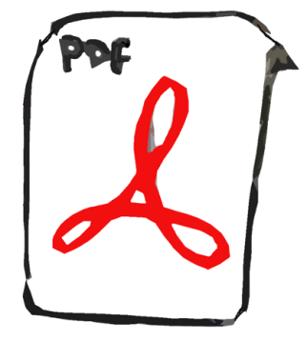
New Paradigm in Journal Reference Managment
Title: Hemorrhagic Fever
Author: KM Larrick
Journal of Biochemistry, 10(6) p111-115, 2008

Slide 29
New Paradigm in Journal Reference Managment
Title: Hemorrhagic Fever
Author: KM Larrick
Journal of Biochemistry, 10(6) p111-115, 2008

Slide 30
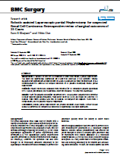

Citation
Title: Hemorrhagic Fever
Author: KM Larrick
Journal of Biochemistry, 10(6) p111-115, 2008
In vitro assays were made of the effect of a static magnetic field of a neodymium magnet on cellular behavior(1,2). The cell turnover rate was examined by the incorporation of
References
Taylor, R. Cell systems as environmental propellants. Cell 28 (2), pp 32-49.
Jonson, T. Exploratory analysis of microbial environment. Disease 78 (3).
Wilson, C. Systems theory for studying germs. Nature 68 (2), pp 78-90.
Han, W. Natural Process that take place in the bloodstream. Blood, 32 (4), pp 31-46.

Slide 31
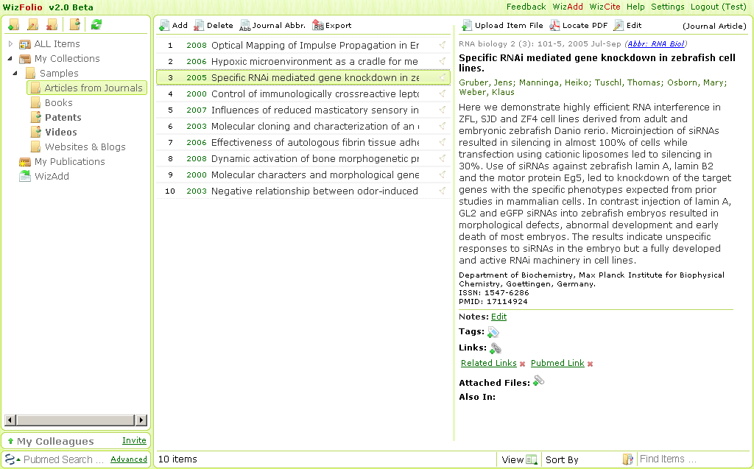
Why WizFolio?
A web-based journal reference management tool
A powerful in-text citation tool
Allows collaboration

Slide 32
Why Web Application?
Access information anywhere
Connect to other users
No installation & updates
No data loss
Offline access (coming soon)

Slide 33
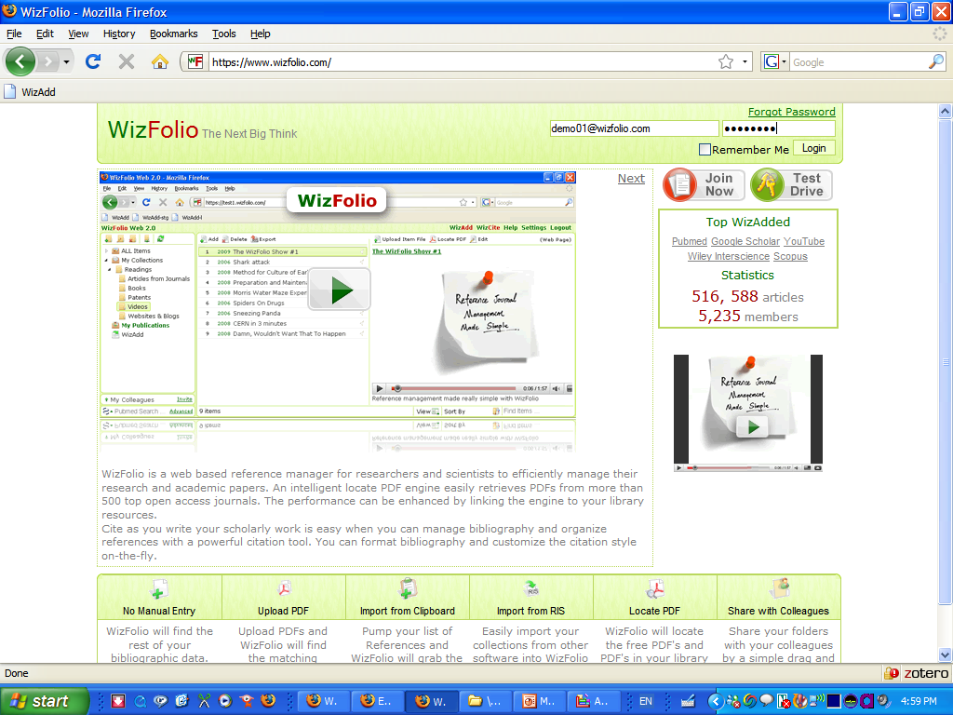

Slide 34
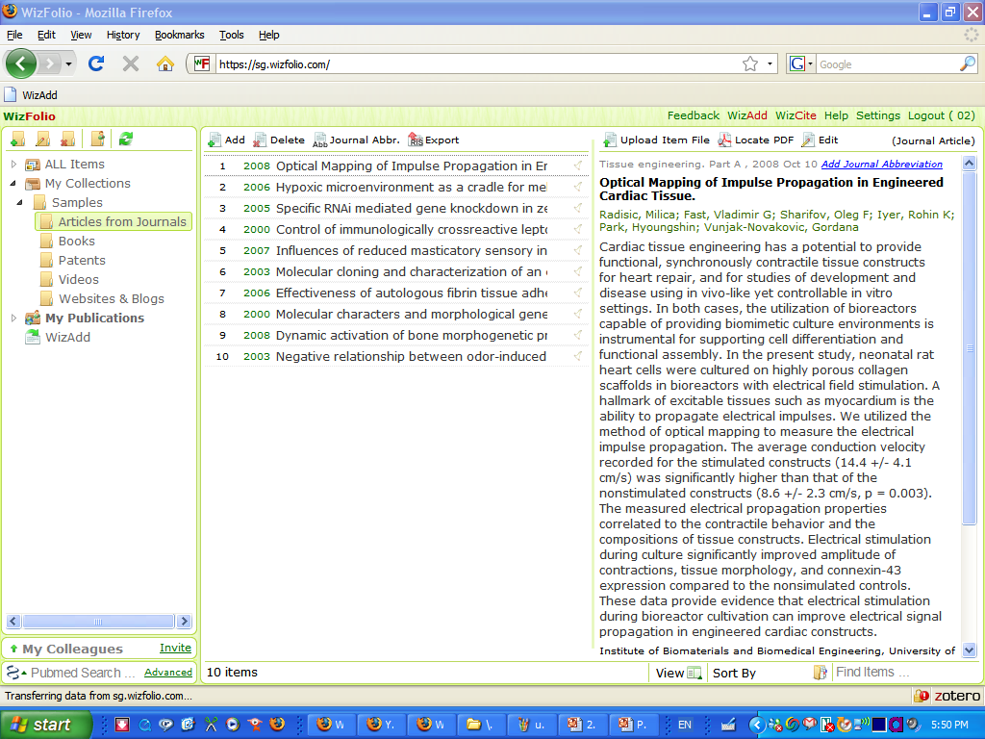

Slide 35
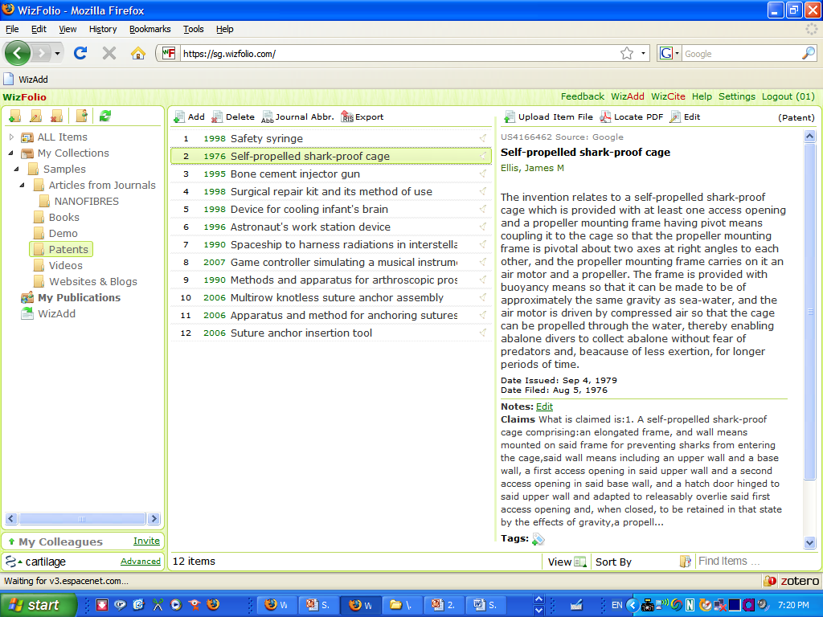
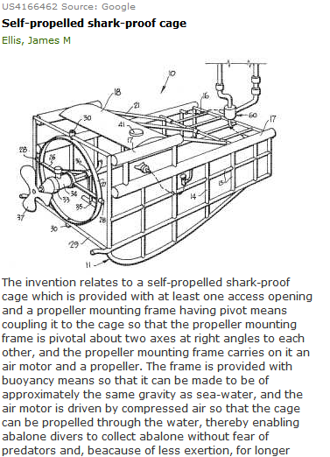
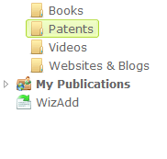

Slide 36
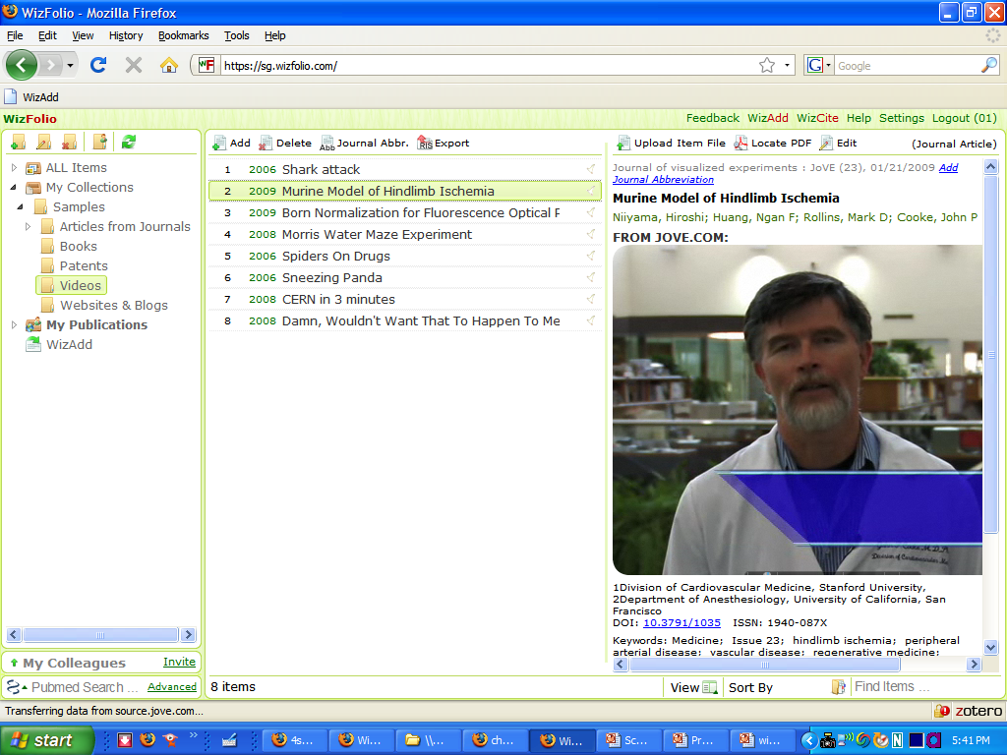

Slide 37
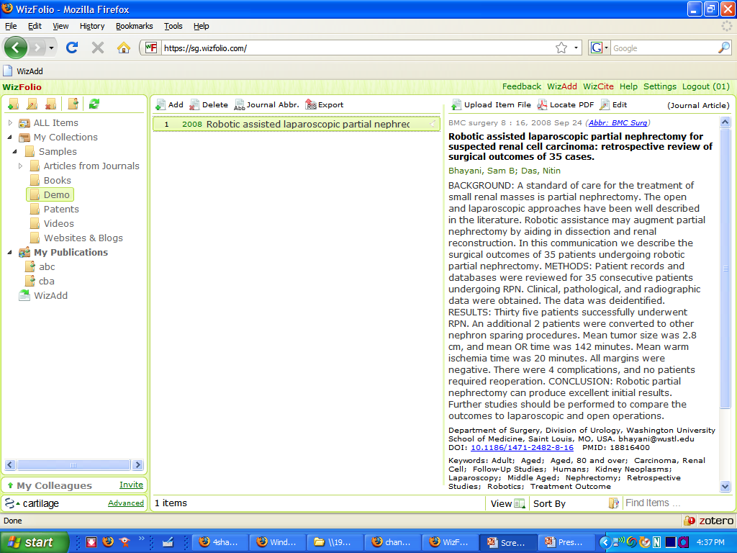

Slide 38
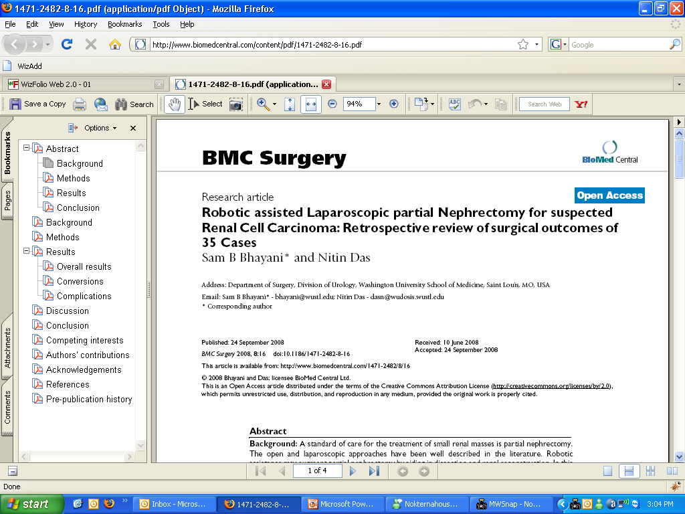

Slide 39
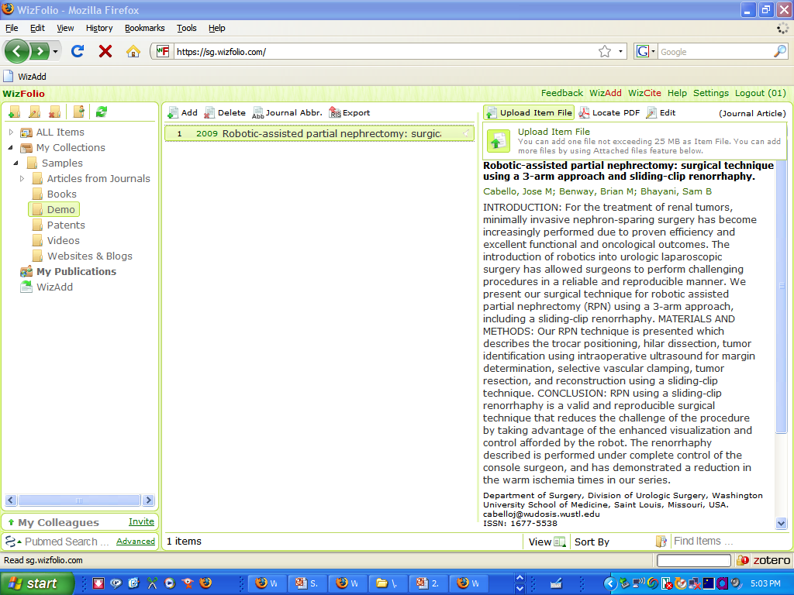

Slide 40
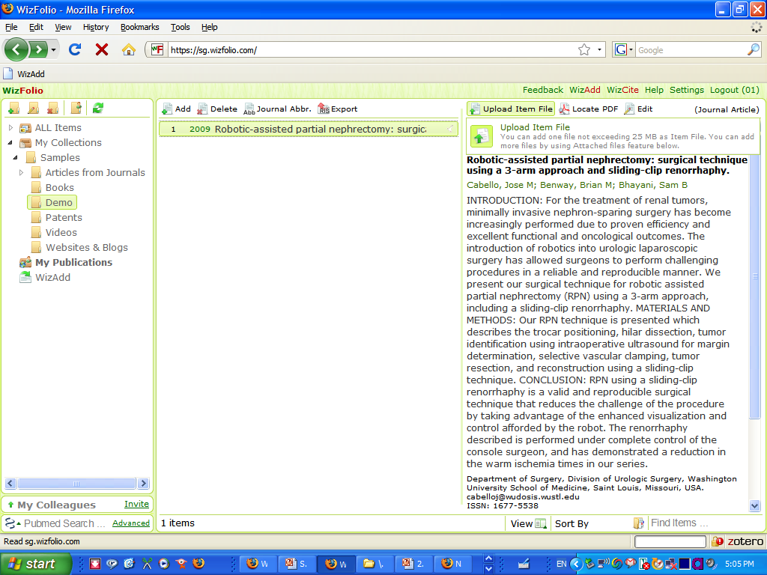

Slide 41
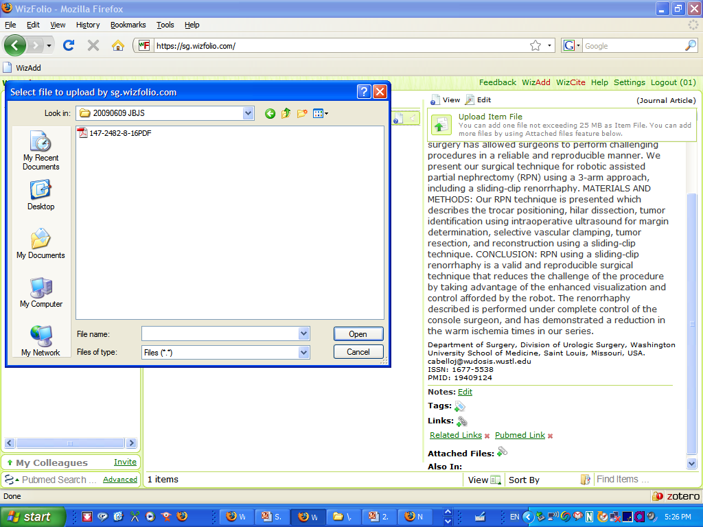

Slide 42
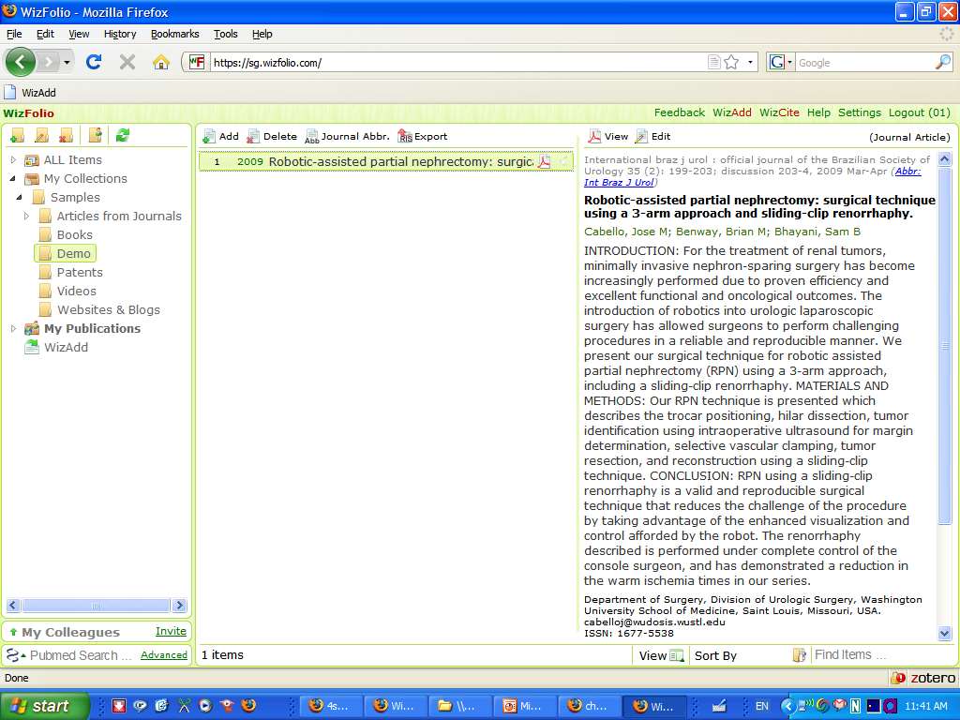

Slide 43
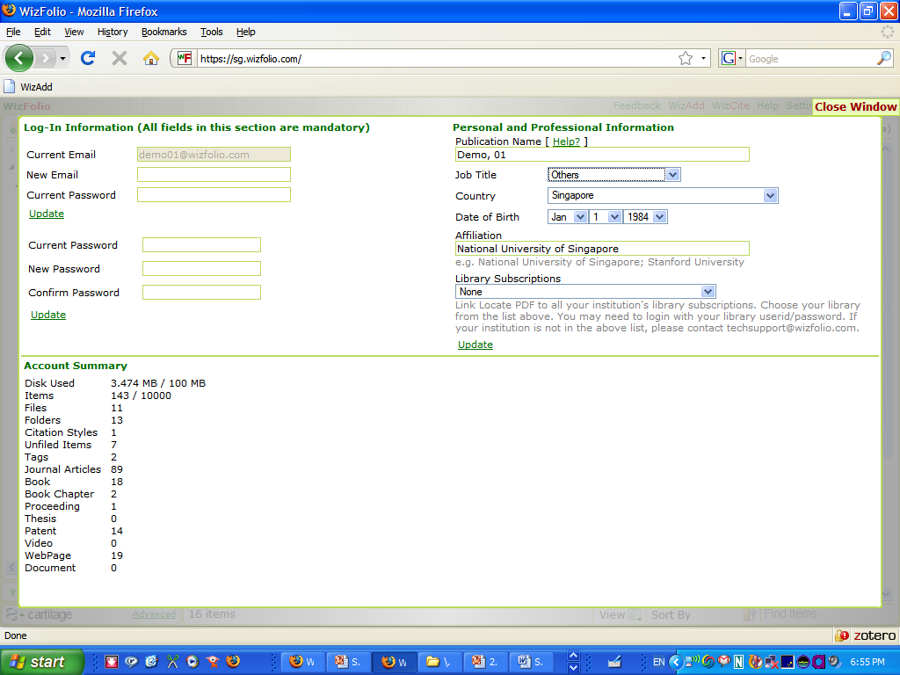

Slide 44
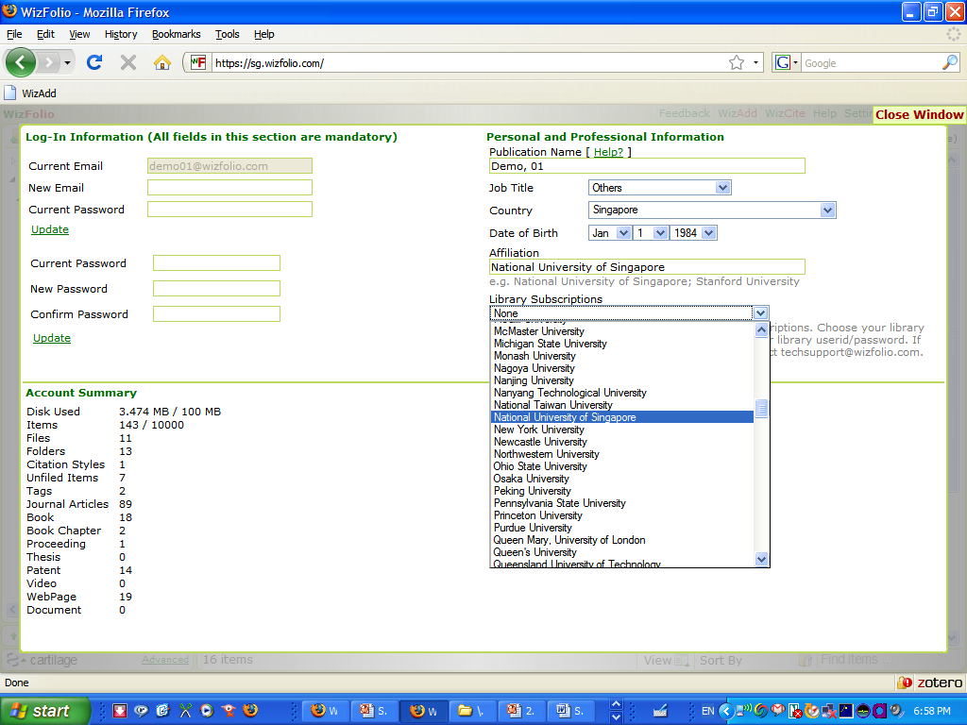

Slide 45
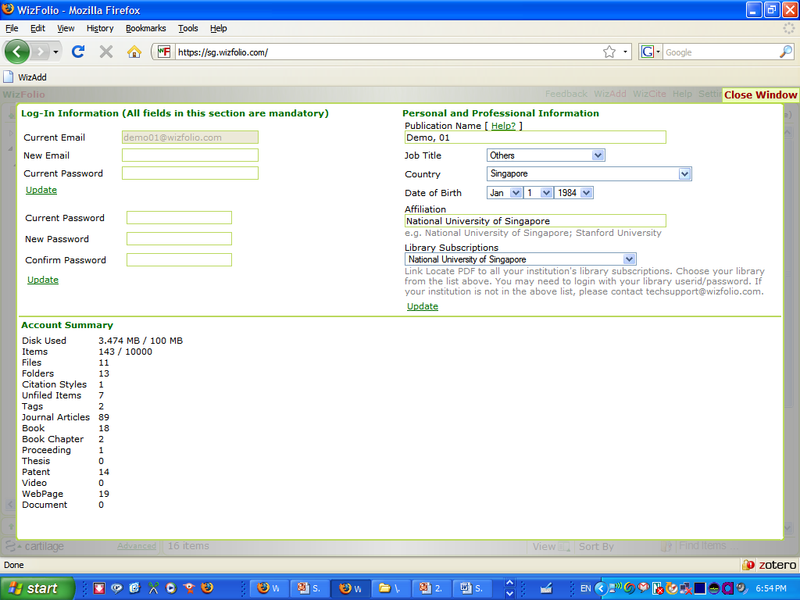

Slide 46
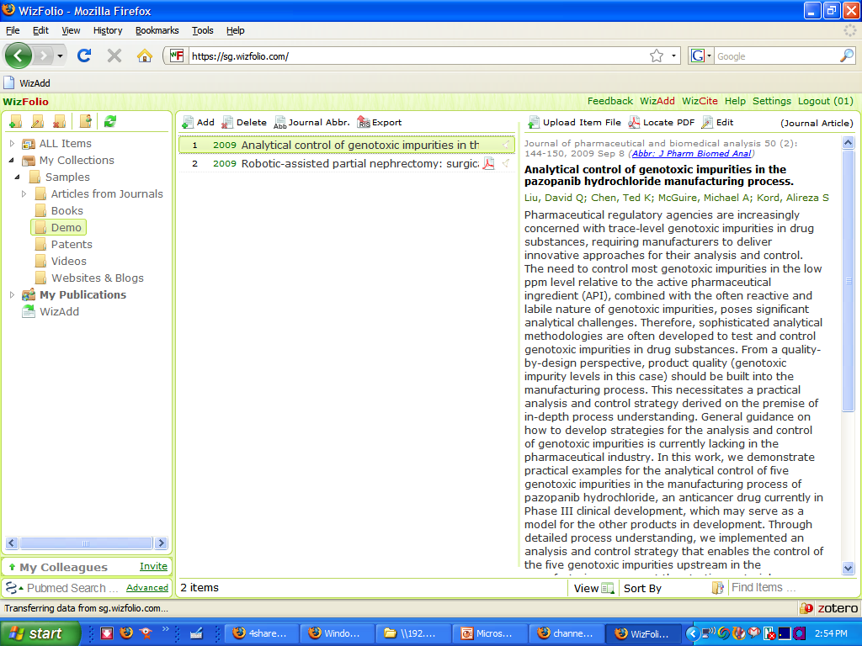

Slide 47
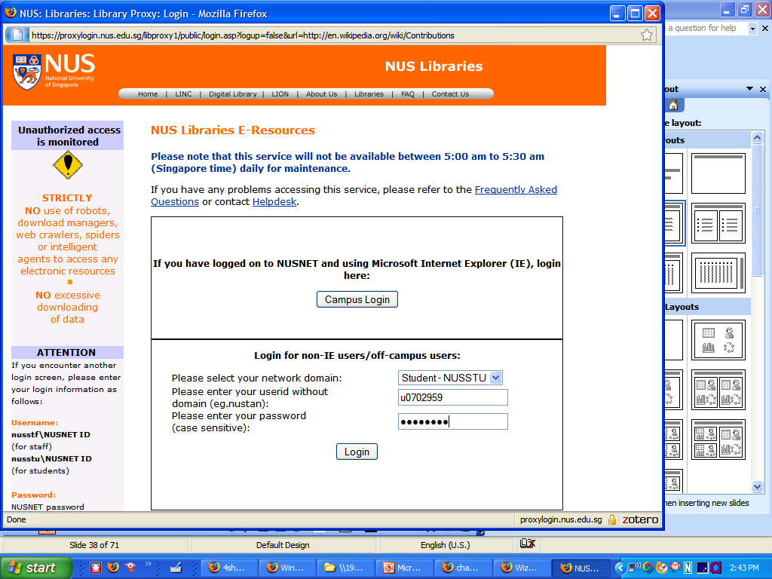

Slide 48
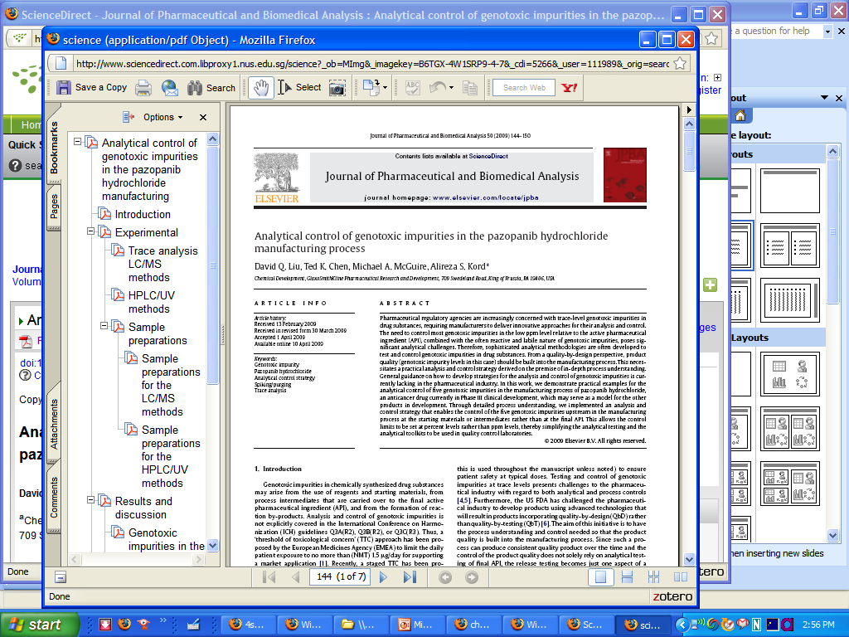

Slide 49
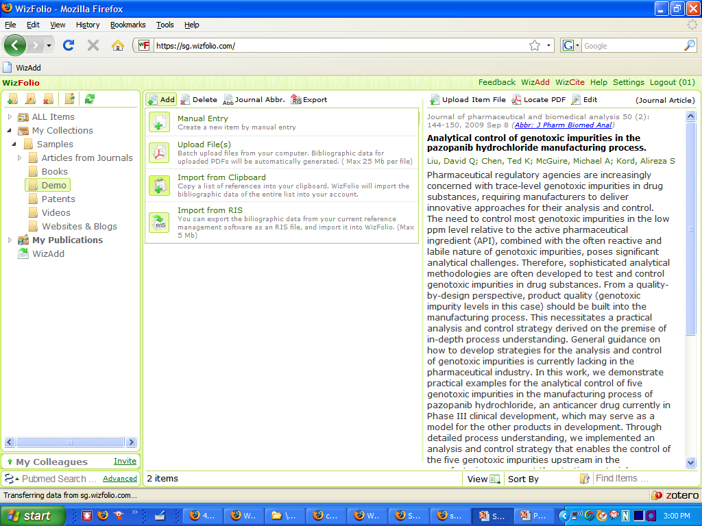

Slide 50
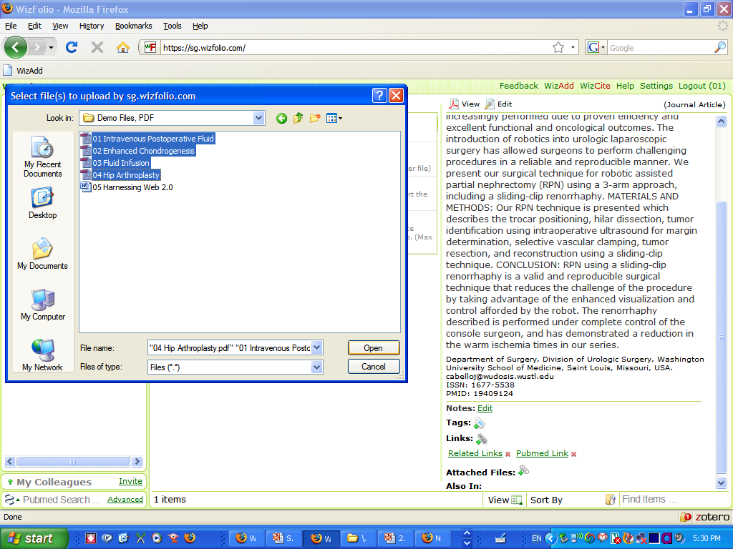

Slide 51
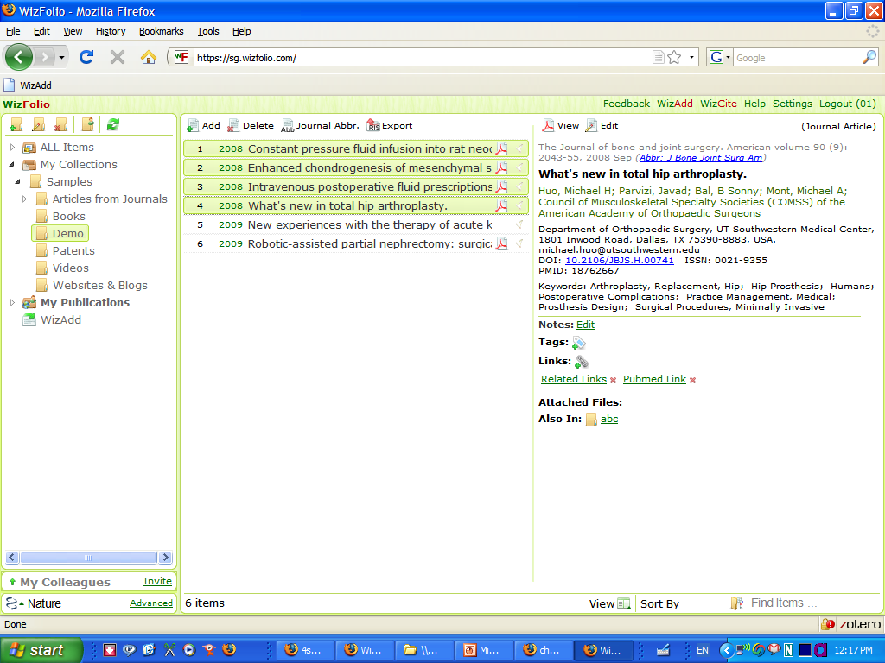

Slide 52
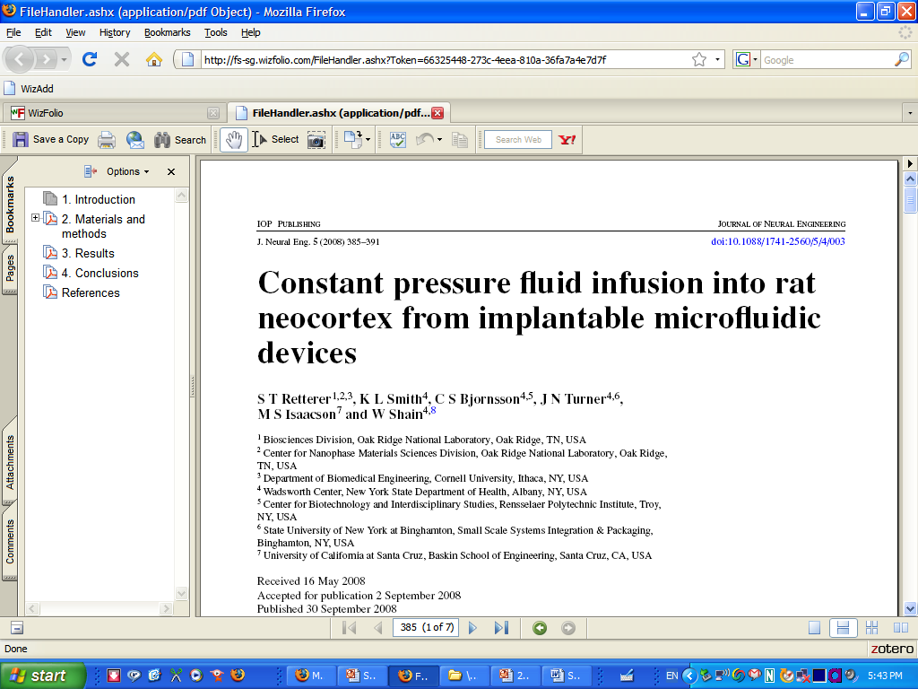

Slide 53
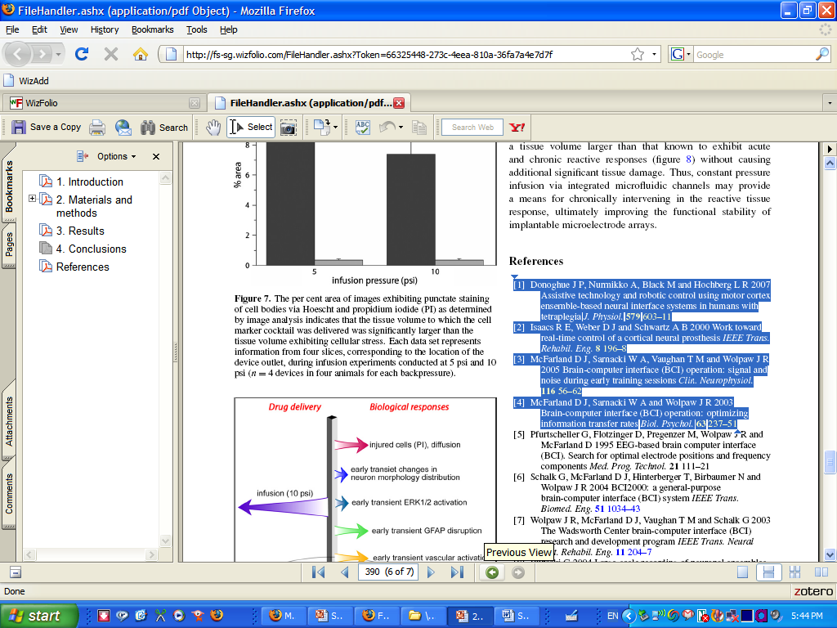
Copy to Clipboard (Ctrl+C)

Slide 54
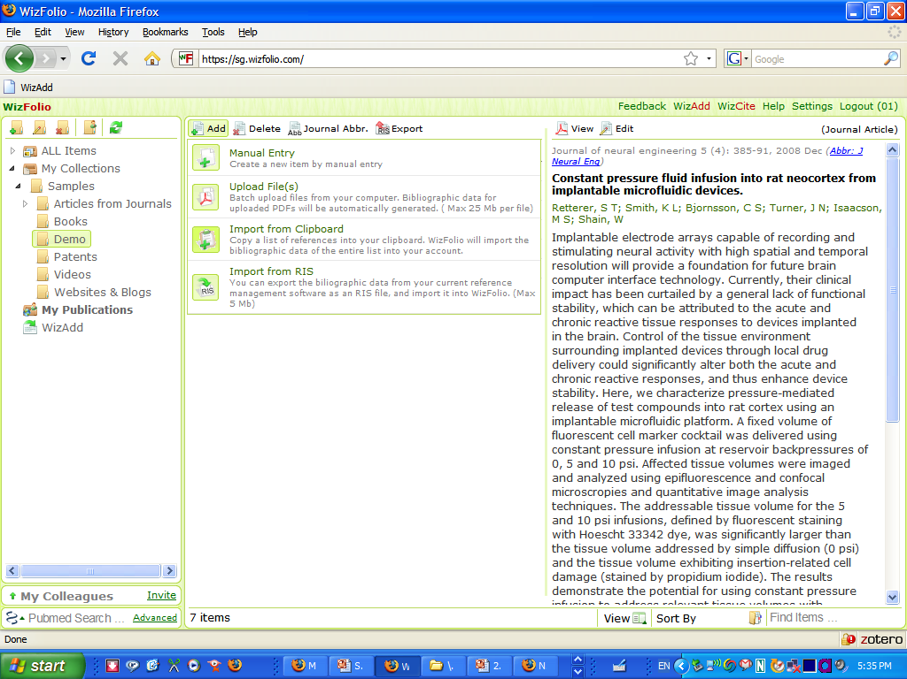

Slide 55
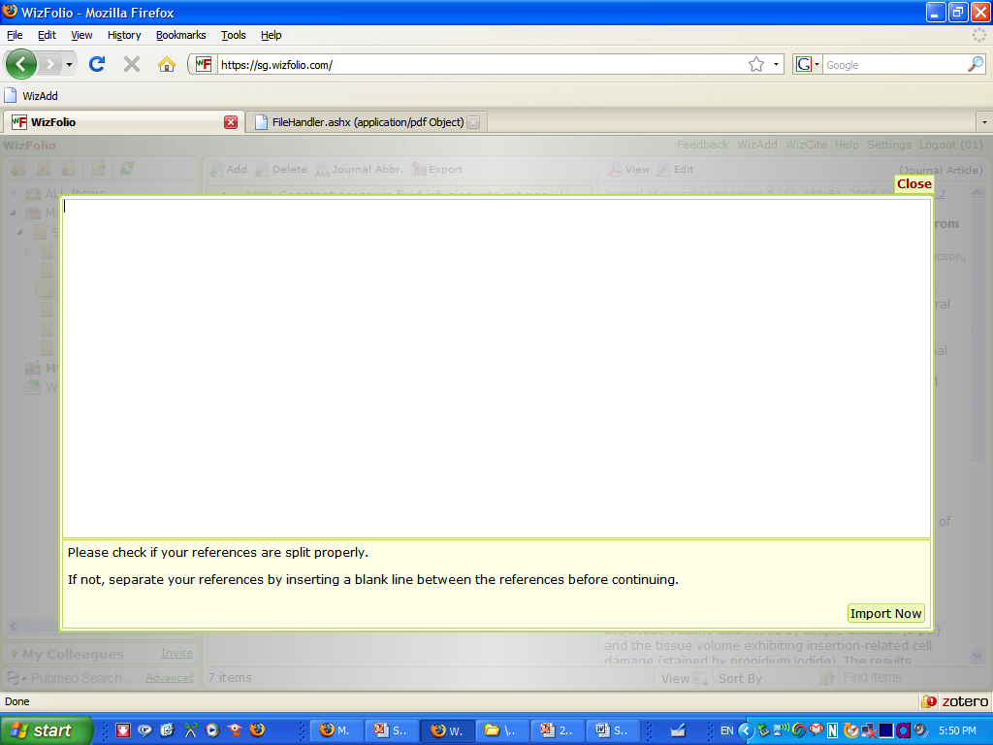
Paste to Clipboard (Ctrl+V)

Slide 56
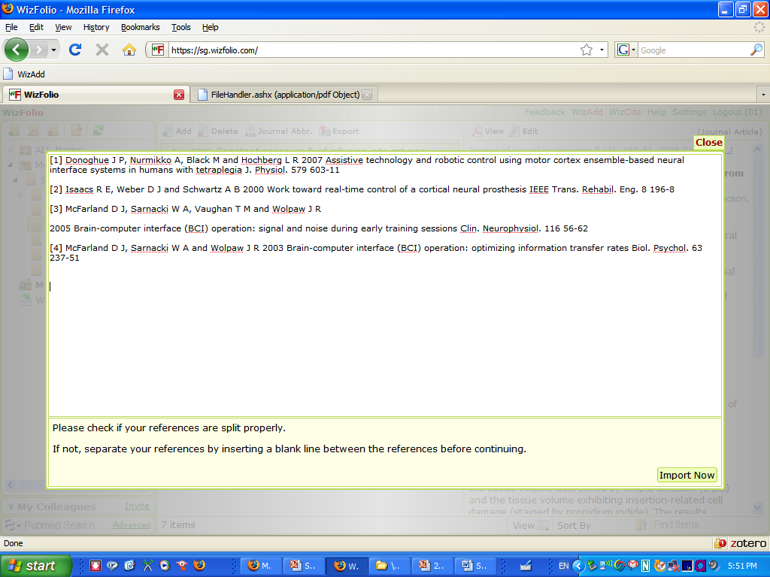

Slide 57
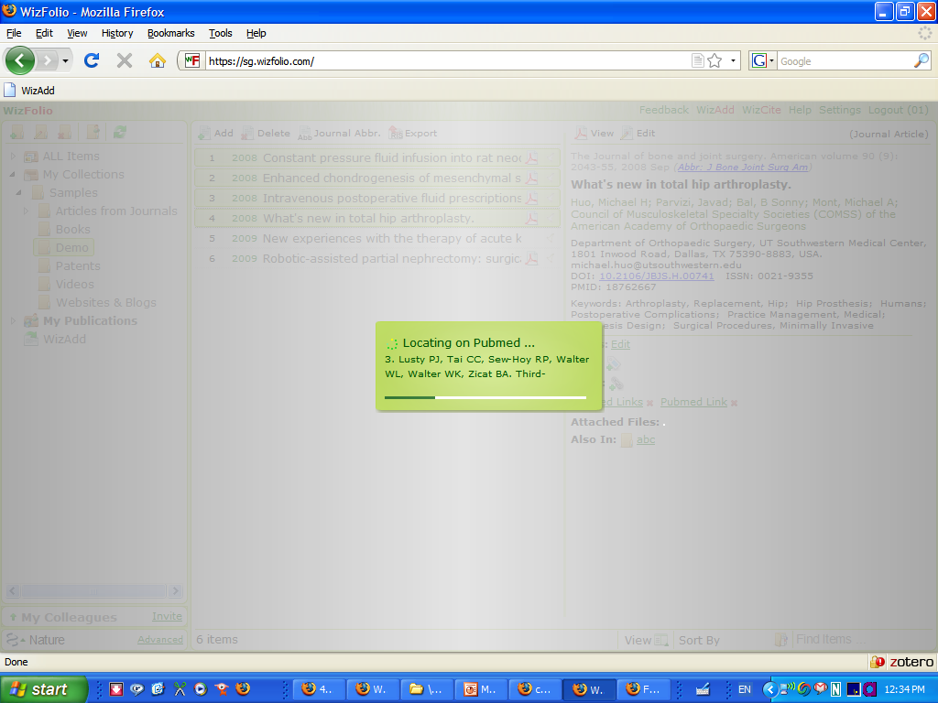

Slide 58
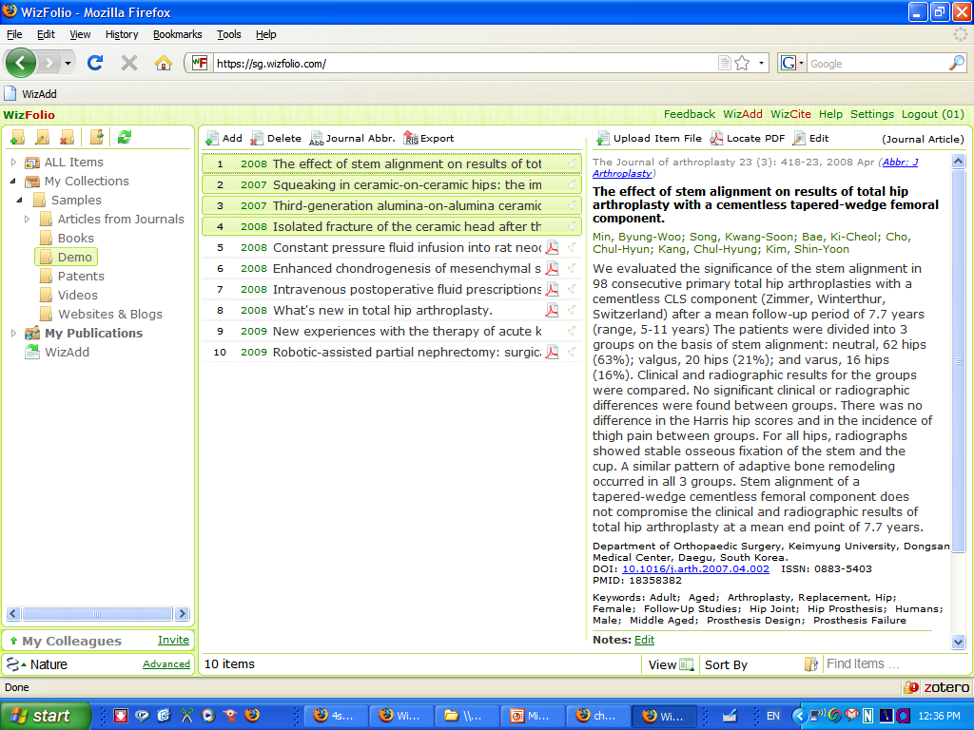

Slide 59
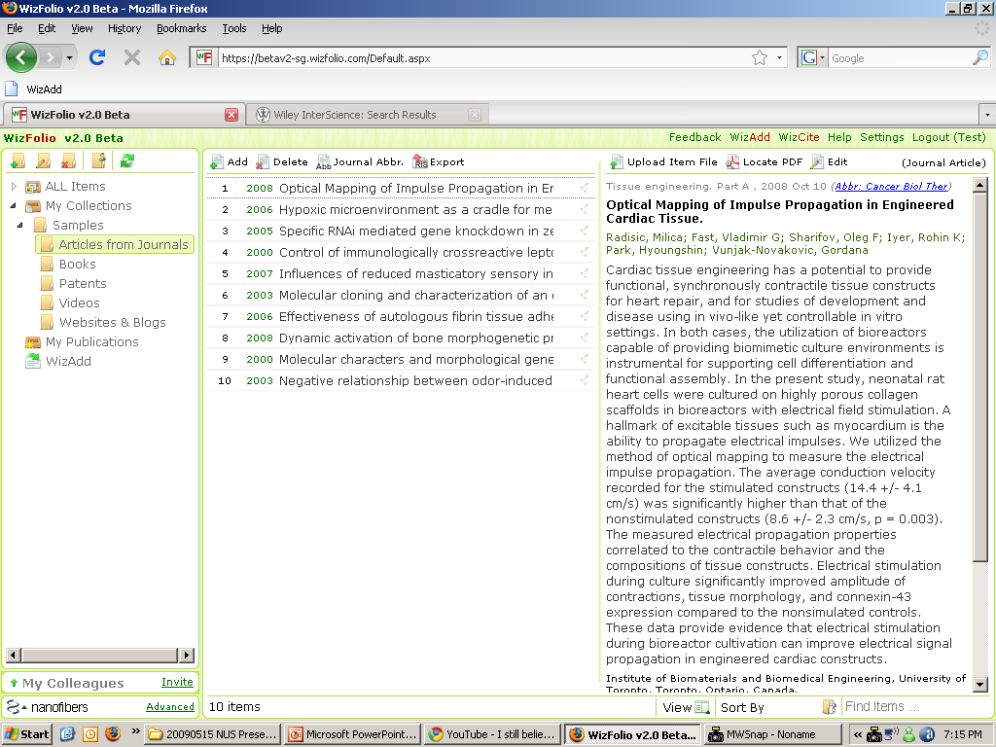

Slide 60
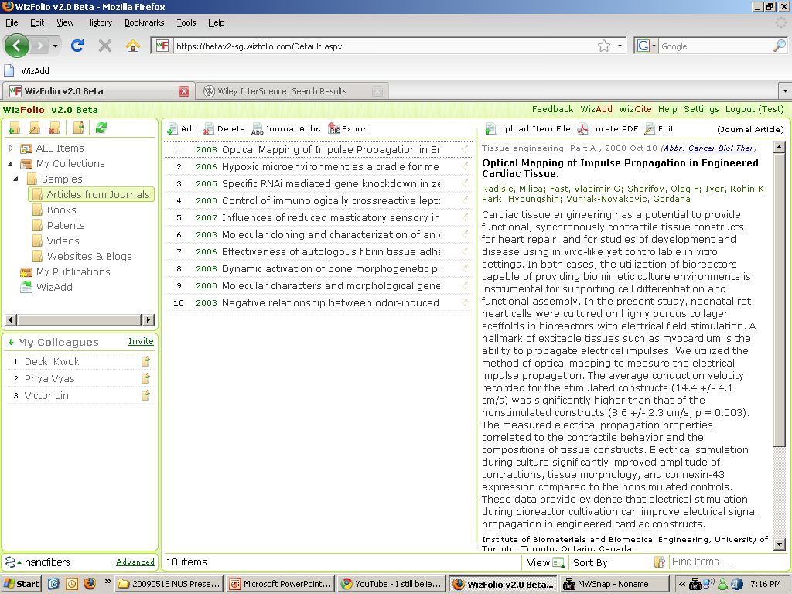

Slide 61
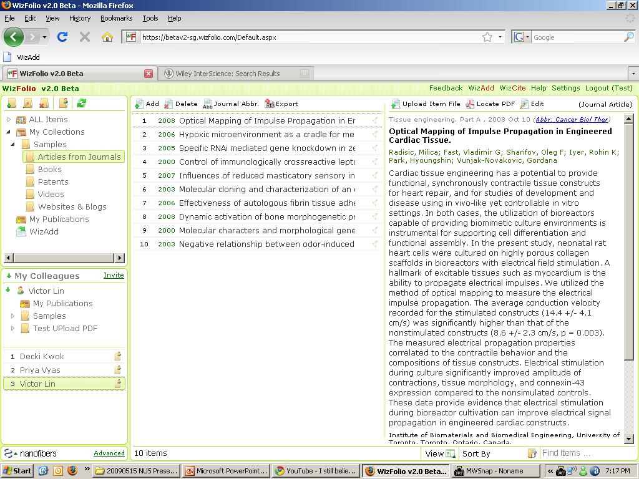

Slide 62
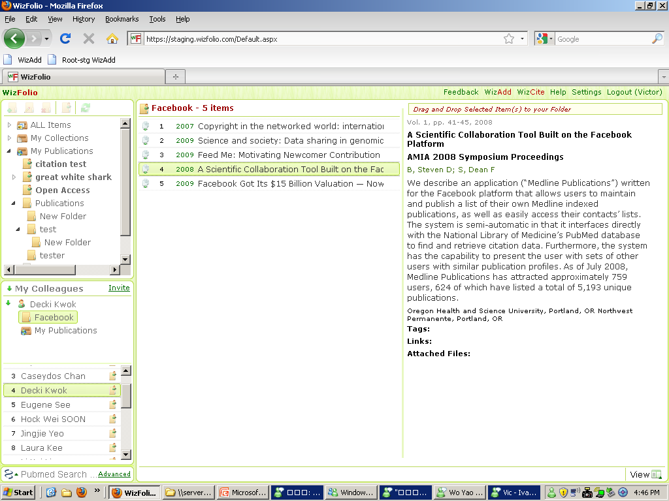

Samples
Notes:
62

Slide 63


Slide 66
Thank you
Q&A

Slide 67
Talk about SFX – a more effective system

Slide 68

Digital Object Identifier (DOI)
DOI Agency
DOI Dictionary
DOI
10.1002/20892
Link
http://nature.com/article.pdf
DOI Resolver
Publisher

Slide 69
Linking Metadata and PDF
Digital Object Identifier
Metadata
Author, Title,
Journal
10.1002/20892
From Search Results
Journal Article

Slide 70
Problem #1
DOI Agency
X
DOI Dictionary
DOI
10.1002/20892
Link
http://nature.com/article.pdf
DOI Resolver
Publisher

Slide 71
Digital Object Identifier (DOI)
Digital Object Identifier
Metadata
Author, Title,
Journal
Publisher
X
From Search Results
Distributors

Slide 72
Managing Journal Articles like MP3s
Publisher
Source of Bibliographic Data
Bibliographic data
Bibliographic data
Author: Taylor, H.
Author: Taylor, H.
Title: A review of…
Title: A review of…
Signature
Download
Bibliographic data
Sharing

Slide 73

Arthur C. Clarke:
“Any sufficiently advance technology is indistinguishable from magic.”
Magic is about illusions

Slide 74
Metadata, Bibliography and Label
Label
Product Name
Manufactured by
Ingredients
Manufacturing Date
Expiry Date
Unlabelled Can
Tomato Soup
MP3 File
Metadata provides detailed information about MP3 file
Title: Maggie Mae
Artist: Rod Stewart
Genre: Pop
Album: Gasoline Alley
Year: 1972
Studio: EMI
PDF Journal Article
Limited fields
Incomplete
Non-descriptive
Filename: 876gdty.pdf
Author:
Title:
Notes:
when without label, people will write the minimum amount of information on it
Pdf is not labeled, small space to label which doesn’t include all metadata
Not all publishers include full metadata
We want an automatic process of labelling

Slide 75
Knowledge Management
METADATA Database
References
PUBLISHER Database
Full Text
Pubmed, Scopus,
Google Scholar
Nature, Science, Biomed Central
Metadata
Author, Title,
Journal
Researcher
Reference
Manager
Notes:
Usually when researchers seek for information, they look for relevant references in a consolidated database such as Pubmed, Scopus, Google Scholar. After downloading the references to a reference manager, researchers go to publishers’ website and look for full text articles. Then the PDF and bibliographic data are stored together in a reference manager for future retrieval.
Now, for open access publications, researchers do not need to go through the process of grabbing PDF manually. Let me demo the reference management tool that I have developed which automates the entire process.
(Show WizAdd grabbing references from Pubmed)
(Show Locate PDF for references grabbed)

Slide 76


Pain #1: Collecting Bibliographic Data
1. Search in Pubmed
2. Go to Publisher’s Page
Search
Dengue
3. Download PDF
4. Return to Pubmed

Slide 77

Reference Journal Management
Made Simple
WizFolio
Presents
The WizFolio Show

Slide 78
Publications
Year
Notes:
The number of publications indexed by Medline has grown steadily over the years.
The growth has been exponential in the last 10 years and as of today, there are 18 million articles indexed by Medline.
As a result it is becoming increasingly difficult to manage bibliographies.

Slide 79



Title: Hemorrhagic Fever
Author: KM Larrick
Journal of Biochemistry, 10(6) p111-115, 2008
Notes:
Everytime u need to look up a research article, you search for it on the internet such as the Pubmed database. You then download the PDF file from the publisher. Everytime you do this, you have wasted valuable time which you could have spent doing your research. This is the old way!

Slide 80
Old Way
New Way
Title: Hemorrhagic Fever
Author: KM Larrick
Journal of Biochemistry, 10(6) p111-115, 2008
Title: Hemorrhagic Fever
Author: KM Larrick
Journal of Biochemistry, 10(6) p111-115, 2008
Notes:
So the old way treats bibliographic data and the PDFs as separate entities. The new way integrates these two entities as a single object.

Slide 81




Title: Hemorrhagic Fever
Author: KM Larrick
Journal of Biochemistry,
10(6) p111-115, 2008
Title: Stem Cells
Author: LO Hay
Journal of Biochemistry,
10(8) p111-115, 2001
Title: NanoFibers
Author: MA Ngiam
Langmuir,
1 (2) p123-125, 2002
1.
2.
cancer
nano
3.
tag
Title: Stem Cells Uses
Author: TT Phan
Biomaterials,
3(8) p11-15, 2005
Title: Hemorrhagic Fever
Author: KM Larrick
Journal of Biochemistry,
10(6) p111-115, 2008
Title: Using Stem Cells
Author: HE Merlin
Tissue Engineering,
1 (1) p111-115, 2003
4. Title = “Stem Cells”
Title: Hemorrhagic Fever
Author: KM Larrick
Journal of Biochemistry,
10(6) p111-115, 2008
Title: Hemorrhagic Fever
Author: KM Larrick
Journal of Biochemistry,
10(6) p111-115, 2008
Title: Effect of Stem Cells
Author: WD Lin
Journal of Biochemistry,
7(2) p1-5, 2007
cancer

Slide 82

Notes:
There are two ways to get started!

Slide 83
Notes:
First, you need to register an account at www.wizfolio.com. Once your email is confirmed, you are good to go!

Slide 84

www.WizFolio.com
Notes:
Once your email is confirmed, you are good to go!

Slide 85
Notes:
Two,

Slide 86

WizFolio
Quick Start

Slide 87
Reference Journal Management
Made Simple
The WizFolio Show

