Slide 1
The oligonucleotide frequency derived error gradient and its application to the binning of metagenome fragments
Isaam Saeed & Saman K Halgamuge
MERIT, Biomedical Engineering
Melbourne School of Engineering

Slide 2
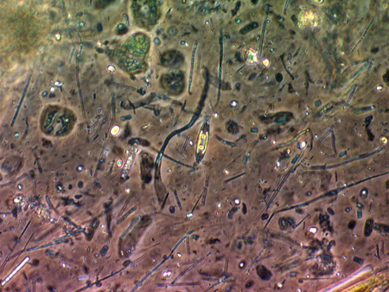
Outline
What is metagenomics?
Introducing OFDEG
Application to metagenomics
Benchmarking results
Concluding remarks

Slide 3



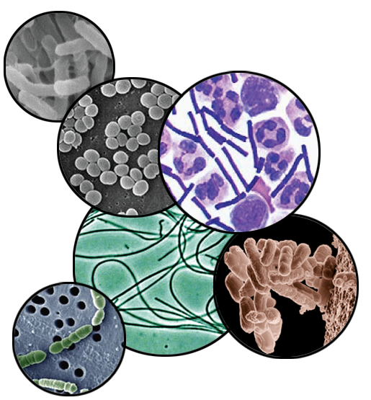
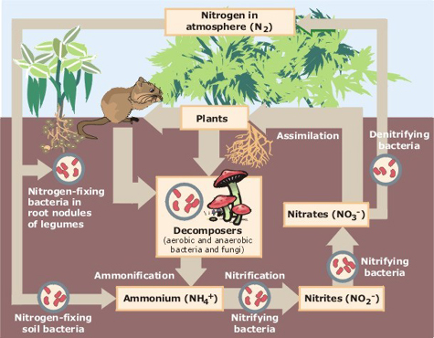
Metagenomics: a brief introduction
Environmental niches
Microorganisms working together as a community
Example:
Nitrogen fixation in soil
Notes:
Metagenomics is relatively recent...
Dealing primarily with...
These microorganims work together and interact...that are NECCESSARY
As an example consider soil.
Now it may seem MUNDANE but it is one of the MOST COMPLEX .
What makes this SO CALLED interesting is that they exist in harsh and extreme environments, such as
In harnessing the knowledge of how these EXIST and FUNCTIONS, we can expand our knowledge BIOSPHERE, BIOTECH
Before we can perform detailed analysis such as reconstructing metabolic pathways or investigating their biogeochemistry, we need to ask two fundamental questions

Slide 4
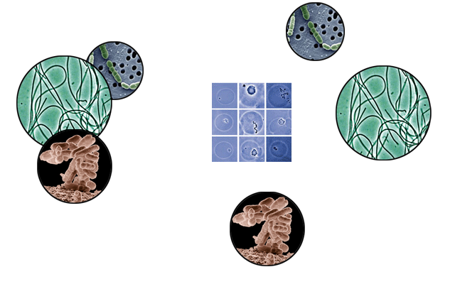
Metagenomics: a brief introduction (cont’d)
Isolate each constituent organism
in pure culture
clone → sequence → analyse
clone → sequence → analyse
clone → sequence → analyse
!
Modified and adapted from:
Keller, M. & Zengler, K.: Tapping into microbial diversity. Nature Reviews Microbiology: 2, 141-150 (February 2004)
BUT, we only know about laboratory culturing methods for ~1% of extant microbiota
Notes:
Early attempts at ANALYSING ... RELIED

Slide 5
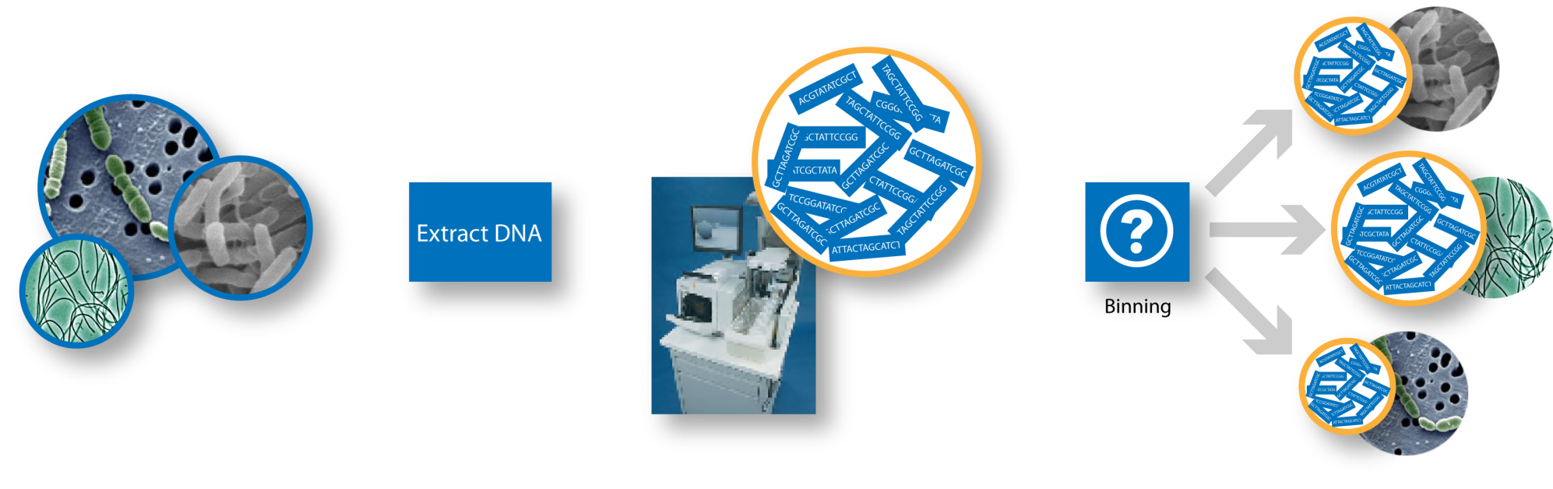
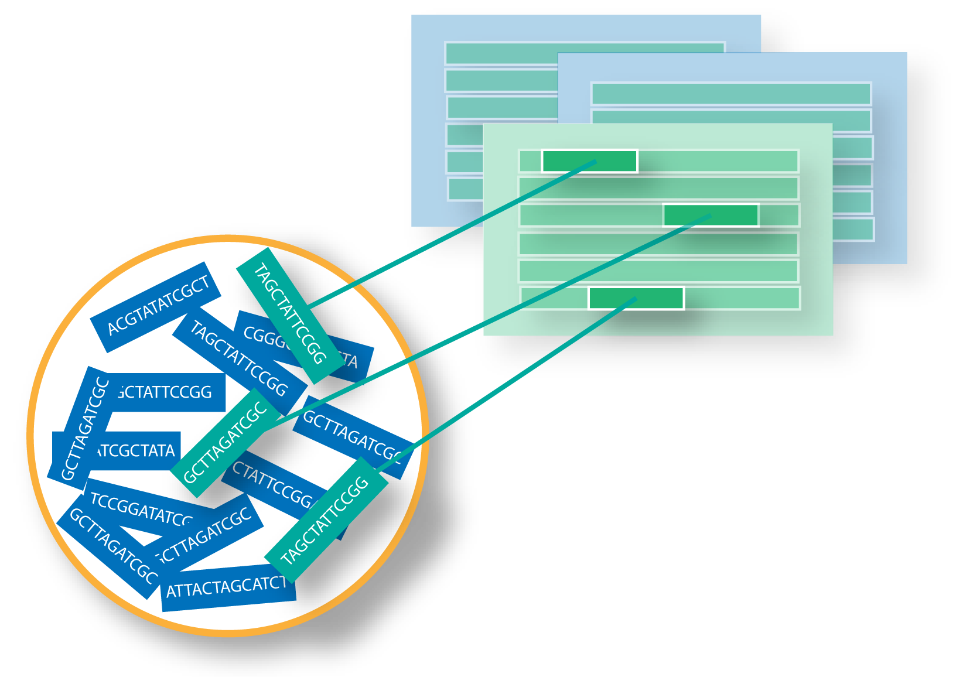
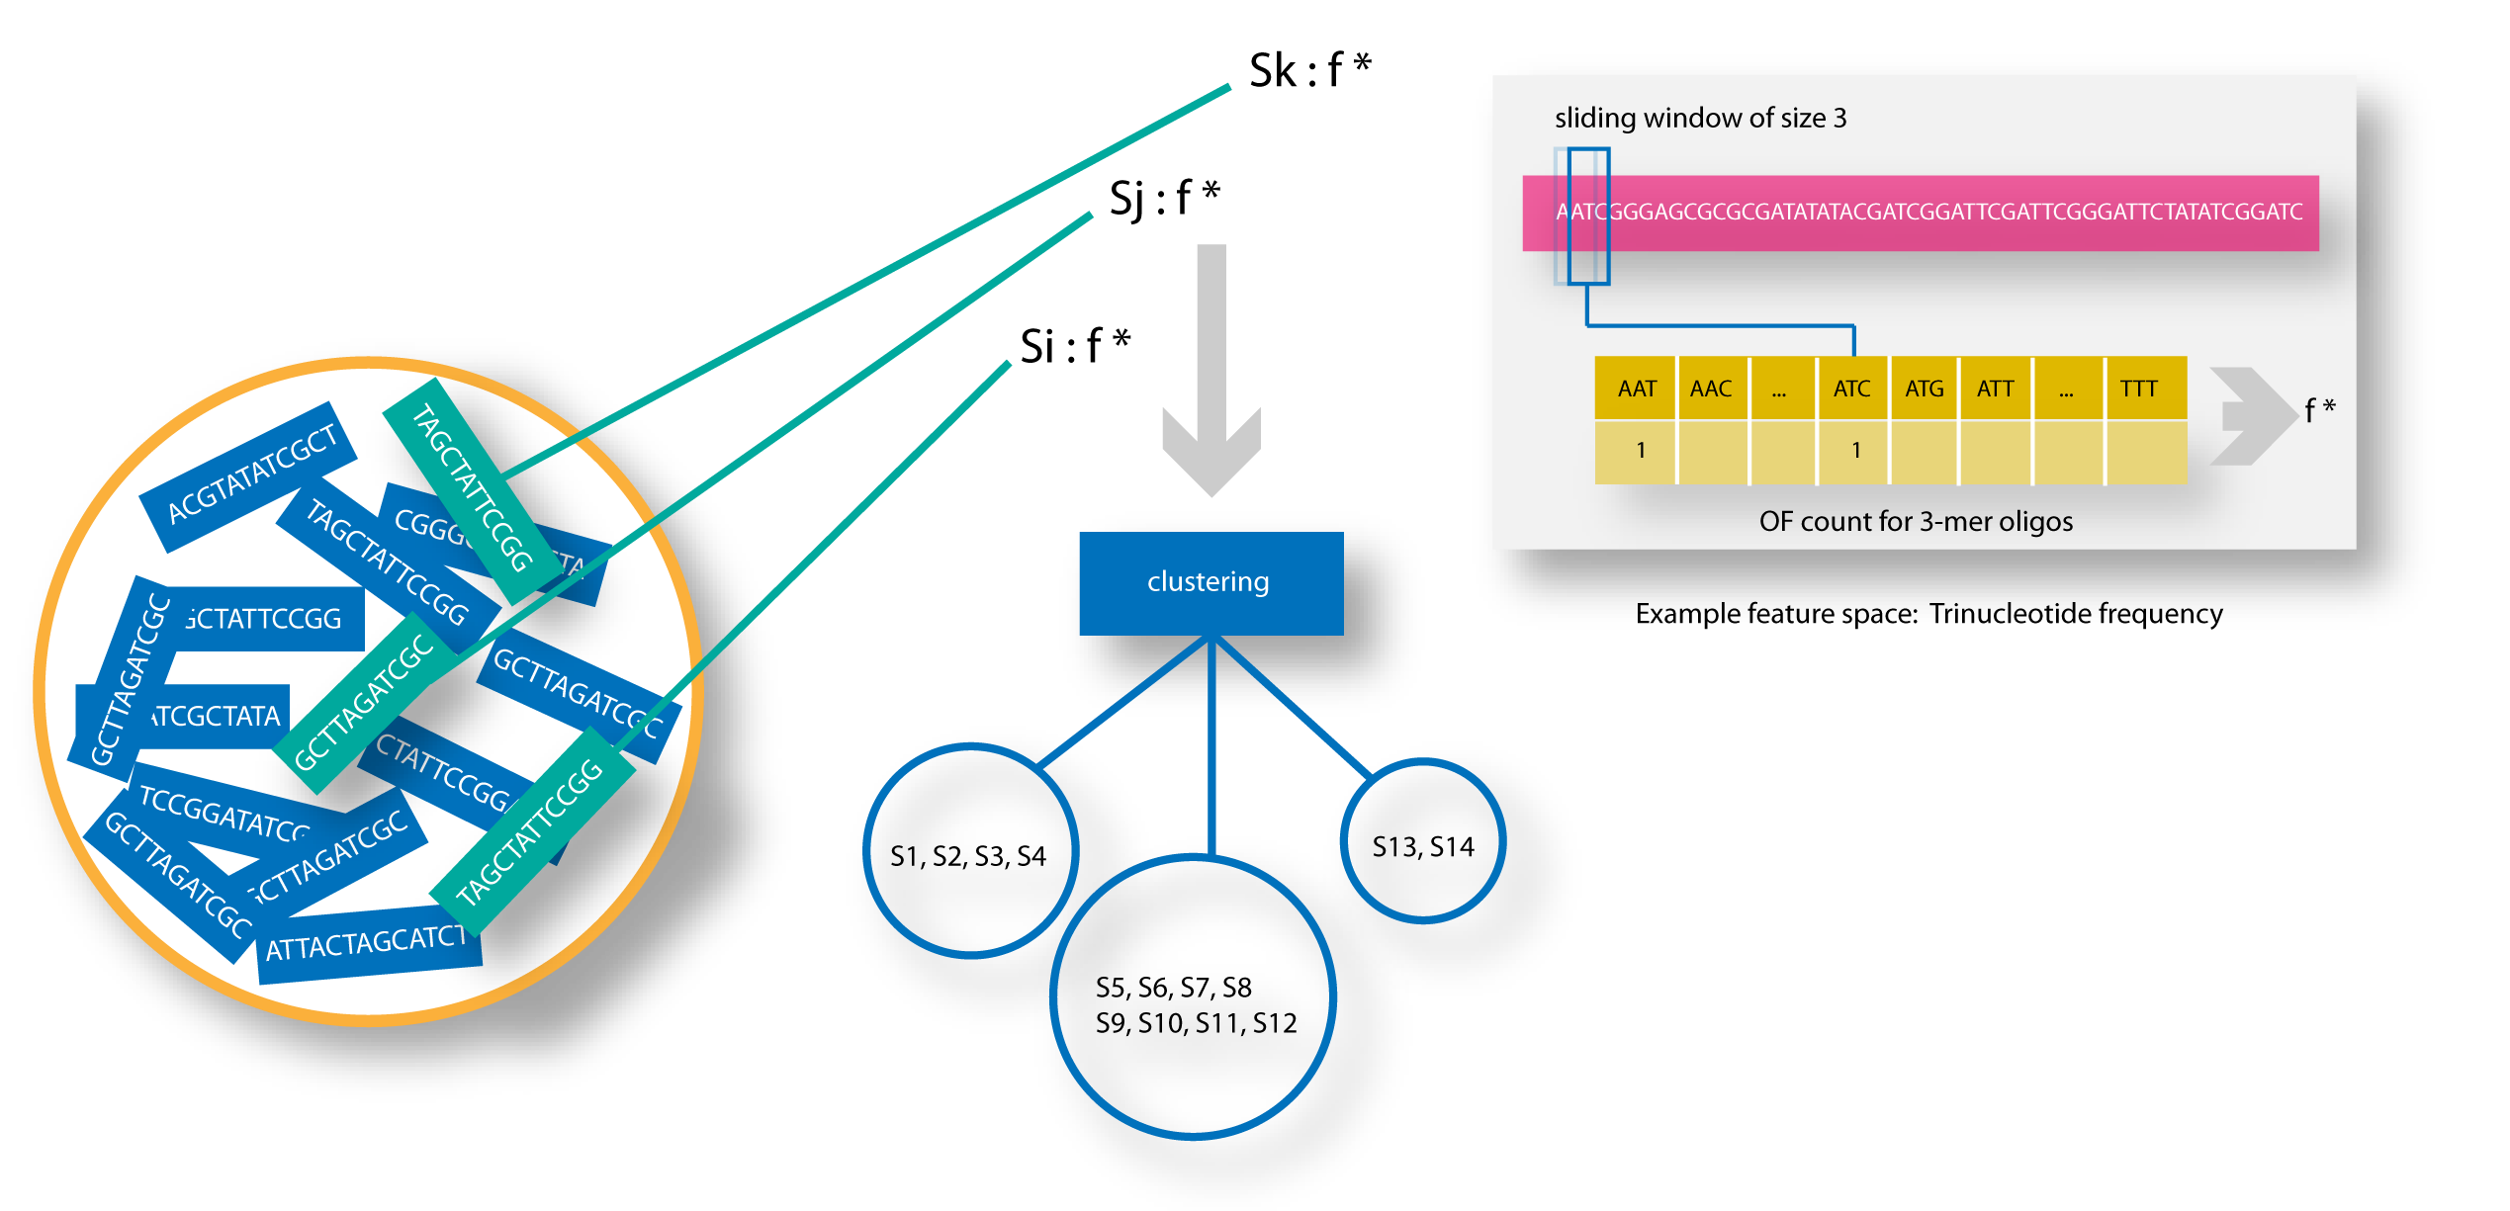
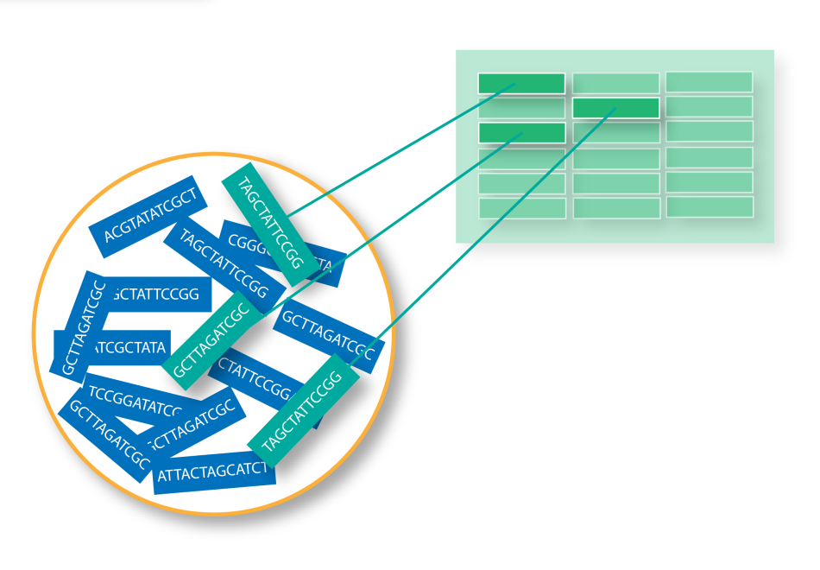
Novel microbes and the binning problem
Metagenomics approach
Binning
Conserved marker genes
* high accuracy
* low coverage
Sequence similarity
* very short sequences
* computationally intensive
* biased
Sequence composition
* unbiased (?)
* long sequence length
Notes:
How do we handle novel microbes that resits lab CULTIVATION?
So now we arrive at the metagenomics approach
SO we have our environmental sample or microoragisms
Once we have extracted CONTAINED, we BLINDLY
The question then becomes

Slide 6
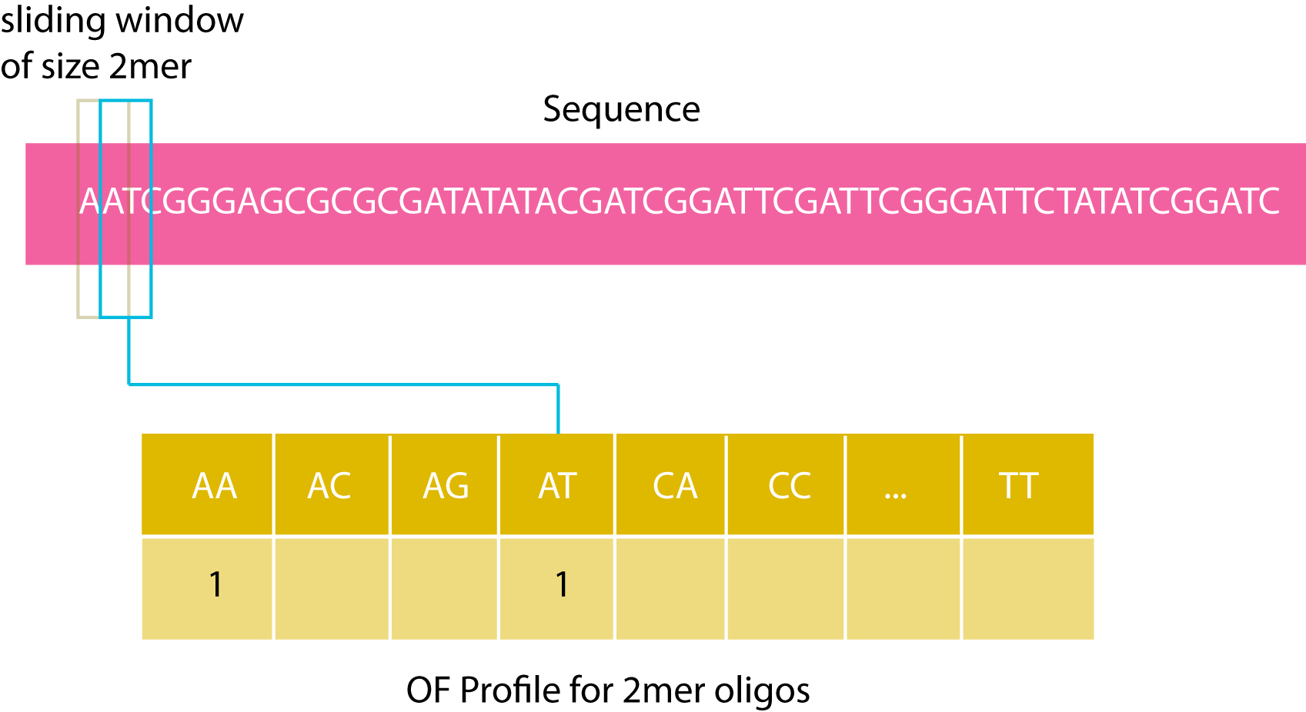
Sequence composition: oligonucleotide frequency (OF)
Pride D, Meinersmann R, Wassenaar T.: Evolutionary Implications of Microbial Genome
Tetranucleotide Frequency Biases. Genome Research 2003, 13:145-158.
Teeling H, Meyerdierks A, Bauer M, Amann R, Glockner FO: Application of tetranucleotide frequencies
for the assignment of genomic fragments. Environmental Microbiology 2004, 6(9):938-47

Slide 7
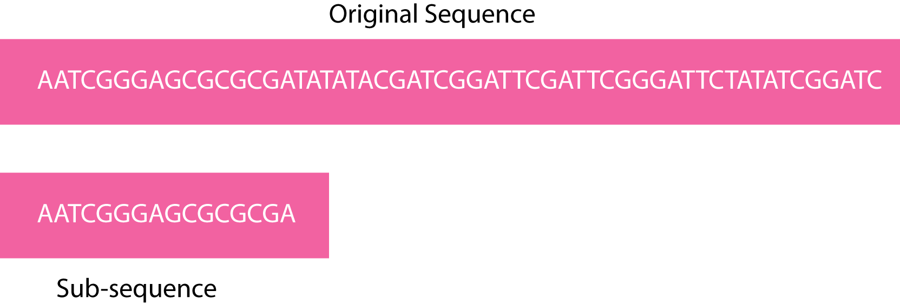
The oligonulceotide frequency derived error gradient (OFDEG)
Sample, i, of length l
Linear regression
OFDEG
compute OF profiles
l = l + step.size
No
Yes
samples ≥ N

Slide 8
OFDEG in relation to microbial phylogeny
Family: Xanthomonadaceae
Class: Gammaproteobacteria
Family: Enterobacteriaceae

Slide 9
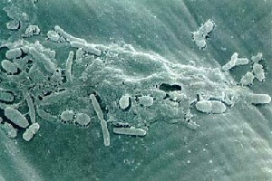
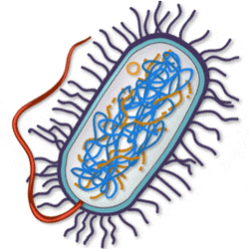
Benchmarking procedure: metagenomic data
simLC: biophosphorus removing sludge
  Dominant species:
    Rhodopseudomonas palustris HaA2 strain
    Coverage: 5.19x
simMC: acid mine drainage biofilm
  Dominant species:
    Xylella fastidiosa Dixon
    Rhodopseudomonas palustris BisB5
    Bradyrhizobium sp. BTAi1
    Coverage: 3.48 to 2.77x
simHC: agricultural soil
  Dominant Species:
    none
Mavromatis K, Ivanova N, Barry K, Shapiro H, Goltsman E, McHardy AC, Rigoutsos I, et. al.: Use of
simulated data sets to evaluate the delity of metagenomic processing methods. Nature Methods
2007, 4(6):495-500.

Slide 10
Benchmarking procedure: assemblers
simMC
contigs ≥ 8,000 bp
Phrap
8000 bp*
Arachne
8000 bp*
major contigs
Phrap
230 bp*
Arachne
1334 bp*
* Cutoff length

Slide 11
Benchmarking procedure: algorithms
simMC
contigs ≥ 8,000 bp
Phrap
8000 bp
Arachne
8000 bp
major contigs
Phrap
230 bp
Arachne
1334 bp
U*
SS*
U*
SS*
U*
SS*
U*
SS*
For:
  - Tetranucleotide Frequency (TF)
  - OFDEG
  - OFDEG + GC Content
* U – unsupervised
SS – semi-supervised

Slide 12
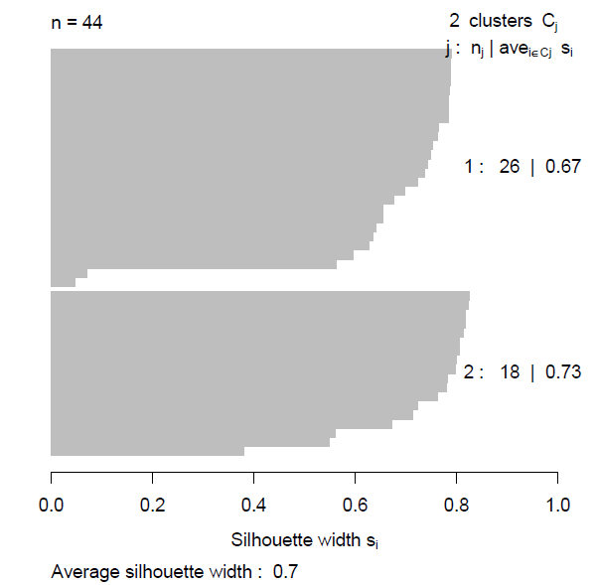
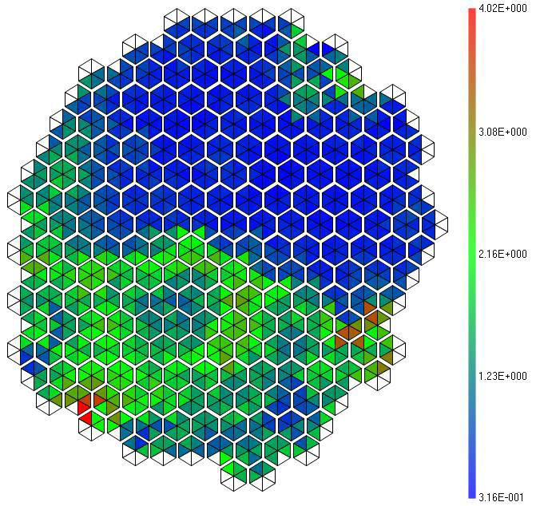
Benchmarking procedure: algorithms
Unsupervised:
  i.e. Partitioning about Mediods (PAM)
  Silhouette width governs optimal class selection
Semi-supervised:
  SGSOM¹
    Based on Self-organising Maps
    Cluster-then-label strategy
  Labels (“seeds”):
    Upstream/downstream flanking sequences of 16S rRNA gene, subject to selection criteria
  CP set at 55% and 75% as per recommendations
¹Chan CKK, Hsu A, Halgamuge SK, Tang SL: Binning sequences using very sparse labels within a metagenome. BMC Bioinformatics 2008, 9(215)

Slide 13
Benchmarking procedure: accuracy
Taxonomy definition: NCBI
All results taken at the rank of Order
Standard definitions of
  Sensitivity: TP / (TP + FN)
  Specificity: TN / (TN + FP)
Bins containing predominantly one organism considered reference bin, i.e. TP’s.
SS accuracy measured based on assigned label vs actual label.
Domain: Bacteria
Phylum: Proteobacteria
Class: Gammaproteobacteria
Order: Xanthomonadales
Family: Xanthomonadaceae
Genus: Xylella
Species: Xylella fastidiosa
Strain: Xylella fastidiosa Dixon

Slide 14
Results: overall comparison
Feature | Algorithm Type* | Assigns. (%) | Spec. | Sens. | Disc. Ability
TF | U | 97.33 | 0.9905 | 0.6565 | 0.8235
OFDEG | U | 97.32 | 0.9100 | 0.8300 | 0.8700
TF (CP=55%) | SS | 69.28 | 1.0000 | 0.7450 | 0.8725
OFDEG+GC (CP=75%) | SS | 77.75 | 0.8000 | 0.9625 | 0.8813
TF (CP=75%) | SS | 83.44 | 0.9925 | 0.8925 | 0.9425
OFDEG+GC | U | 97.33 | 0.9513 | 0.9525 | 0.9519
OFDEG+GC (CP=55%) | SS | 63.65 | 0.9400 | 0.9950 | 0.9675
*
U – Unsupervised
SS – Semi-supervised

Slide 15
Conclusions
Novel representation of short DNA sequence
Increase in binning fidelity vs TF
Need to break away from single genomes assemblers
  Development of composition-based assignment in the right direction
  More beneficial than developing intricate ML algorithms
Potentially captures phylogenetic signal
Still in its early stages:
  Theoretical framework (?)
  True biological meaning (?)

Slide 16

Thank you. Questions?

Slide 17
Results: at least 8,000bp in length

Slide 18
Results: at least 8,000bp in length

Slide 19
Results: contigs composed of at least 10 reads

Slide 20
Results: contigs composed of at least 10 reads

