Slide 1

The first Korean Genome Analysis
Work by Lee Gil-ya cancer diabetes Inst and KOBIC (KRIBB)
Presented by Jong Bhak
20090909
jongbhak@yahoo.com

Slide 2
Acknowledgement
Incob organizers.
Especially Shoba and Tinwee for so much work.
Jong Bhak, under openfree BioLicense

Slide 3
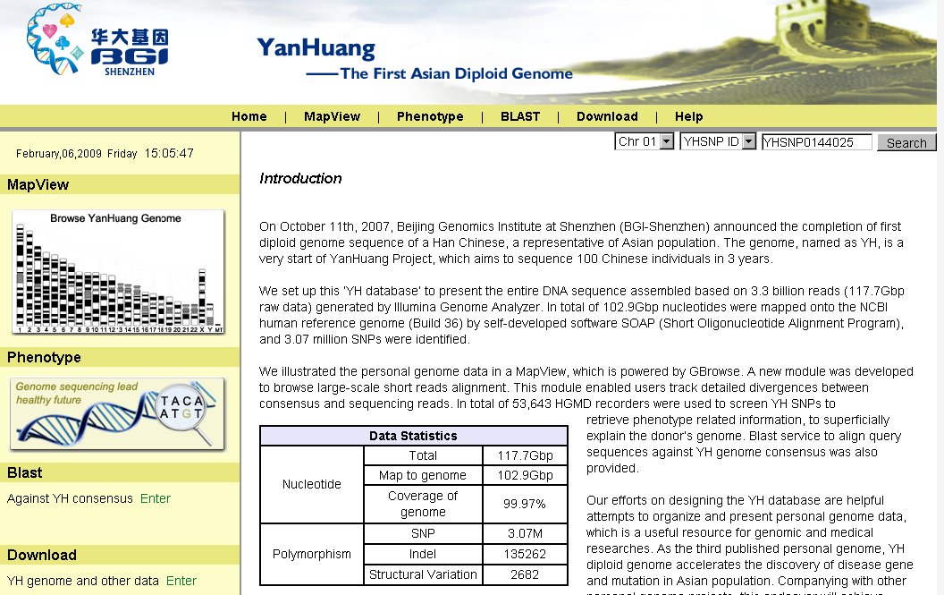
YH genome China (Nov. 2008)

Slide 4
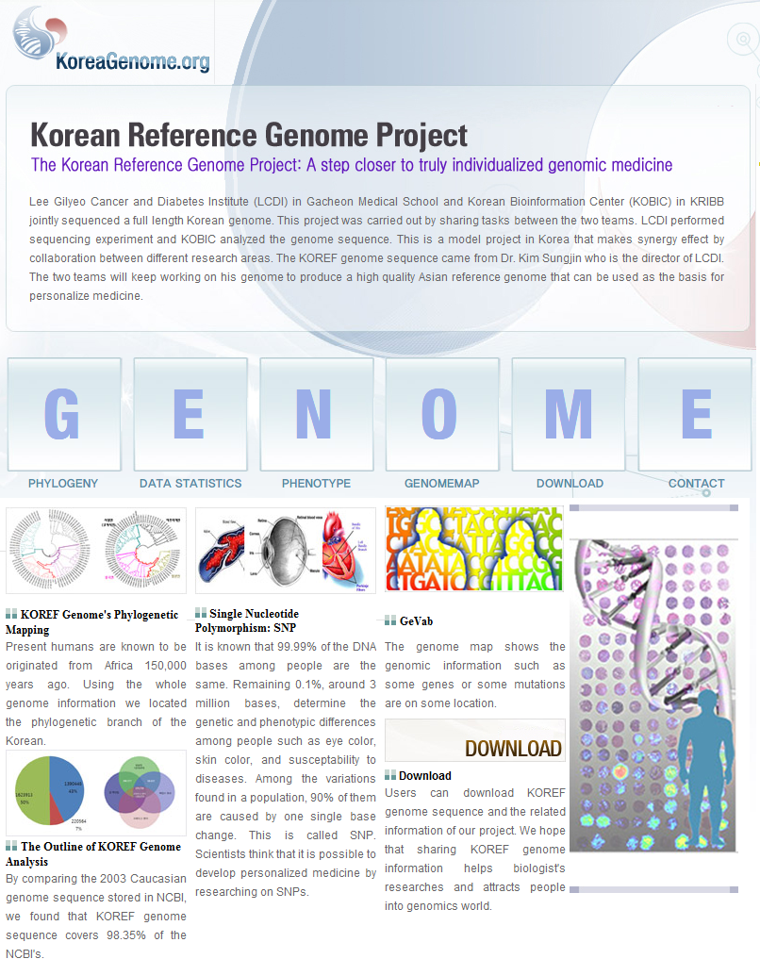
Korean Genome: Dec. 2008

Slide 5
6 Complete Genomes by 2008
NCBI Reference genome, Caucasian
Craig Venter, Caucasian(publically available)
James Watson, Caucasian (publically available)
Nigerian (anonymous), African
    HapMap sample ➔ Illumina (publically available)
Yang Huanming, Chinese, publically available
Kim Seong-Jin, Korean, publically available
Jong Bhak, under openfree BioLicense

Slide 6
1st and 2nd Generation Sequencers
Re-sequencing
Short-read sequencing
Cyclic array sequencing
….
….

Slide 7
Cost down
NCBI reference genome: 3,000 million USD
Craig Venter: 100 million USD
James Watson: 1 million USD
YH Chinese: 0.5 million USD
Nigerian African: 0.25 million USD (Illumina)
Kim Seong Jin: 0.25 million USD
Jong Bhak, under openfree BioLicense

Slide 8
Full Genome Sequencing Cost (2)
2012: $100 USD?

Slide 9
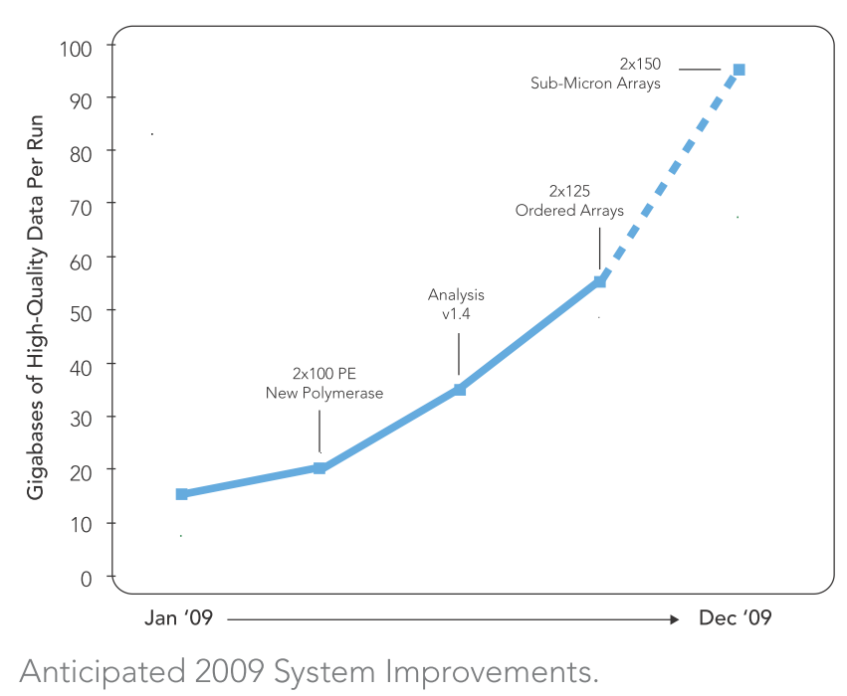
Illumina Roadmap
Jan. | 2 X 75 | 15G | 5X
3 | 2 X 100 | 20G | 7X
6 | Analysis ver. 1.4 | 30G | 10X
9 | 2 X 125 Ordered Array | 55G | 18X
12 | 2 X Sub-micron Array | 95G | 31X

Slide 10
Genomics era?
  Full genome sequencing Full genomics
  Individual sequencing cost can be
  $1000 or $100 by the year 2013
  However,
Jong Bhak, under openfree BioLicense

Slide 11
Genomics era?
  However,
  Useful Genomics per person can still cost
  $10,000 or more
  ➔ $1000 genomics ➔ Personal Genome
  ➔ $0 Genomics
  an openfree genomics project
Jong Bhak, under openfree BioLicense

Slide 12
Ome versus Omics graph
$3,000,000,000
$50,000 per person
Cost
$ 0
2003
Ome and Omics
Balance point
2016
Year
Jong Bhak, under openfree BioLicense

Slide 13


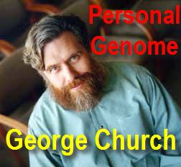
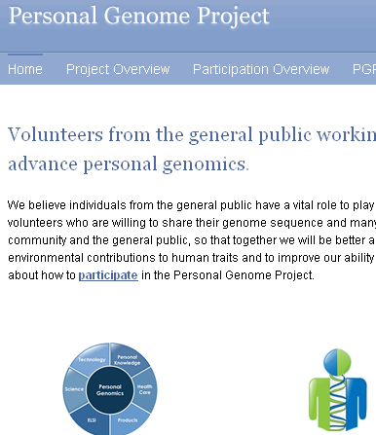



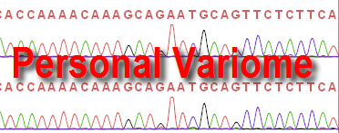
Personalization
Personal Computers and the Internet
  The Internet is a big pool of openfree data, information and knowledge.
One Laptop per Child association (OLPC)
PersonalGenome.org + Knome.com
Jong Bhak, under openfree BioLicense

Slide 14
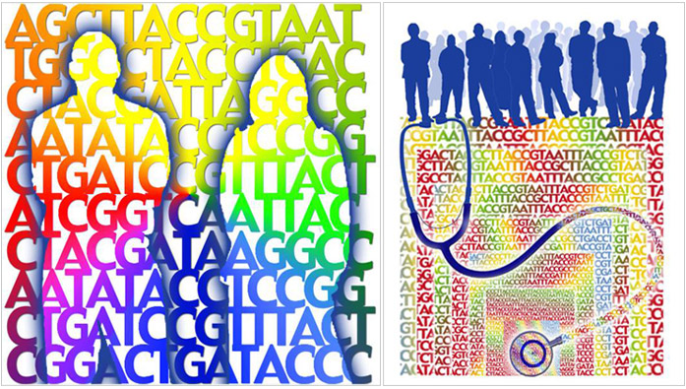
The Korean Genome
http://koreagenome.org

Slide 15
The first Korean genome sequence and analysis: Full genome sequencing for a socio-ethnic group
Sung-Min Ahn1,5,7, Tae-Hyung Kim2,7, Sunghoon Lee2,7, Deokhoon Kim1, Ho Ghang2, Dae-Soo Kim2, Byoung-Chul Kim2, Sang-Yoon Kim2, Woo-Yeon Kim2, Chulhong Kim2, Daeui Park2, Yong Seok Lee2, Sangsoo Kim3, Rohit Reja2, Sungwoong Jho2, Chang Geun Kim6, Ji-Young Cha1, Kyung-Hee Kim4, Bonghee Lee1,
Jong Bhak2,8 and Seong-Jin Kim1,8
2009. May 26th Genome Research

Slide 16
The First Korean Genome (SJK)
Gacheon medical school LCDI & KOBIC
First annotated and made public
on 4th Dec. 2008 (through web and ftp)

Slide 17
The first Korean Genome (SJK) 2/4
To be used as the first National Reference Genome
SNP, CNV, and indels were analysed
Automated phenotypic association study was done
Non-syn. Analysis

Slide 18
The first Korean Genome (SJK) 3/4
Phylogenetic study of mtDNA, Y Chr And autosomes.
First intra-Asian genome comparison (Chinese and Korean)

Slide 19
Data Summary of SJK (Seong-Jin Kim)
 | SJK |  | James Watson
Number of reads | 1,752,140,314 |  | 106,500,000
Total bases | 82.11 Giga bp |  | 24.5 Giga bp
Number of mapped reads | 1,638,353,588 |  | 93,200,000
Mapped bases | 76.5 Giga bp |  | -
NCBI reference genomic coverage | 99.90% |  | -
Sequence production coverage | 28.73X |  | 7.4X
Agreement between genome sequencing and SNP chips | 99.94% |  | 84.21%
 | homozygous | heterozygous | homozygous | heterozygous
 | 99.84% | 99.13% | 95.1% | 75.8%

Slide 20
Base composition
 | A | C | G | T
NCBI Reference genome | 29.53% | 20.44% | 20.46% | 29.57%
SJK Genome | 29.22% | 20.77% | 20.67% | 29.34%

Slide 21
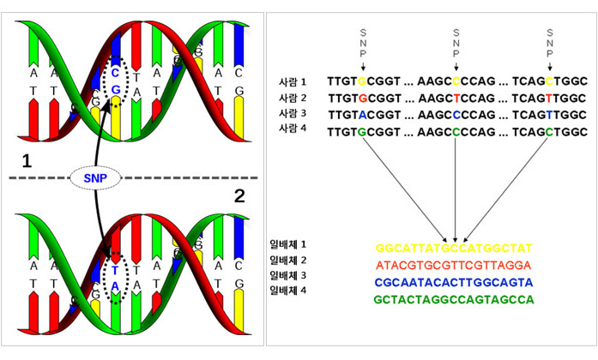
Variation and Variomics

Slide 22
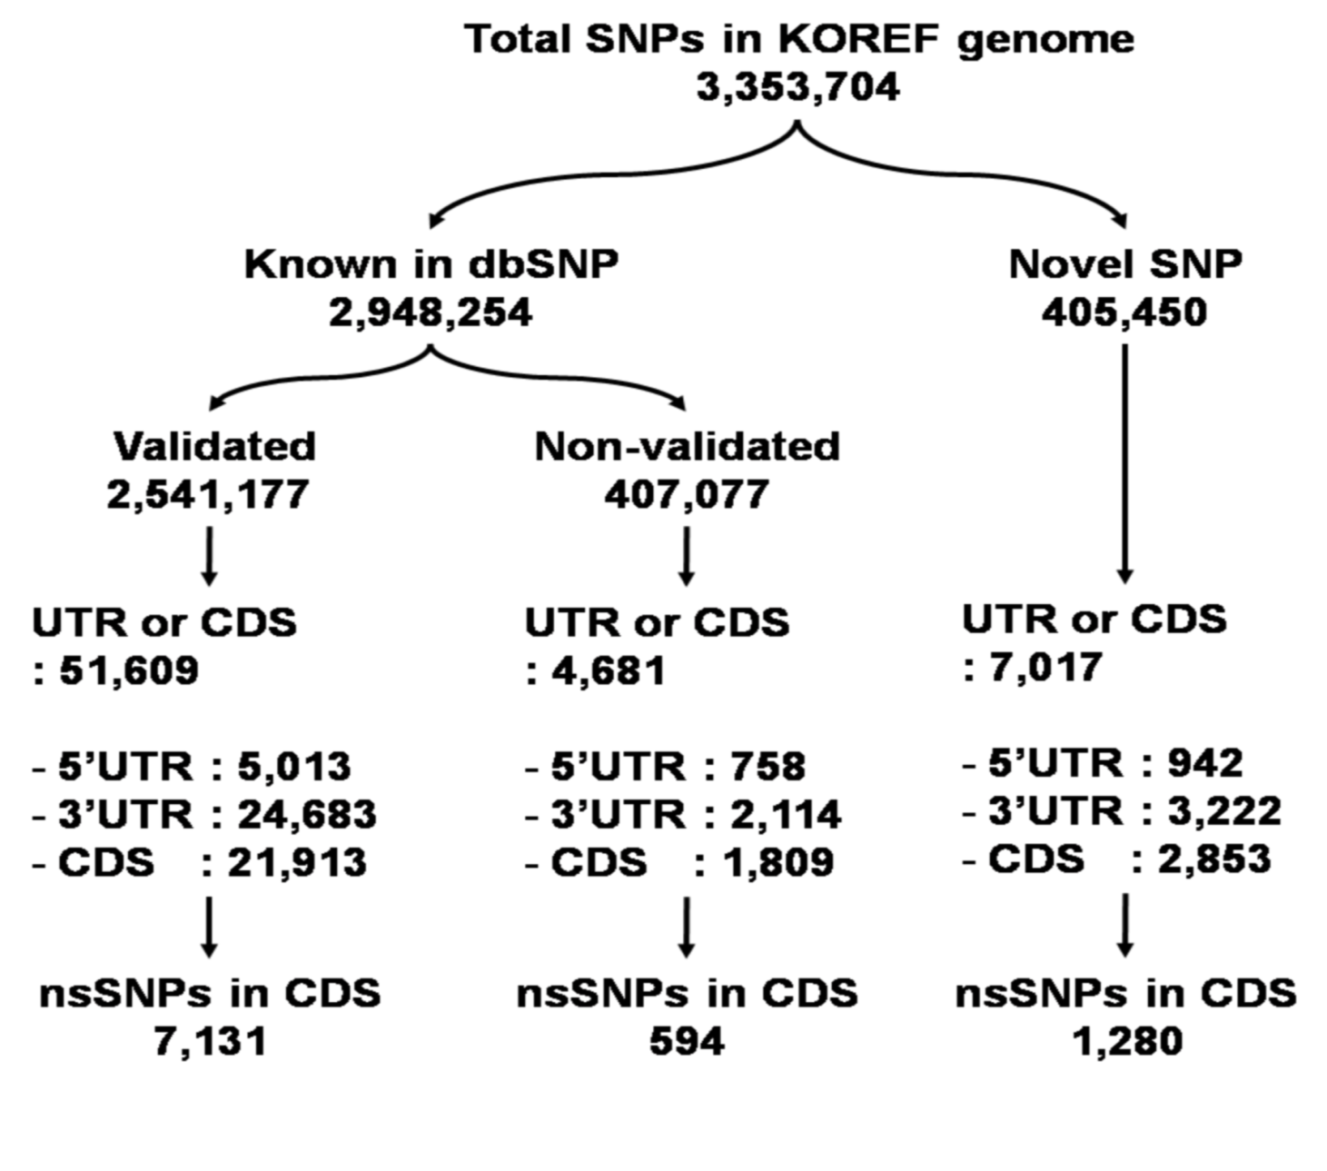
Classification and number of intra-genic SNPs
Notes:
Intra-genic SNPs identified in KOREF were classified as known or novel according their presence in dbSNP. Then, the SNPs were further classified based on their locations within genic regions. nsSNPs indicate nonsynonymous SNPs.
22

Slide 23
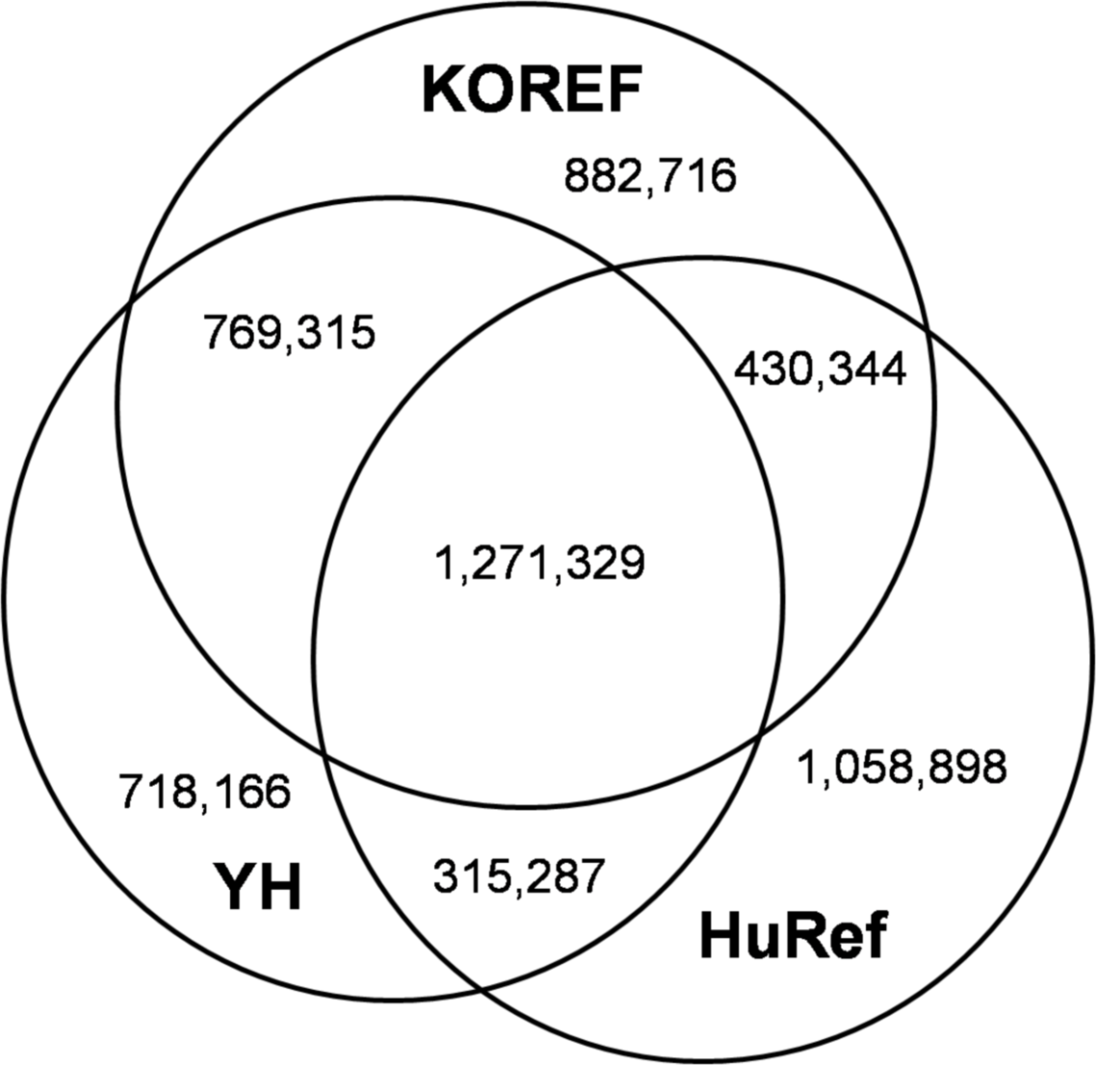
Comparison of SNPs among SJK(KOREF), HuRef(Venter), and YH(China)
Notes:
The SNPs of the KOREF genome were compared with those of HuRef and YH (Fig. 2) (Levy et al. 2007; Wang et al. 2008). KOREF shared 61% of SNPs with the YH genome and 51% with the HuRef genome, while the YH genome shared 52% with HuRef genome.
23

Slide 24
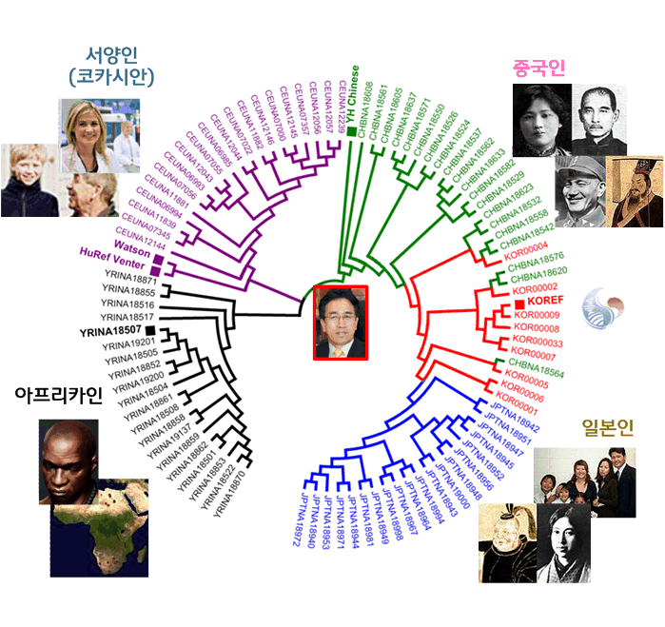
Ethnic Phylogeny

Slide 25
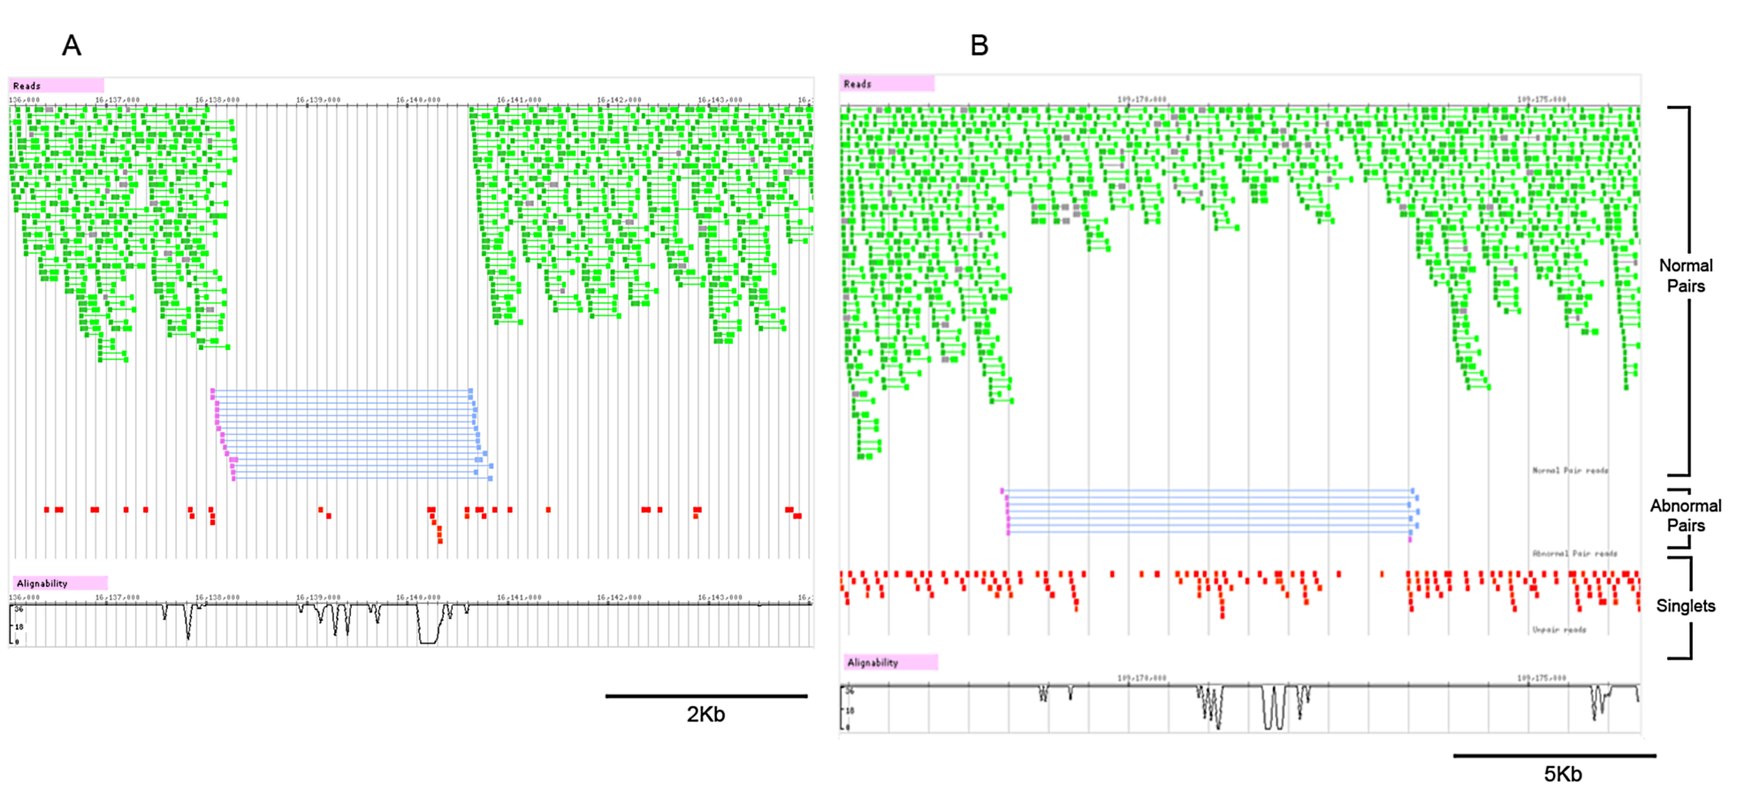
Homo- and heterozygous deletions in SJK genome
. (A) Homozygous 2.3 kb genomic deletion and (B) Heterozygous 5 kb genomic deletion.
Notes:
Homozygous 2.3 kb genomic deletion and (B) Heterozygous 5 kb genomic deletion. Violet bars indicate detected large deletions by anomalous paired-end reads; green bars: normal read pairs, grey bars: normal paired-end read track mapped with Smith Waterman algorithm in MAQ, red bars: singletons (reads without mate pairs).
we found deletion SVs in eleven coding genes (ANP32B, C1orf62, CDC27, COL22A1, HYDIN, IRAK2, MLL3, MUC6, PRKRA, SLC36A3, and ZNF717), which may disrupt normal protein structures and functions.
25

Slide 26
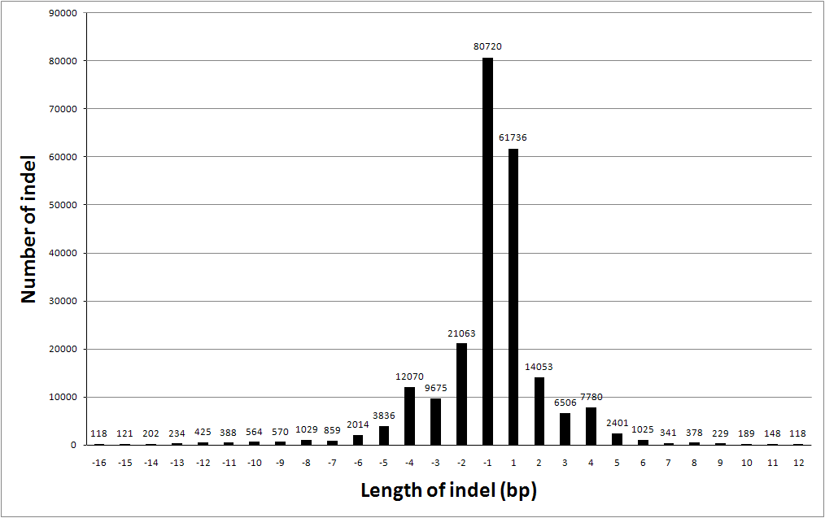
Indels
342,972 short indels (-32 - +14 bp).

Slide 27
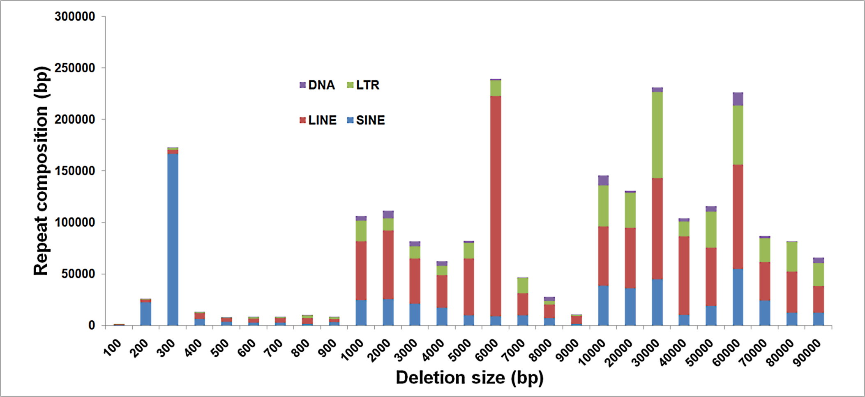
long terminal repeat, Long Interspersed Sequence

Slide 28
Summary
Human genome sequencing for ethnic groups is useful
Each ethnic group should have a reference genome

