Slide 1


BioBarcode: a general DNA barcoding database and server platform for Asian biodiversity resources
>>> Korea Research Institute of Bioscience and Biotechnology (KRIBB)
InCoB 2009, Singapore
Jeongheui Lim
Korean BioInformation Center
Korea Research Institute of Bioscience and Biotechnology
>>> Korean BioInformation Center (KOBIC)
Notes:
I am Jeongheui Lim, and I am working at the Korean BioInformation Center.
I am going to present a general DNA barcoding database and server platform for Asian biodiversity resources, briefly called as BioBarcode.

Slide 2
Acknowledgement
Dr. Jong Bhak, Korean BioInformation Center,
Korea Research Institute Bioscience and Biotechnology
Prof. Won Kim, Seoul National University, Korea
Dr. Woon-Kee Paek, National Science Museum, Korea
Prof. Chang-Bae Kim, Sangmyung University, Korea
Mr. Sangyoon Kim, Sungmin Kim and Hae-Seok Eo
1/13
Notes:
Before I start my presentation,
I would like to say thank Dr. Jong Bhak at Korean Bioinformation Center who directed the study.
Also, I thank Prof. Won Kim at Seoul National University who coordnated the collaboration and the study asssociated with BioBarcode and Korean Barcode of Life. And I also thank Dr. Woon-Kee Paek at National Science Museum, and Prof. Chang-Bae Kim at Sangmyung University who involved in reviewing and revising it for intellectual content.
Finally, I thank Mr. Sangyoon Kim, Sungmin Kim and Hae-Seok Eo who provide technical assistance while constructing the database.

Slide 3
Contents
Background of DNA barcoding
Overview of BioBarcode
An exemplary system; Asian BioBarcode
Future development
Conclusion
2/13
Notes:
In my presentation, I will introduce the general background of the DNA barcoding.
Then I will overview the BioBarcode database server system and introduce an exemplary system using the BioBarcode.
To be finished my talk, the future development and conclusion will be presented.

Slide 4
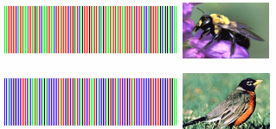
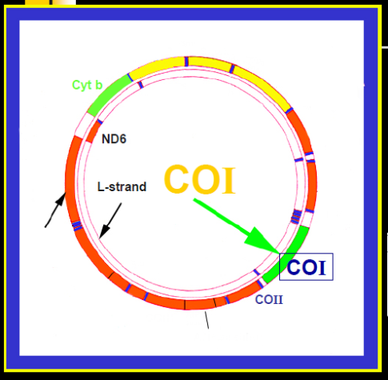
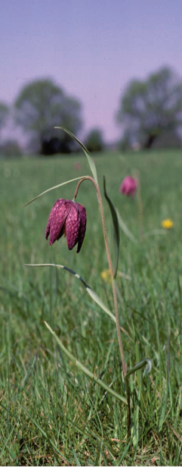
Background
DNA Barcoding is ;
sensu stricto : species identification
- standardized minimal approach using a short section of DNA sequence
(“barcode”)
- mitochondrial gene, cytochrome c oxdase I (COI), for animal species
- chloroplast genes, matK and rbcL, for land plants (August 4, 2009)
3/13
Notes:
I am going to introduce the background of DNA barcoding in short.
DNA barcoding sensu stricto is the standardized minimal approach to facilitate biodiversity studies that include species identification and discovery by minimal sequence of DNA. By harnessing advances in electronics and genetics, barcoding will help many people quickly and cheaply recognize known species and retrieve information about them, and will speed discovery of the millions of species yet to be named.
Species-level identification through DNA barcoding is usually accomplished by the retrieval of a short DNA sequence from a standard part of the genome (i.e., 650-base fragment of the mitochondrial cytochrome c oxidase I called COI gene for animal species).
Its use for plants was delayed because of the complex nature of plant genetics and disagreements over the appropriate DNA regions to use. However, the plant working group of CBOL has recently identified and published for the two chloroplast genes called matK and rbcL as the plant barcode.

Slide 5
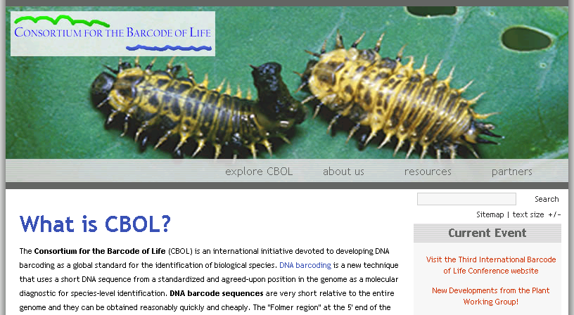
Consortium for the Barcode of Life (CBOL)
To developing DNA barcoding as a global standard for the
identification of biological species
Sloan Foundation grant, launched in May 2004
Secretariat opens at Smithsonian, September 2004
Now an international affiliation of: 170+ Member Org’s, 50 countries
4/13
Notes:
For your reference, CBOL is an international initiative devoted to developing DNA barcoding as a global standard for the identification of biological species. It was launched in May 2004 and now includes more than 170 member organizations from 50 countries.

Slide 6

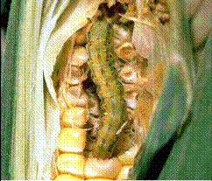
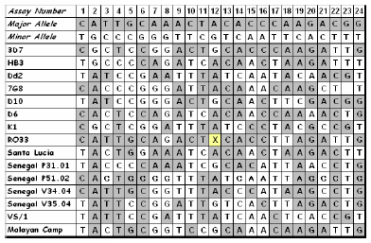
Background
DNA Barcoding is ;
sensu lato : new research areas other than taxonomy
- forensic science
- biotechnology, food industries
- agricultural inspect, public health
- single-nucleotide polymorphisms (SNPs)
- biodiversity assessment from environmental samples (e.g., soil or water)
5/13
Notes:
Meanwhile, DNA barcoding sensu lato have reached out actively to new research areas other than taxonomy such as forensic science, biotechnology and food industries. Agricultural inspectors and public health officials with the need to identify specimens are exploring barcoding as a new approach to applied problems.
Also, taxon identification with diagnostic single-nucleotide polymorphisms and biodiversity assessment from environmental samples (e.g., soil or water) can be considered DNA barcoding sensu lato.

Slide 7
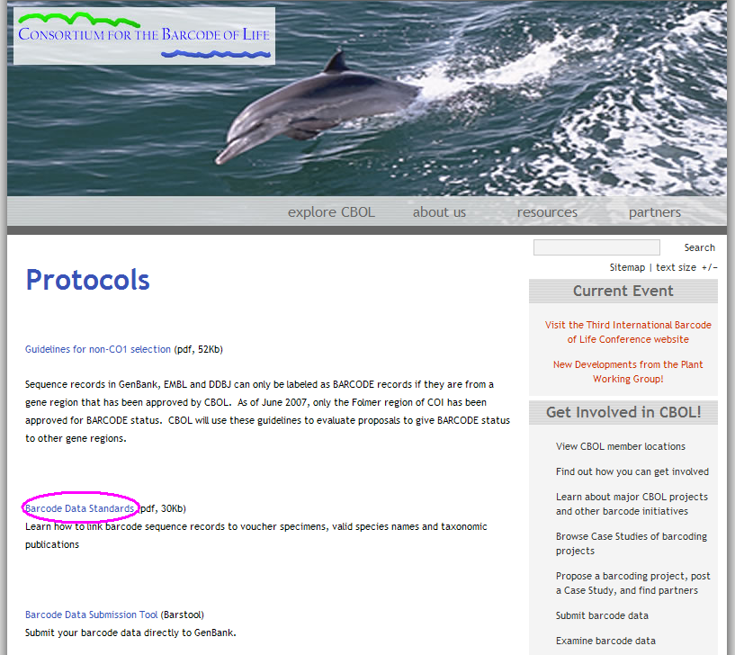
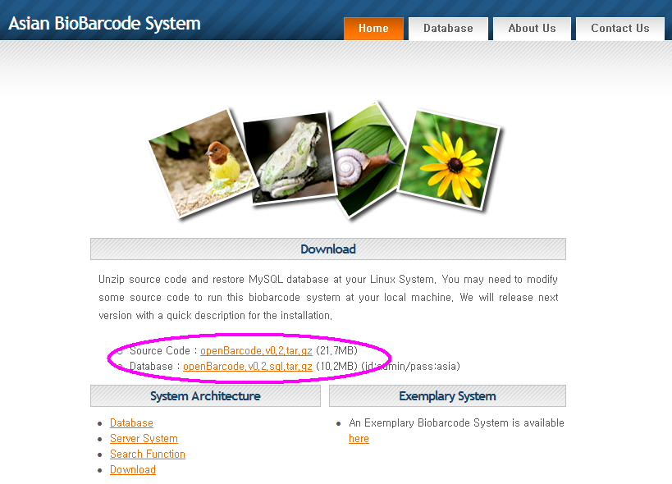
BioBarcode : open source software
6/13
Notes:
In this background, we have built a DNA barcode data processing system, BioBarcode, with open source software.
To establish the data standards and interoperability, we adopted the guidelines in the Consortium for the Barcode of Life.
The BioBarcode system can be downloaded from the website through unzipping source code and restoring mySQL database at Linux System.

Slide 8
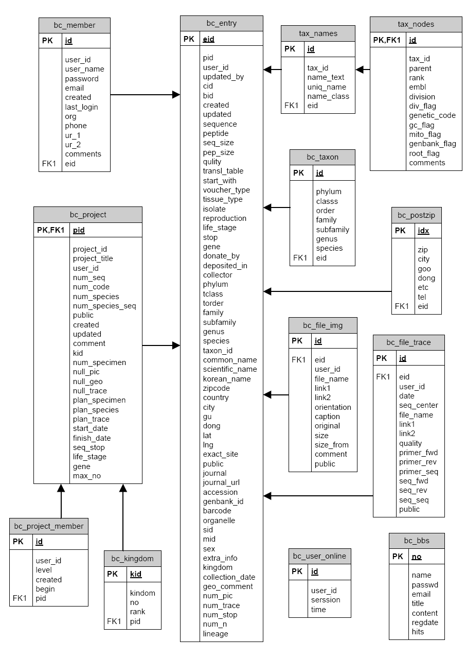
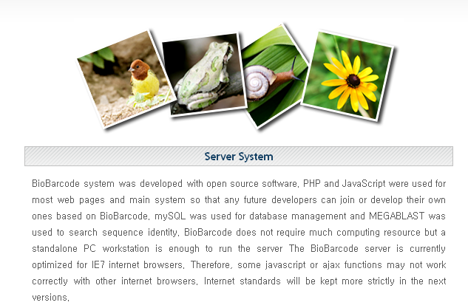
BioBarcode overview (1/2)
System architecture and scheme
Computational resources
PHP and JavaScript
mySQL
MEGABLAST
IE7 internet browser
7/13
Notes:
(1) System architecture and scheme
The database structure of BioBarcode system consists of 12 tables as shown in this Figure.
These tables are mainly bc_entry (a table for management of general information on specimens).
We used a lineage table as tax_names and tax_nodes from the NCBI taxonomy database to search and navigate lineage.
This table contains taxonomy information of 370,000 species from kingdom to subspecies.
(2) Computational Resources
PHP and JavaScript were used for most web pages and the main system so that any future developers can join or develop their own based on BioBarcode. mySQL was used for database management and MEGABLAST was employed to search sequence identity. The server is optimized for IE7 internet browser.

Slide 9
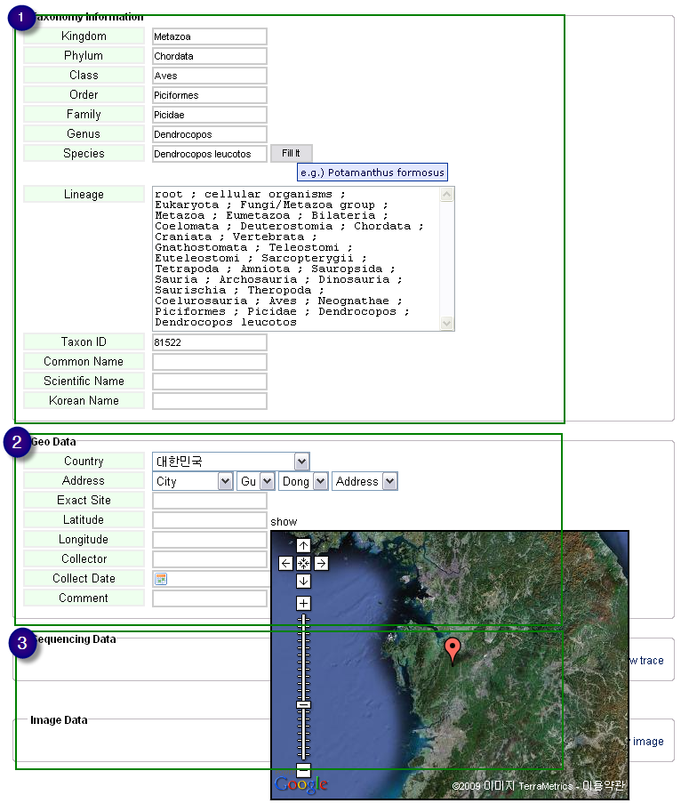
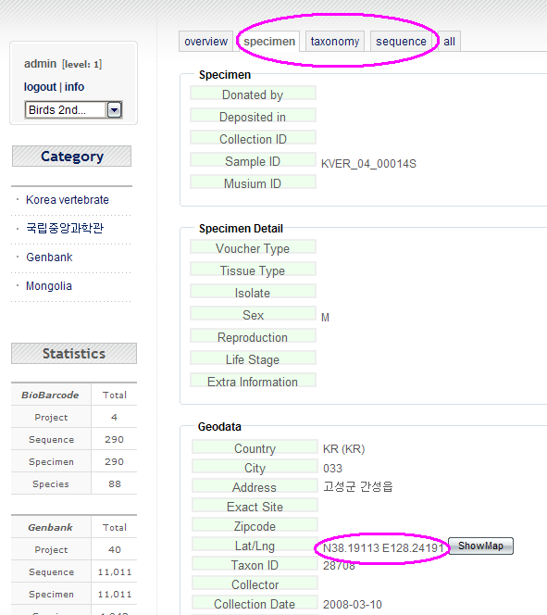
BioBarcode overview (2/2)
Data uploads and repository
8/13
Notes:
(3) Data uploads and repository
As shown in this Figure, BioBarcode system can be uploaded data in three parts: specimen, taxonomy, and sequence.
Key specimen data, such as voucher information and collection data with geographical distributions, is recorded in the specimen entry.
Clicking an icon using the Google map API makes an automatic entry of longitude and latitude of the selected location in geographical information.

Slide 10
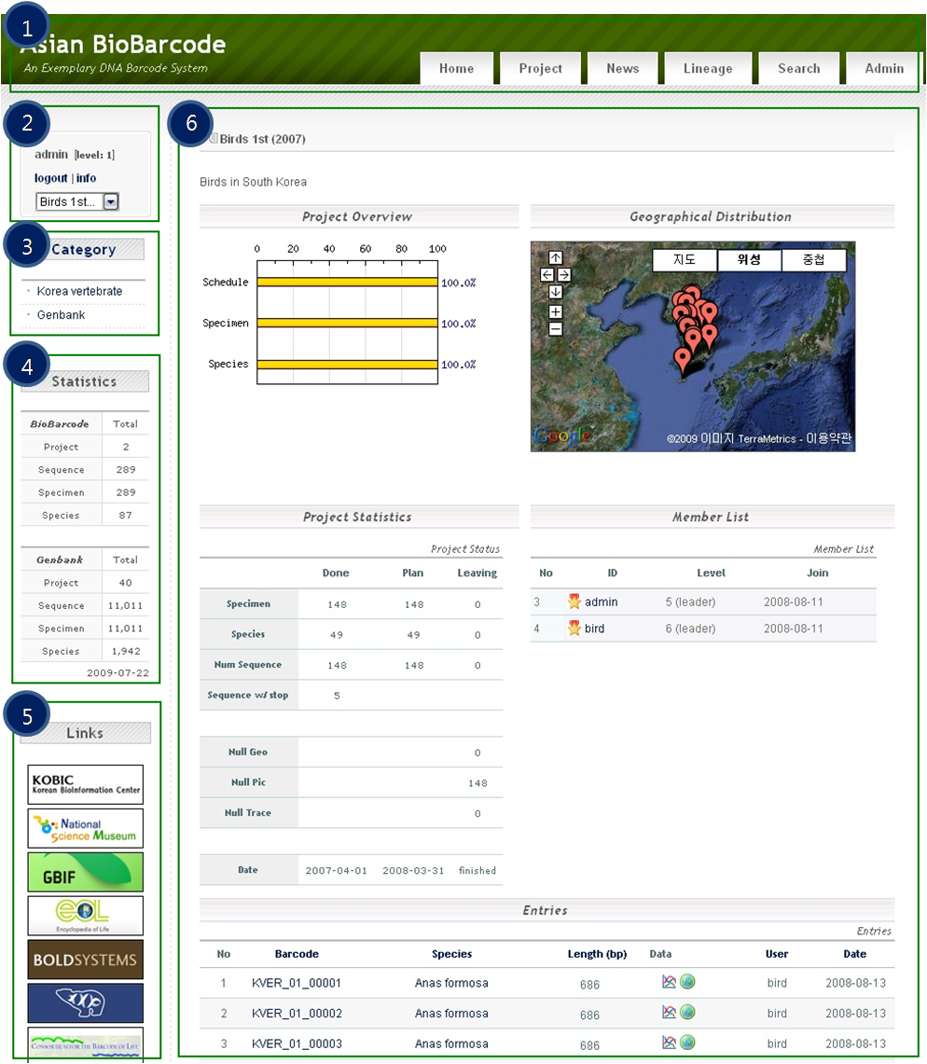
Asian BioBarcode System (1/3) an exemplary web system using BioBarcode
User Interface
9/13
Notes:
Using the Biobarcode platform, we have constructed an exemplary web system called Asian BioBarcode System, to build an Asian Biodiversity Resource System.
User Interface
At present, Asian BioBarcode System has around 289 specimen entries from Korean data and 11,000 from GenBank data.
As shown in this picture, the database consists of five entries: main menu bar including the section of project, news, lineage, search, and administration. And log-in system, category, statistics, and other links to related organizations to facilitate effective and user-friendly database management.
The ‘Project’ page consists of six parts such as project title, project overview, geographical distribution, statistics, member list, and data entries for barcode ID, species, and sequence with trace data.

Slide 11
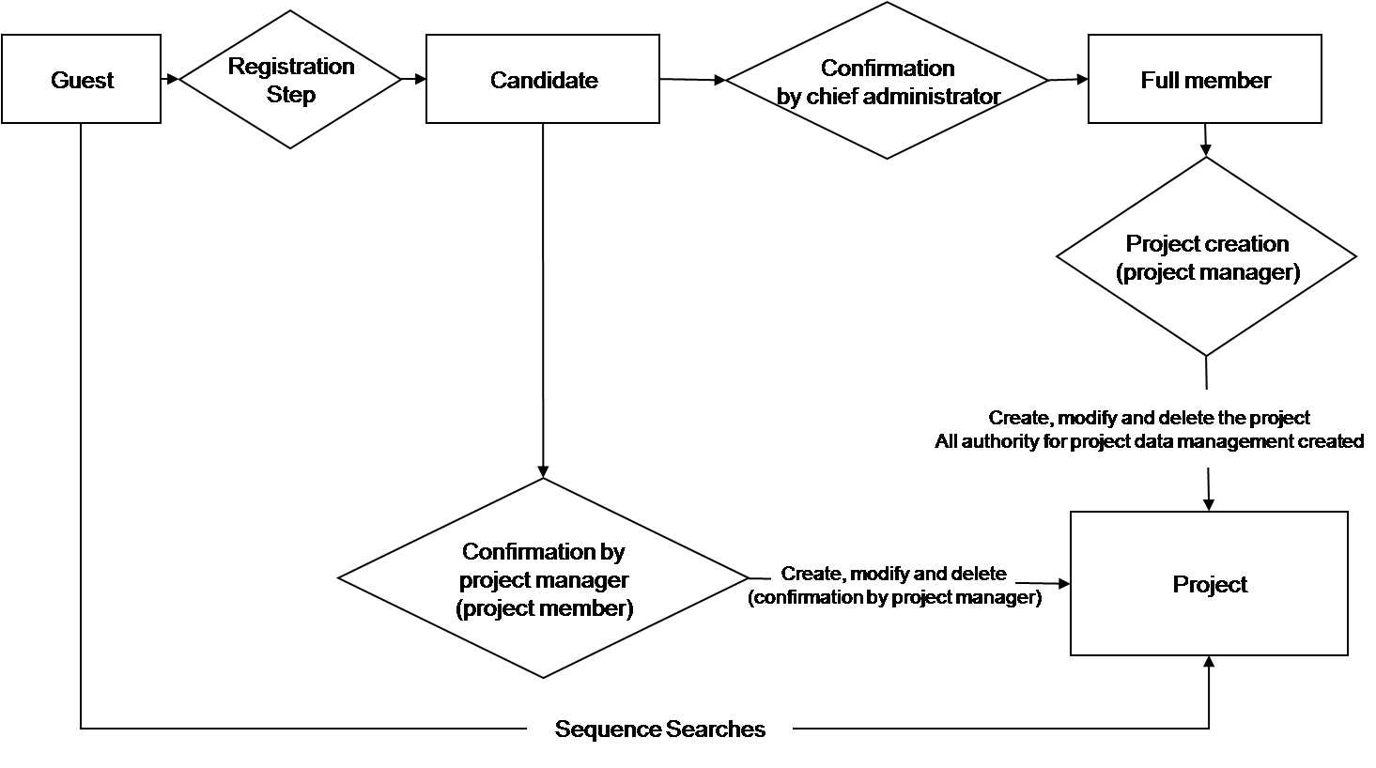
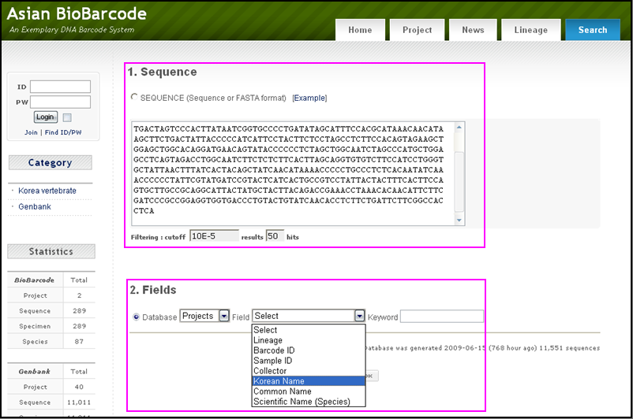
Asian BioBarcode System (2/3) an exemplary web system using BioBarcode
Data access authority
Data Searches
10/13
Notes:
(1) Data access authority
The data access authority in BioBarcode system is based on membership level. The data input and modification depend on the member level. Any project data is accessible only when a user is registered to the project and certified by the project manager. However, up to two items, such as image and species name, can be accessed by any unregistered member. Data retrieval is restricted to project members and chief administrator if the project is not open to the public.
(2) Data Searches
A data search can be performed by the input of a DNA sequence or a keyword.
Sequence-based data retrieval is done by creating a database containing publically available mitochondrial COI gene data registered in GenBank and Korean barcode projects. The search of an input sequence data is accomplished by using the MEGABLAST program.
On the same search web page, there is the keyword-based data retrieval section. Barcode ID, sample ID, collector, Korean name, common name, and scientific name can be used as a search parameter.

Slide 12
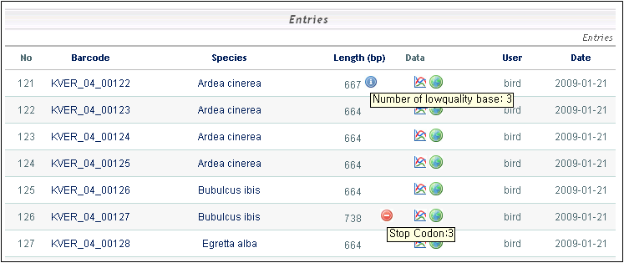
Asian BioBarcode System (3/3)
an exemplary web system using BioBarcode
Data Collection and Quality Validation
Sample Collection
(unknown species)
DNA Extraction
(mitochondrial COI gene)
Amplification using PCR
Sequencing COI gene
(low throughput sequence)
Alignment against DBs (MEGABLAST)
yes
Species Identification
(known species)
yes
no
Low Sequence Quality (# of N)
no
Stop Codon Check
yes
no
Data Upload to DB
(sequence and specimen information)
Asian BioBarcode System
11/13
Notes:
This is a flowchart of data collection and quality validation in the Asian BioBarcode System.
All submitted DNA sequences which have gone through experimental steps such as sample collection, DNA extraction, amplification, and sequencing, are translated into proteins and then compared against already known COI proteins to verify that they are true COIs using MEGABLAST program. The main target database is GenBank and any in-house database can be used to be compared with the input sequence.
The sequences that pass this check are then examined for stop codon to detect the presence of pseudo-genes.
Finally, the sequence data are uploaded into the Asian BioBarcode database with the specimen information.
As shown in this table, if any potential errors are detected, the sequence is flagged. The blue icon is shown as the number of low quality bases. Also, the red icon is marked when the automatically translated amino acid sequence contains stop codons.

Slide 13
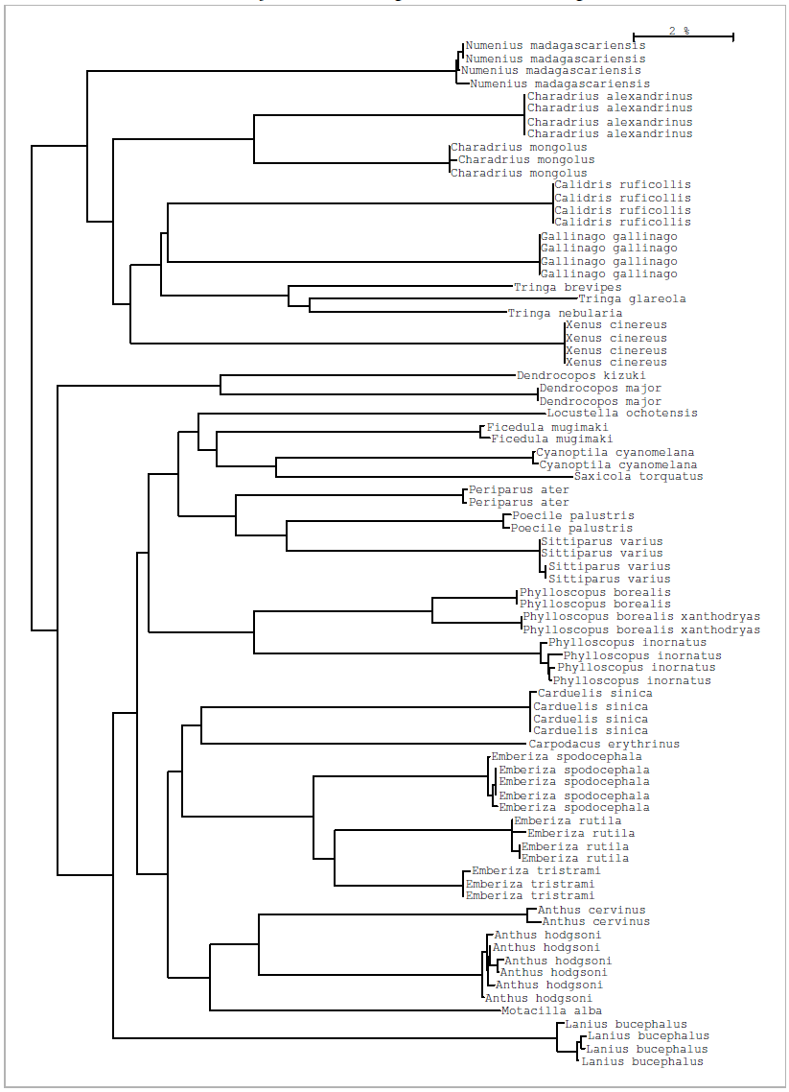
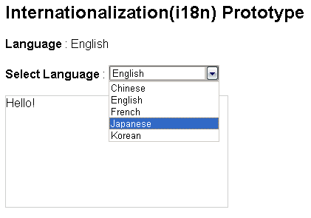
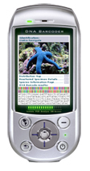
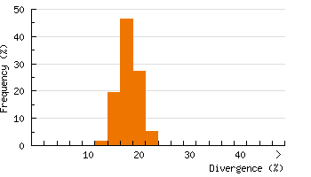
Future Development
sequence analysis tools
cross-platform support
mobile application interface
various Asian language supports
12/13
Notes:
For the future development,
Firstly, we are now developing sequence analysis tools such as phylogenetic tree and its distance summary, using the results from DNA sequence search.
Secondly, BioBarcode server is currently optimized for IE7 internet browsers. Some javascript or ajax functions may not work correctly with other internet browsers. Therefore, internet standard will be kept more strictly so that users will be able to use the service, regardless of OS or web browser preferences.
Thirdly, mobile application interface will be provided soon so that researchers can easily and rapidly deposit and search data in real time for sampling locations, collections, and observations.
Lastly, the information of database is currently available in English and Korean language. However, we plan to provide various Asian language supports for both Asian BioBarcode webpage and open BioBarcode program using the i18n function which can convert the program code into the specified language (코드를 설정된 나라의 언어로 변환해주는 기능). Simply by setting up the language option, users can access to the services much more easily.

Slide 14
Conclusion
Asia has a very high degree of biodiversity resources
need rapid identification of massive numbers of samples
“DNA barcoding” - using short, standardized DNA regions
BioBarcode database server system
- an efficient bioinformatics protocol
- easy to run and maintain with open source software
- can be freely downloaded from the website,
www.koreanbio.org/biobarcode
- make barcoding cheaper and faster in the biodiversity community
13/13
Notes:
I am going to conclude my talk here.
Asia has a very high degree of biodiversity. So, BioBarcode system is targeted to Asian researchers who have many local biodiversity resources.
Many mistakes and some limitations of these DNA markers will be made, but the obvious benefits of rapid identification of massive numbers of samples makes it imperative to push forward and develop the reference databases needed to make DNA barcoding as effective as possible.
Using short and standardized DNA regions, non-specialists can assign specimens to known species – even specimens that can confound specialists (e.g., eggs, larvae, incomplete adults). Therefore, barcoding can free taxonomists from the routine identification task of documenting new species. Next-generation DNA sequencing systems will enable the rapid production of barcodes, thus eventually promoting the assignment of unknown individuals to classified species.
In this background, BioBarcode database server system will be very useful to provide an efficient bioinformatics protocol that can be freely used by researchers and research organizations interested in DNA barcoding. It intends to be easy to run and maintain with open source software. The system can be freely downloaded from the website at www.koreanbio.org/biobarcode. It will promote rapid acquisition of DNA sequence data of biological species, and also provide the useful tools that will make barcoding cheaper and faster in the biodiversity community.

