Slide 1
MitoVariome: A variome database of human mitochondrial DNA
8th InCoB 2008 Singapore
Yong Seok Lee
Korean BioInformation Center, KRIBB

Slide 2
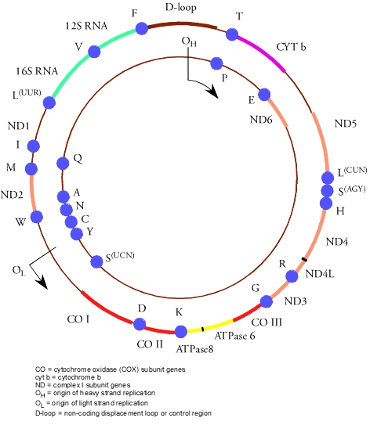
Human mitochondrial DNA
Maternally inherited
Rapid evolutionary rate
Lack of introns
Absence of recombination
Circular DNA, 16,569 bp
22 tRNAs, 2 rRNAs, 13 protein coding genes, and a non-coding region

Slide 3
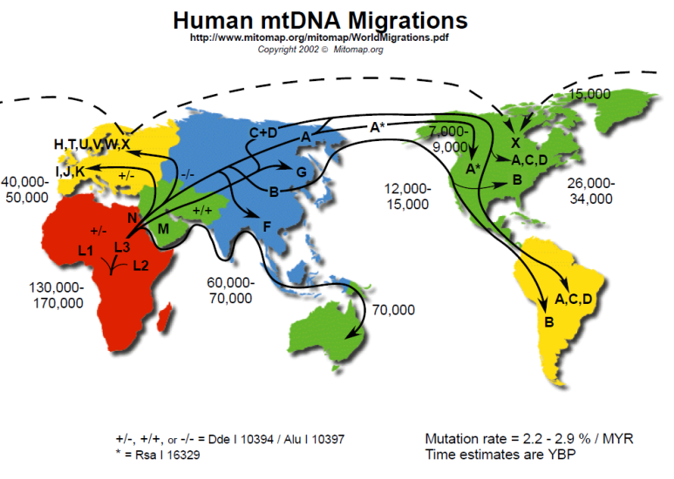
Mitochondrial DNA sequence variation in human
Having variation features (HVSI, HVSII, SNP, restriction enzyme sites, and STR)
Providing critical information for studying human evolution, forensics, and aging process

Slide 4

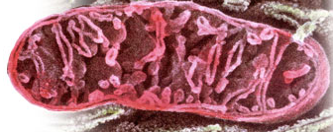


Mt DNA databases

Slide 5
MitoVariome
Over 5,000 complete human sequences of mitochondrial DNA
Geographic location and haplogroup to elucidate the history of human evolution
Linked to GenBank and Pubmed database
Showing a graphical view of the variation information

Slide 6
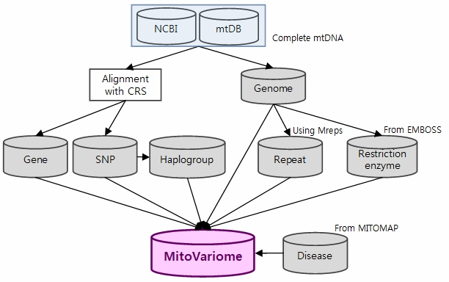
MitoVariome scheme

Slide 7
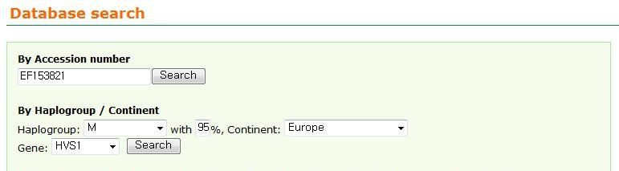
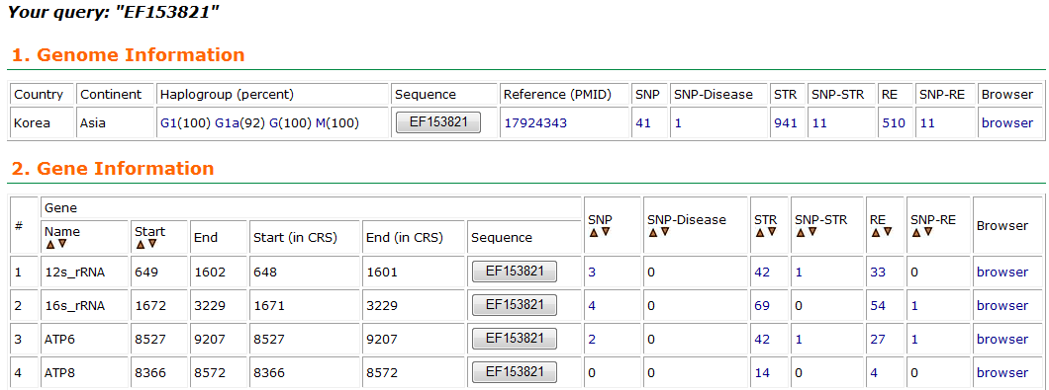
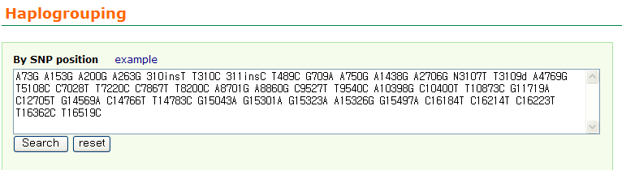
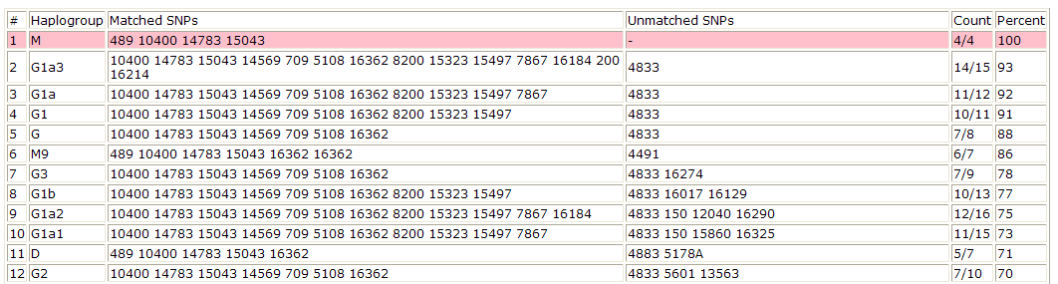
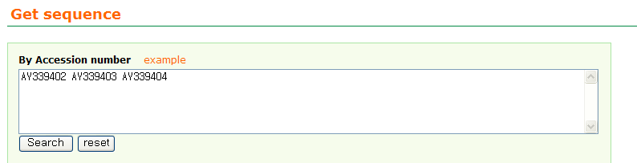

MitoVariome input page

Slide 8
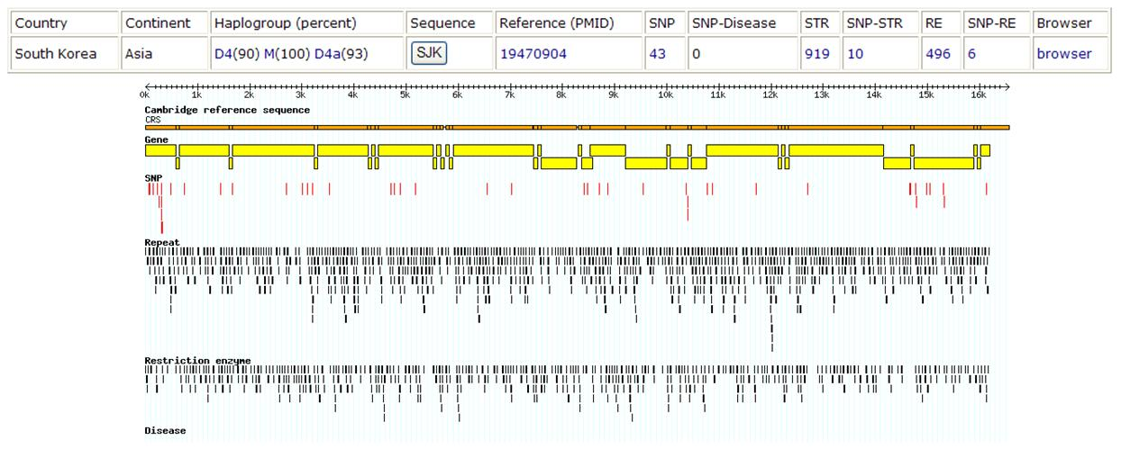
The MitoVariome main output page

Slide 9
Application of MitoVariome
Useful for understanding mitochondrial variations of each individual, haplogroup, or geographical location
Understanding of variation and its relationship with human evolution and disease
Assignment of haplogroup

Slide 10
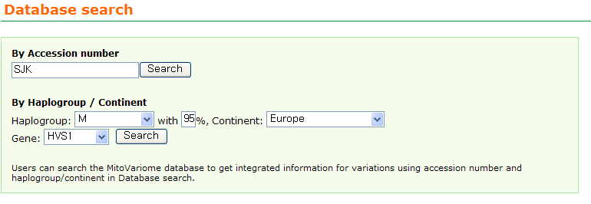
Example of MitoVariome
A Korean genome (SJK)
The first full length Korean individual genome sequence

Slide 11
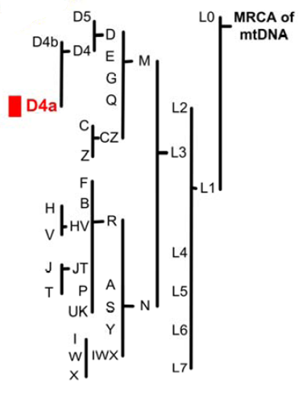
Example of MitoVariome
A Korean genome (SJK)
The first full length Korean individual genome sequence

Slide 12
Conclusion
A database and analysis server for human mitochondrial DNA variation
A platform to retrieve all kinds of variation information
The function to assign haplogroup with user SNP data
Available at http://variome.kobic.re.kr/MitoVariome

