Slide 1
GeVab:
Genome Variation Analysis Browsing Server
InCoB2009 KRIBB
Korean BioInformation Center, KRIBB
http://gevab.org

Slide 2
GeVab
Motivation
  Gevab was constructed as a database and web server for the exploration and downloading of KOREF.
GeVab is a genome browser for individual diploid genome sequence data.
  Genetic Variation Browser
  Genome Map Browser
KOREF is the first Korean genome published online in May 26th 2009. (Genome Research)

Slide 3
KOREF Data source
Generation using the Illumina GA
  About 1248 million paired 36-base reads & about 504 million 75-base reads
Mapping and assembly
  Using MAQ (Mapping and Assembly with Qualities) program
  Aligned to NCBI human genome (build 36)
Coverage 99.9% and 25.92 fold depth (sequencing depth was 28.95-fold)

Slide 4
Analysis of KOREF
3.44 million SNPs and 342,965 short indels (-29 - +14 bp)
2920 deletions and 415 inversion structural variants (SV) in the range of 0.1~100kb
963 insertion events in the range of 175~250bp

Slide 5
Genetic Variation Browser
Using GBrowse developed by GMOD project
Integration of individual genomes: KOREF, Venter, Watson, and YH
Annotations: dbSNP, HapMap, Entrez genes, Ensembl genes, OMIM, SNPedia, and DNA/GC content

Slide 6
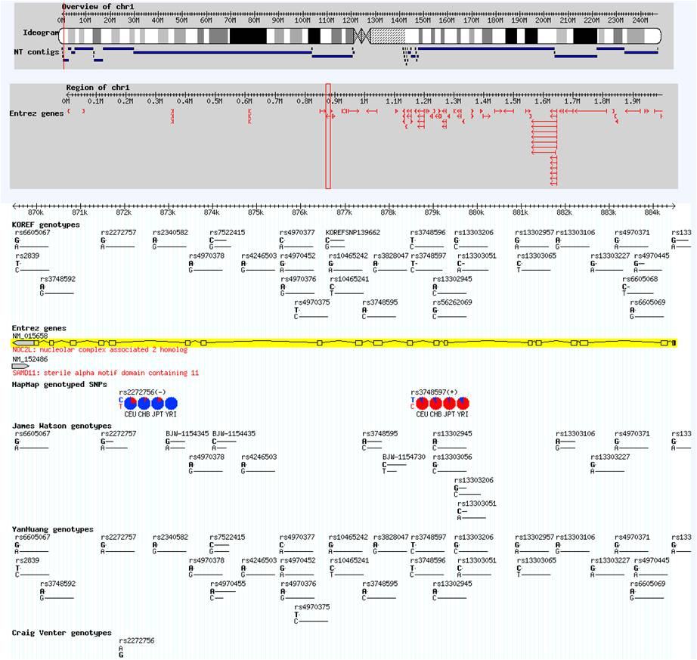
Genetic Variation Browser Functions
- Chromosome ideogram &
NT contigs
- Overview of Entrez genes
KOREF genotypes, indels, deletions, and insertions
Venter genotypes
Watson genotypes
YanHuang genotypes, indels, and CNV
HapMap genotypes
dbSNP (ver. 129)
Ensembl genes
Entrez genes
OMIM
SNPedia
DNA/GC contents

Slide 7
Genome Map Browser
Development at KOBIC
Reads mapping and quality information obtained from KOREF project

Slide 8
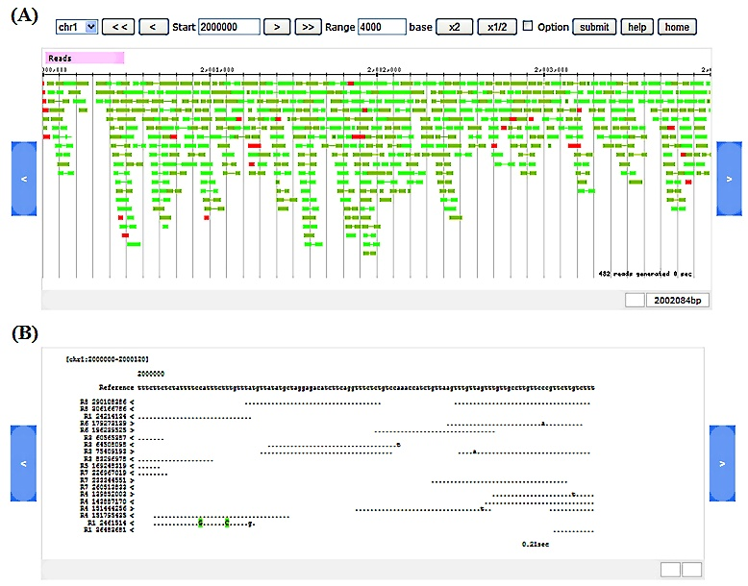
Genome Map Browser Functions
Graphic mode (more 1000 bp)
Pair-end reads:
Forward - dark green
Reverse - light green
Single reads: red
Tracks: Alignability, GC contents
Pair coverage, unpair coverage
Text mode (less 1000 bp)
Reference sequence
Reads sequence
Mutation base
Quality value

Slide 9
Features of GeVab, Venter, Watson, and YH genome browsers
 | GeVab | Venter | Watson | YH
genome | Korean | Caucasian | Caucasian | Chinese
read mapping | O | X | X | O
sequencing coverage | O | O | O | X
genotype | O | O | O | O
indel | O | O | X | X
structure variation | O | O | X | X
variations to compare | Venter, Watson, YH, dbSNP, HapMap | dbSNP | dbSNP, HapMap | dbSNP, HapMap
web site | http://gevab.org | http://huref.jcvi.org | http://jimwatsonsequence.cshl.edu | http://yh.genomics.org.cn/

Slide 10
Conclusion
GeVab contains all the raw and processed data of a Korean genome sequence, variants, and annotation.
GeVab provides open and public access to all data of an individual personal diploid genome.
GeVab provides comparison and validation of genetic variations to further communities for sequencing individual genome.

Slide 11
Thank you
wykim@kribb.re.kr

