Slide 1


Sub-population Analysis Based on Temporal Features of High Content Images
Merlin Veronika, James Evans, Paul Matsudaira,
Roy Welsch and Jagath Rajapakse
InCoB 2009 Singapore 10th September 2009

Slide 2
Outline
Motivation
  Sub-population classification to identify sub-cellular patterns, cell phases
  Cell migration pattern at sub-population level for studying cancer therapeutics
  Dynamic features are not used by existing methods to profile cells
Analysis pipeline and method
  Cell segmentation and extracting static features
  Modeling trajectories and quantifying motility features
  Cell profiling and validation by computational indices
Experimental results
Discussion and conclusion

Slide 3
Motivation
One of Cell Biology’s first mysteries comes under renewed scrutiny as new techniques allow researchers to follow cells’ steps.
Approaches | Authors, year
Neuron Displacement | Ruthazer and Cline , 2002
Flagellar movement | Turner et al , . 2000
Tumor cell migration | Pettet et al , . 2001
Congregation at point of sources | Fenchel and Blackburn , 2001
Sperm displacement | Molyneaux et al , . 2001
White blood cell movement | Yang et al , . 1995
Chromosome displacement | Thomann et al , . 2002
Develop cell profiling method using cell motility properties incorporated with morphological characteristics

Slide 4
Cell profiling pipeline
Cell segmentation by the level set method and quantifying morphology features
Modeling trajectories and quantifying motility featuress
Feature ranking based on differential entropy
Cell profiling and validation by computational indices
Sample preparation and time lapse image acquisition

Slide 5
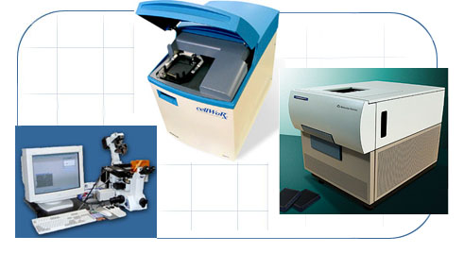
Sample preparation and time lapse image acquisition
  Cell type ̶ IC 21 murine macrophages
  Camera ̶ Cellomics KineticScan with Hamamatsu ORCA ER digital CCD camera (fluorescent confocal microscopy)
  Size ̶ 1024 × 1024 pixels × 6 time points
  Spatial resolution ̶ 0.64 × 0.64 μ/pixel
  Time interval ̶ 15 min/frame

Slide 6

Region-based active contours for segmentation
The task of segmentation is formulated as energy minimization problem.
Chan and Vese, 2001 used Mumford Shah segmentation techniques to stop the evolution of contour.
  Where,
    φ is the level set function
    µ is the intensity image
    c _{I} is the mean intensity of pixels inside level set
    c _{O} is the mean intensity of pixels outside level set
    α, λ_{1,} , λ₂ are fixed positive parameters learned by trial and error

Slide 7

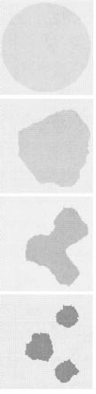
Region-based active contours for segmentation (contd)
Advantages
  Handles changes in topology (i.e. splits, merges)
  Robust to noise and allows segmentation of objects with blurred edges

Slide 8
Modeling Cell Trajectories and Quantifying Cell Motility
Trajectories are modeled by autoregressive models which are widely applied to describe non-stationary stochastic processes. (Elnagar et al, 1998; Cazares et al, 2001)
Biological cell movement can be described as a random walk and motility features are computed by using persistent random walk model developed by Dunn and Othmer et al, 1988 .
Model order
Prediction error
AR coefficient
MSD
Cell Speed
Cell Persistence

Slide 9
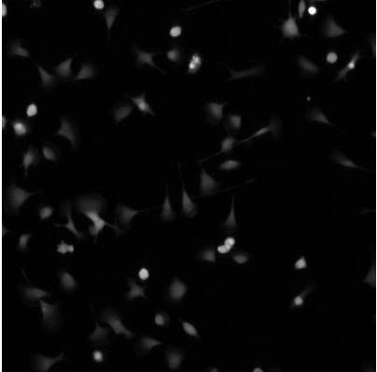
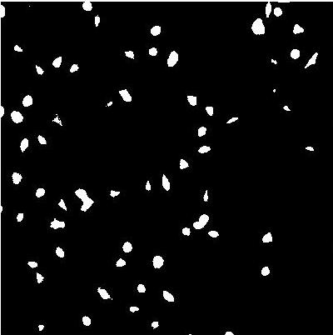


Results: Cell Segmentation
Classical
(Otsu, 1979)
Fuzzy C means
(Sahaphong,2007)
Level sets
(Chan and Vese, 2001)
1 s
50 s
17.4 min

Slide 10
Features extracted from Images
Shape
Area | Eccentricity | Orientation | Solidity
Extent | Perimeter | Form Factor
Zernike
Zernike_0_0 | Zernike_1_1 | Zernike_2_0 | Zernike_2_2
. . . | . . . | . . . | . . .
Zernike_9_3 | Zernike_9_5 | Zernike_9_7 | Zernike_9_9
Kinetic
Mean Cell Speed | Chemotactic Index | Path length | Path displacement
Persistence | Random motility coefficient | Persistence length

Slide 11
Redundancy in feature sets

Slide 12
Entropy-based Feature selection
Differential entropy was used to rank features
Ranks | Features | Ranks | features
1 | Orientation | 8 | Cell Speed
2 | RM Coefficient | 9 | Perimeter
3 | Persistence Length | 10 | Chemotactic Index
4 | Persistence | 11 | Eccentricity
5 | Path Displacement | 12 | Form Factor
6 | Path Length | 13 | Extent
7 | Area | 14 | Solidity

Slide 13
N_{feat}=14
N_{feat}=7
N_{feat}=7

Slide 14
Cluster Validation
Homogeneity Index:
  H_{avg} is the average distance between each point in the cluster (ie cell) and the respective cluster centroid. It reflects the compactness of the cluster.
Separation Index
  S_{avg} is the average distance between clusters. It reflects the overall distance between clusters
Decreasing H_{avg} or increasing S_{avg} suggests better clusters

Slide 15
Validation results
N_{C}=3
N_{C}=4
N_{C}=3
 | Static only | Dynamic only | Static and Dynamic
HI | 1.5825 | 0.3377 | 1.4810
SI | 1.1988 | 0.2924 | 0.9646
Conclusion:
In terms of compactness, dynamic features in four clusters gives better resolution
In terms of separation, static features in three clusters gives better resolution
Dynamic features combined with static gives best of both.

Slide 16

















Area & Speed Vs Time

Slide 17









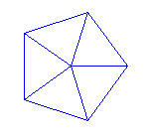




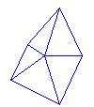




All features Vs Speed
Orientation
solidity
Eccentricity
Extent
Perimeter

Slide 18
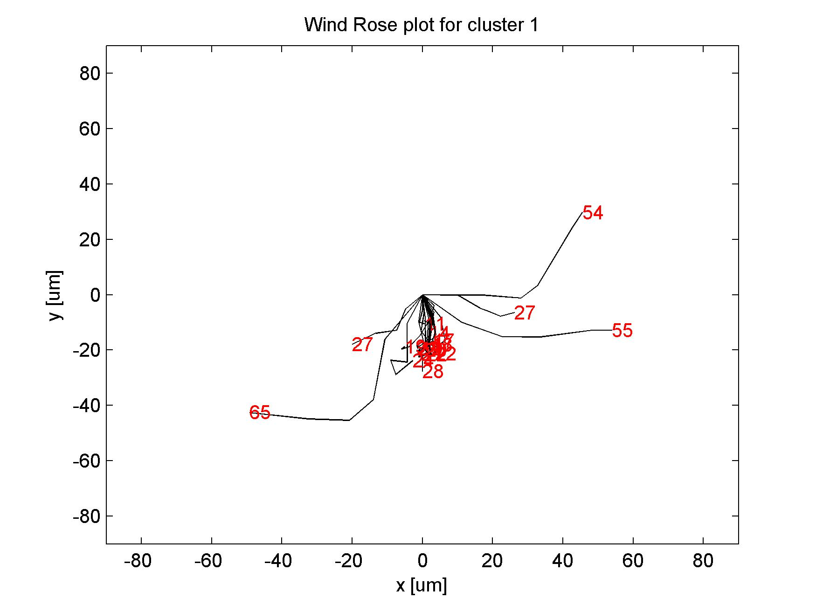
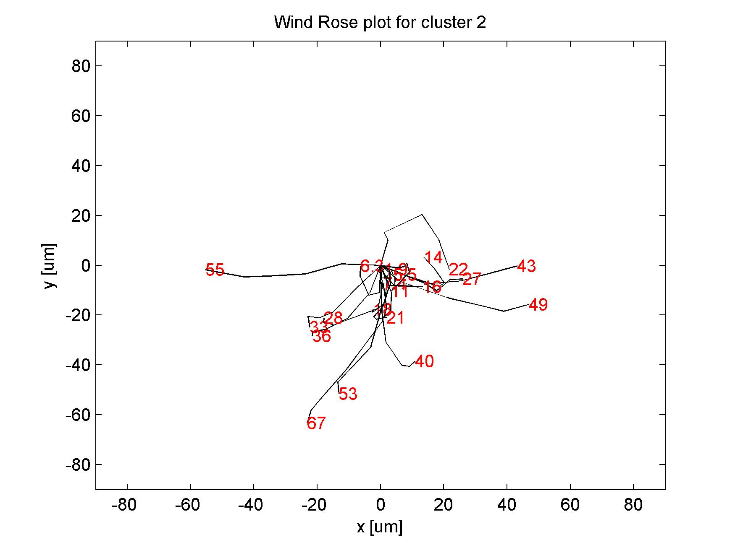
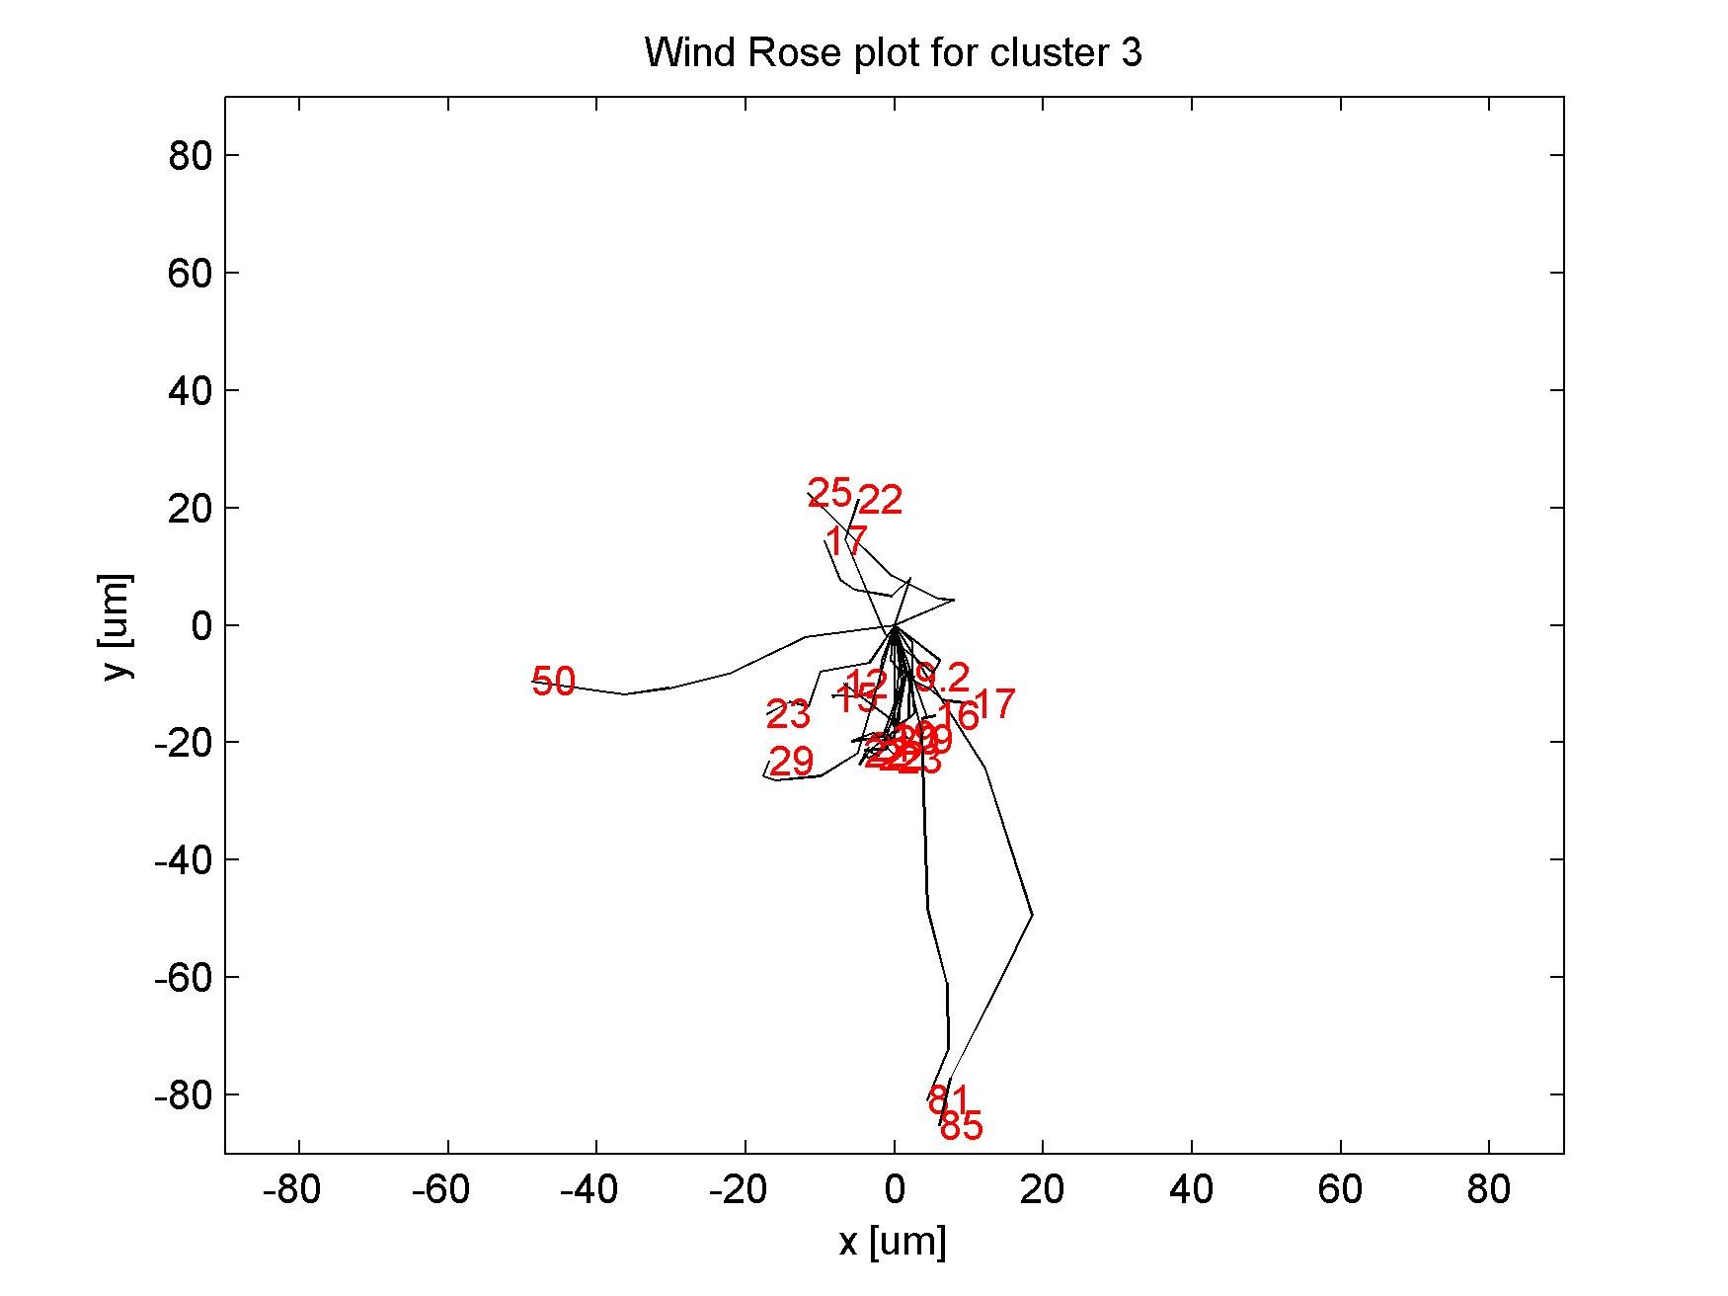

Slide 19
Cluster Correlation

Slide 20
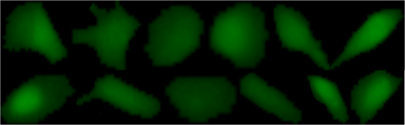
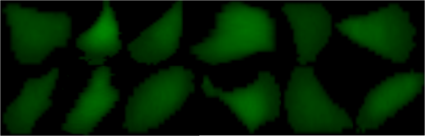
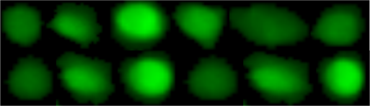
Cluster profile:
Cluster 1:
Cells increase in area, retains similar shape as speed decreases. Maximum speed a cell can reach is 14 – 15 µ/h. 19%
Cluster 2:
Sharp decrease in area as speed increases, gradual increase in size as speed decreases, minimum size of the cell is reached after one hour. Speed and area increased at the next time point. Speed can go up to 7.5 µ/h. 38%
Cluster 3:
Cells tend to increase in volume but retain same shape from initial time point. Speed decreases sharply indicating nil motility. Maximum speed is 12-13 µ/h. 43%

Slide 21
Discussion and conclusion
Demonstrated a novel exploratory method of identifying sub-populations combining dynamic with static features from image based high content data.
Combining both features gave optimally separated and compact clusters.
Dynamic features like RM coefficient, persistence length, path displacement coupled with static features like orientation and area are the major contributors in classification.
Used common data mining techniques like k-means which can be easily reproduced to gain insight into morphology and motility features.
Future work will be to analyze cells perturbed with drugs targeting cytoskeleton (microtubule/actin).

Slide 22




Acknowledgement
Nanyang Technological University
  Prof Jagath Rajapakse
  Dr. Cheng Jierong
  BIRC staff and students
Massachusetts Institute of Technology
  Prof Roy Welsch
  Dr. James Evans
National University of Singapore
  Prof Paul Matsudaira
Singapore MIT Alliance
Thank you for your attention!

