Slide 1
Identification of protein homology using domain architecture
Eighth International Conference on Bioinformatics (InCoB2009)
Byungwook LEE
Sep. 9, 2009
Korean Bioinformation Center (KOBIC)

Slide 2
Protein annotation
>6 million unique proteins
  Annotation
    Computational annotation
    Very few experimental annotation
Computational annotation tools
  Sequence-based methods
  Domain-based methods

Slide 3
Protein annotation
Sequence-based method (FASTA, BLAST,…)
  Using sequence similarity information
  Similar sequences have similar function
  Weakness:
    Distant protein homology
    Multi-domain protein homology
Domain-based method
  Using domain information in proteins.
  Domain
    Structural, functional, and evolutional unit
    Reused during evolution
    Domains are strongly conserved
  Multi-domain protein homology

Slide 4
Research object
Domain-based method
  Development of a homology identification tool using domain architecture
  Domain architecture
    The sequential order of domains in a protein
Protein sequence
>protein sequence
MPTVISASVAPRTAAEPRSPGPVPHPAQSKATEAGGGNPSGIYSAIISRNFPIIGVKEKTFEQLHKKCLE
KKVLYVDPEFPPDETSLFYSQKFPIQFVWKRPPEICENPRFIIDGANRTDICQGELGDCWFLAAIACLTL
NQHLLFRVIPHDQSFIENYAGIFHFQFWRYGEWVDVVIDDCLPTYNNQLVFTKSNHRNEFWSALLEKAYA
KLHGSYEALKGGNTTEAMEDFTGGVAEFFEIRDAPSDMYKIMKKAIERGSLMGCSIDDGTNMTYGTSPSG
LNMGELIARMVRNMDNSLLQDSDLDPRGSDERPTRTIIPVQYETRMACGLVRGHAYSVTGLDEVPFKGEK
Comp.
Protein
sequence DB
Domain databases (Pfam)
Comp.
Domain
architecture

Slide 5
Previous studies
  CDART (Geer et al., 2002)
    Conserved Domain Architecture Retrieval Tool
    Show all possible domain architectures related to a query protein
  Domain distance (DD) (Bjorklund et al., 2005)
    The number of unmatched domains in an alignment between two domain architectures
    Dynamic programming algorithms
  PDART (Lin et al, 2006)
    To measure similarity of domain content and order using a linear function

Slide 6
Problems in previous studies
All domains have the same importance
Considering promiscuous (=mobile) domain
  - Auxiliary functions (ex, allosteric regulation, DNA binding)
  Inserted into proteins during evolution
  Not directly related to homology
  Highly abundant and versatile
Abundance : Number of proteins containing a domain
Versatility : Number of distinct partner domain families of a domain

Slide 7
Measuring domain importance
  Considering abundance and versatility of domains
Protein_1)
A
B
C
Protein_2)
B
B
B
C
Ex) Domain ‘B’
- Abundance = 4
- Versatility = 3
Protein_3)
B
E
Protein_4)
C
B
A
Protein_5)
C
A
E
  Assigning weight score to each protein domain
  Using TF-IDF concept

Slide 8
TF-IDF
TF-IDF
  Weight used in information retrieval
  Measure used to how important a word is in a document
    TF (Term Frequency)
    - Frequency of a given term in specific documents
    IDF (Inverse Document Frequency )
    - A measure of the general importance of a term
    - Obtained by (# all documents) / (# documents containing the term)
    TF*IDF = 0.03 * 9.21 =0.27
TF_{COW} = N_{COW} / Total words
= 3 / 100 = 0.03
… COW …
COW…………
…………COW
    IDF_{cow} = ln (Total documents / documents with COW)
    = ln (10,000,000 / 1,000) = 9.21

Slide 9
Weight score of domains
IAF (Inverse Abundance Frequency)
  To measure general importance of domains in protein world
P_{t} : number of total proteins
P_{d} : number of proteins containing domain d
α : pseudocount
IV (Inverse Versatility)
  To measure importance of domains in proteins belonging to the domain
f_{d} : number of distinct partner domains of domain d
Weight score: ws(d) = idf(d) × iv(d)

Slide 10
Distribution of domains
Proteins: RefSeq Protein database (5,590,364)
Domains: Pfam database
Cutoff E-value : 0.01
Pfam-annotated proteins : 3,024,820 (72%)
Domain architectures
(55,841)
Domains
(8,771)
Eukaryote
Bacteria
Eukaryote
Bacteria
28,411
2,449
20,582
1,059
2,686
1,953
1,687
190
1,195
1,510
110
525
1,327
124
Archaea
Archaea

Slide 11
Domain weight scores
Number of domains
Eukaryote | Bacteria | Archaea
Ank (0.19) | TPR_2 (0.41) | Fer4 (0.86)
WD40 (0.24) | Response_reg (0.45) | PKD (1.71)
zf-C2H2 (0.3) | ABC_tran (0.47) | CBS (1.82)
zf-C3HC4 (0.3) | Acetyltransf_1 (0.50) | Radical_SAM (2.15)
RRM_1 (0.41) | Fer4 (0.62) | AAA (2.50)
7tm_1 (0.44) | TPR_1 (0.63) | Response_reg (2.79)
PH (0.46) | HATPase_c (0.64) | HATPase_c (2.81)
efhand (0.46) | fn3 (0.73) | HTH_5 (2.84)
EGF (0.48) | HTH_3 (0.74) | PAS (3.08)
MFS_1 (0.53) | HisKA (0.75) | TPR_2 (3.15)
Weight score

Slide 12
Distribution of domains
215 known eukaryotic promiscuous domains (Basu, et al., 2008)
(76 Pfam + 139 Smart)
All of the known promiscuous domains have very low weight scores
Number of domains
Weight score

Slide 13
Comparing domain architectures
Using domain weight scores
Two properties of domain architectures
Shared domains
  -> Cosine similarity
2) Domain order
-> Domain pair comparison
Weighed Domain Architecture Comparison (WDAC)

Slide 14
1) Shared domains
Cosine similarity
  Similarity measure of two documents represented as vectors, which are built the vector-space model
  To compare two sets of distinct domains derived from two architectures
  The range of the cosine similarity is [0, 1]

Slide 15
2) Domain order
    Shared domain pair
      To estimate the similarity of the order of two architectures
      Domain pairs in protein domain architecture occur in only one order
      The order similarity is measured by dividing
      the shared domain pairs (Qs) by the total domain pairs (Qt)

Slide 16
Evaluation
- Comparison b/w WDAC and PDART (unweighted method)
  Using Human and mouse proteins
9,764
human proteins
(≥2 domains)
WDAC
24,634
mouse proteins
(≥1 domains)
PDART
    HomoloGene database
      - To validate homologous pairs of human and mouse
      - 5,672 HomoloGene groups
Extracted HomoloGene ID of Query (human) and best match protein (mouse) in the WDAC and PDART results
Examined the same HomoloGene ID in the results
 | WDAC | PDART
Same HomoloGene ID | 5,102 (90%) | 4,843 (85%)

Slide 17
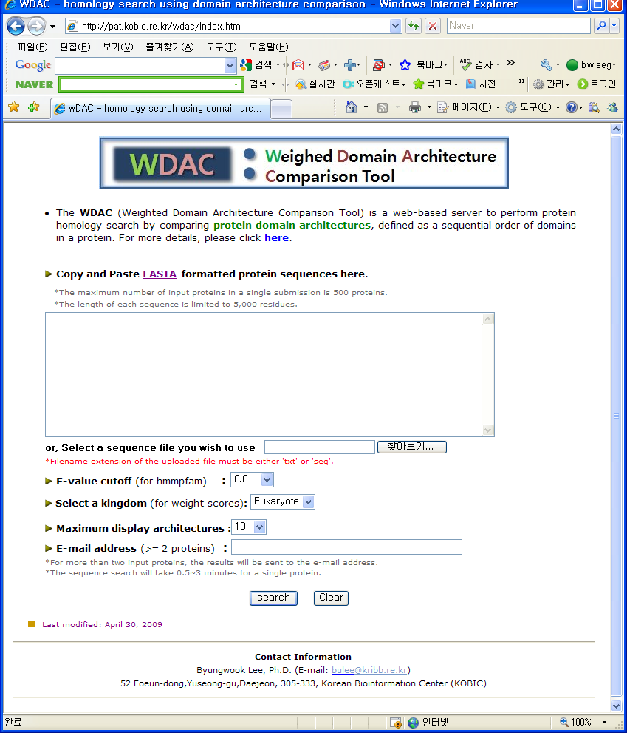
Construction of WDAC server
http://www.wdac.kr/

Slide 18
Construction of WDAC server
(A)
query
proteins
(B)
Domain assignment
with Pfam DB
RefSeq
Obtaining
domain architecture
Weight score
of domains
BLASTP
Domain architecture comparison
DADB
Sorting the matched architectures
Combining the sorted
domain architectures
and BLASTP results
Sending results
via e-mail

Slide 19
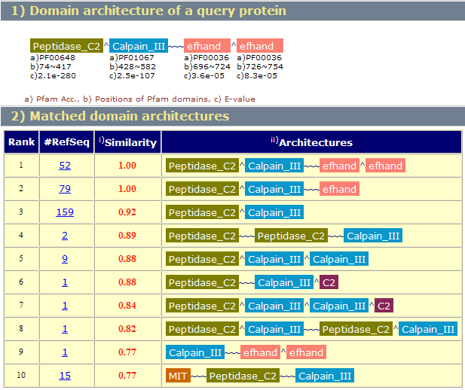
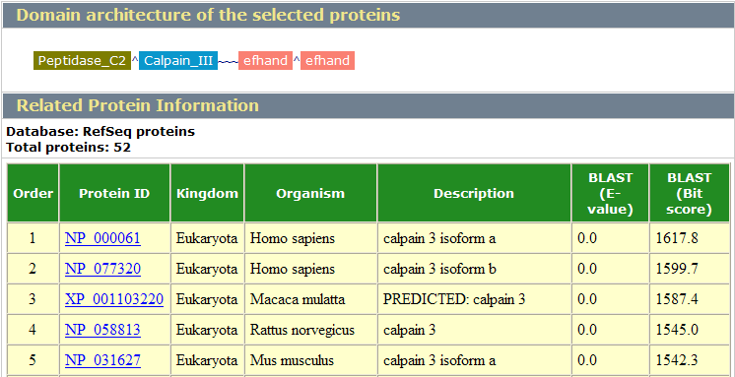
Results of WDAC
(A)
(B)

Slide 20
Conclusion
We developed a scoring measure to distinguish promiscuous domains from important domains.
We developed a new method, WDAC, to compare domain architectures using weight scores.
Considering domain promiscuity improves the accuracy of multi-domain proteins comparison.

