Slide 1
A sequence-based hybrid predictor for identifying conformationally ambivalent regions in proteins
Meng-Han Yang
September 9, 2009

Slide 2
Outlines
Background
Methods
  The QUICKRBF algorithm
  The RVKDE algorithm
  The hybrid predictor
  The training data set
  The testing data set
  Performance metrics
Results
  comparison with Boden’s predictor
  comparison with Kuznetsov’s predictor
Conclusion

Slide 3
Background (1/2)
Proteins are dynamic macromolecules which may undergo conformational transitions upon changes in environment, and protein flexibility is correlated to essential biological functions
  the GTPase Ras protein
  the U1 snRNP A from Homo sapiens
  the prion protein (PrP)
There were methods which identify conformationally flexible regions in proteins
  folding of protein tertiary structures
  analysis of protein sequences

Slide 4
Background (2/2)
In this atricle, we propose a novel approach to design a sequence-based predictor, which incorporates two classifiers based on two distinctive supervised learning algorithms, for identifying polypeptide segments that may fold to form different secondary structure elements in different environments
  the QUICKRBF algorithm
  the relaxed variable kernel density estimation (RVKDE) algorithm

Slide 5
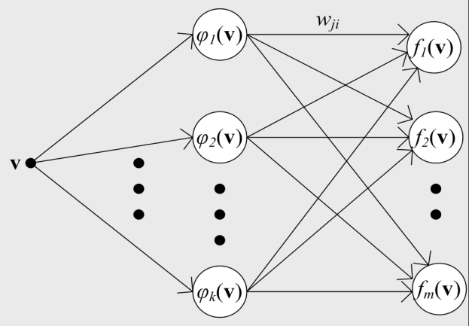
Methods: the QUICKRBF algorithm (1/2)

Slide 6
Methods: the QUICKRBF algorithm (2/2)
Structure of a RBF network
  The input layer broadcasts the feature vector of the input query sample
  Each node in the hidden layer generates its associated radial basis function
  Each node in the output layer computes a linear combination of radial basis functions associated to the hidden nodes

Slide 7
Methods: the RVKDE algorithm (1/2)
The RVKDE algorithm
  Randomly and independently select a set of sampling instances from the training set
  For each sampling instance, which is accompanied with its k’ nearest training instances, calculate the corresponding approximate probability density function

Slide 8
Methods: the RVKDE algorithm (2/2)
For data classification applications, one kernel density estimator is created to approximate the distribution of each class of training instances
A query instance located at v is predicted to belong to the class that gives the maximum likelihood value

Slide 9
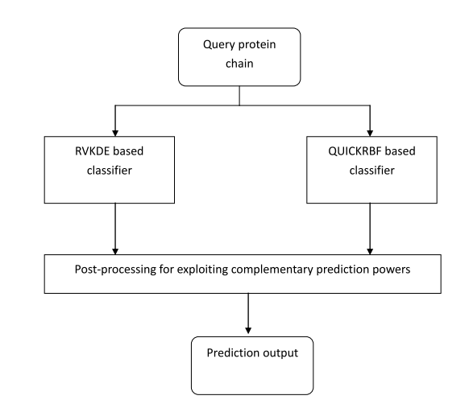
Methods: the hybrid predictor (1/2)

Slide 10
Methods: the hybrid predictor (2/2)
For each amino acid residue
  Both the QUICKRBF and the RVKDE classifiers predict this residue as conformationally ambivalent or rigid
  If the RVKDE classifier predicts it as conformationally ambivalent but the QUICKRBF classifier predicts it as rigid, check whether 3 of the 4 predictions by QUICKRBF for adjacent residues are ambivalent or rigid
  If the QUICKRBF classifier predicts it as conformationally ambivalent but the RVKDE classifier predicts it as rigid, check whether 3 of the 4 predictions by RVKDE for adjacent residues are ambivalent or rigid

Slide 11
Methods: the testing data set
The experiments reported in this article have been conducted with an independent testing data set which contains 170 protein chains from MolMovDB

Slide 12
Methods: the training data set (1/3)
All the protein chains in the PDB (released on 01-April-2008) that have the same entry name and primary accession number in SwissProt (release 55.1) are grouped (11084 groups)
The BLAST package is invoked to check the redundancy among the groups of protein chains (3496 groups)
The CLUSTALW package and the DSSP package are invoked to label each residue in the protein chains with secondary structure types
A conformationally ambivalent region is defined to be a segment of 3 or more consecutive residues within which each residue and the aligned residues have discrepant types of secondary structures

Slide 13
Methods: the training data set (2/3)
The training data set contains 3404 representative protein chains with a feature vector
The feature vectors are derived from the position specific scoring matrices (PSSM) computed by the PSI-BLAST package with sliding window size set to 7

Slide 14
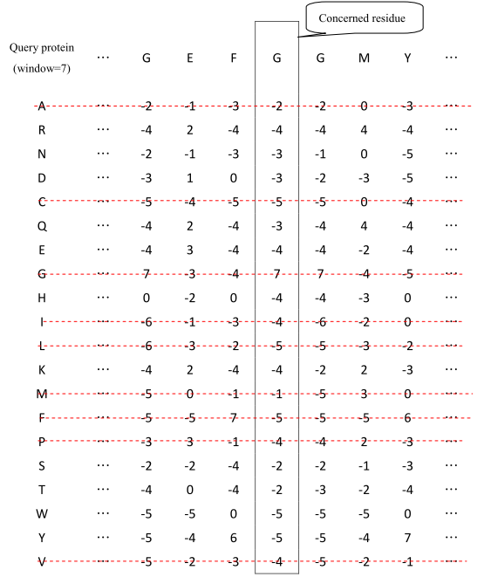
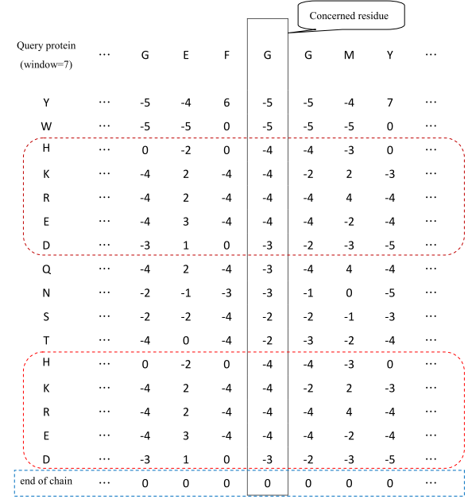
Methods: the training data set (3/3)

Slide 15
Results: performance metrics

Slide 16
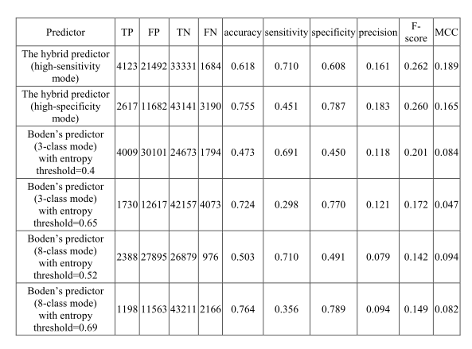
Results: comparison with Boden’s predictor

Slide 17
Results: comparison with Kuznetsov’s predictor (1/2)
By Kuznetsov’s definition, a residue in a protein chain is said to be flexible, if its phi degree varies more than 62 or its psi degree varies more than 68 in two different conformations
we labelled the residues in our collection of training protein chains based on Kuznetsov’s definition and then trained our hybrid predictor with this separately-generated training data set
The independent testing data set contains 137 protein chains; none of them is homologous to Kuznetsov’s or our training protein chains with sequence identity higher than 20%

Slide 18
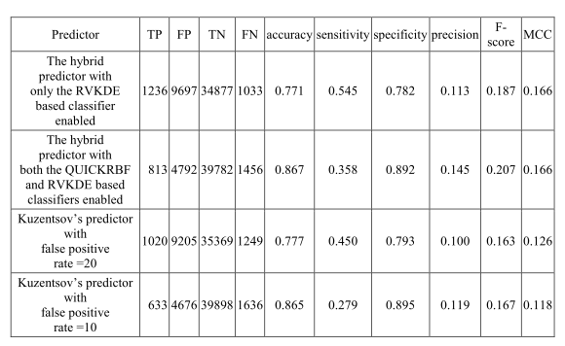
Results: comparison with Kuznetsov’s predictor (2/2)

Slide 19
Conclusion
Experimental results show that the overall performance delivered by the hybrid predictor proposed in this article is superior to the performance delivered by the existing predictors
Room for improvement
  Investigate how physiochemical properties of polypeptide segments can be more effectively exploited
  Investigate the effects of incorporating the lately-developed machine learning approaches, e.g. the random forest design and the multi-stage design

Slide 20
Q & A

Slide 21
Thank you for your attention!

