Slide 1
The example
Protein chain 1 | H H H H E E H H H
Protein chain 2 | H H H L L E L L H
Protein chain 3 | H H H E E E E E H

Slide 2
Discussion (1/3)
We will present a real case to demonstrate the effects delivered by the proposed hybrid predictor
  The protein Ap₄A hydrolase from Lupinus angustifolius L
  PDB ID 1JKN, with ligand ATP．MgF_{x}
  PDB ID 1F3Y, the free format

Slide 3
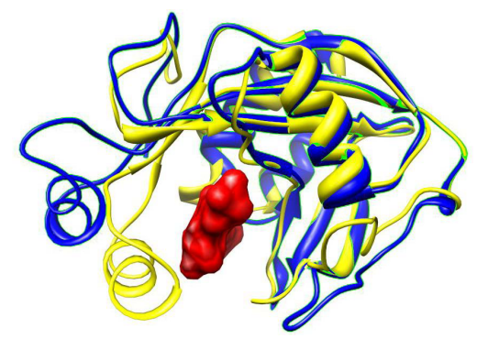
Discussion (2/3)

Slide 4
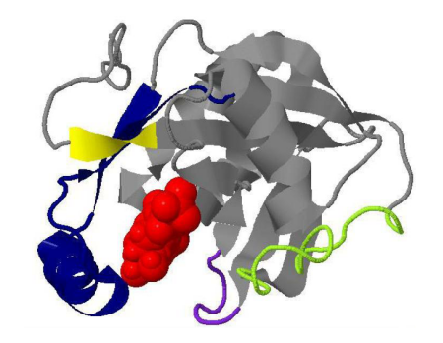
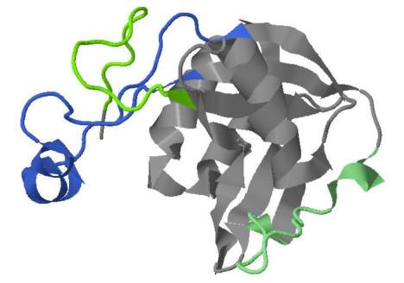
Discussion (3/3)

Slide 5
Peng K, Radivojac P, Vucetic S, Dunker AK, Obradovic Z: Length-dependent prediction of protein intrinsic disorder. BMC bioinformatics 2006, 7:208.
Hirose S, Shimizu K, Kanai S, Kuroda Y, Noguchi T: POODLE-L: a two-level SVM prediction system for reliably predicting long disordered regions. Bioinformatics (Oxford, England) 2007, 23(16):2046-2053.

