Slide 1
DNA-binding Residues and Binding Mode Prediction with Binding-Mechanism Concerned Models
Yu-Feng Huang¹, Chun-Chin Huang², Yu-Cheng Liu³, Yen-Jen Oyang^{1,4,5}, Chien-Kang Huang²*
¹ Department of Computer Science and Information Engineering
² Department of Engineering Science and Ocean Engineering
³ Institute of Biomedical Engineering
⁴ Graduate Institute of Biomedical Electronics and Bioinformatics
⁵ Center for Systems Biology and Bioinformatics
National Taiwan University, Taipei, Taiwan, Republic of China
International Conference on Bioinformatics 2009 (InCoB2009), 7-11 Sept 2009
Notes:
Opening: session chair, ladies & gentlemen, good afternoon. I’m Yu-Feng Huang from National Taiwan University.
It’s my pleasure to share our experience about “DNA-binding residues and binding mode prediction with binding-mechanism concerned models.” If you have any question, please feel free to interrupt me.
Explain the topic:
In this work, there are two issues should be discussed. One is DNA-binding residues prediction; another is binding mode prediction.
In DNA-binding residues prediction, given a sequence, what we do is to identify binding residues in a protein sequence. Further, we try to use prediction results to predict the binding mode. Why binding-mechanism concerned models should be addressed? It’s will be discussed later.

Slide 2
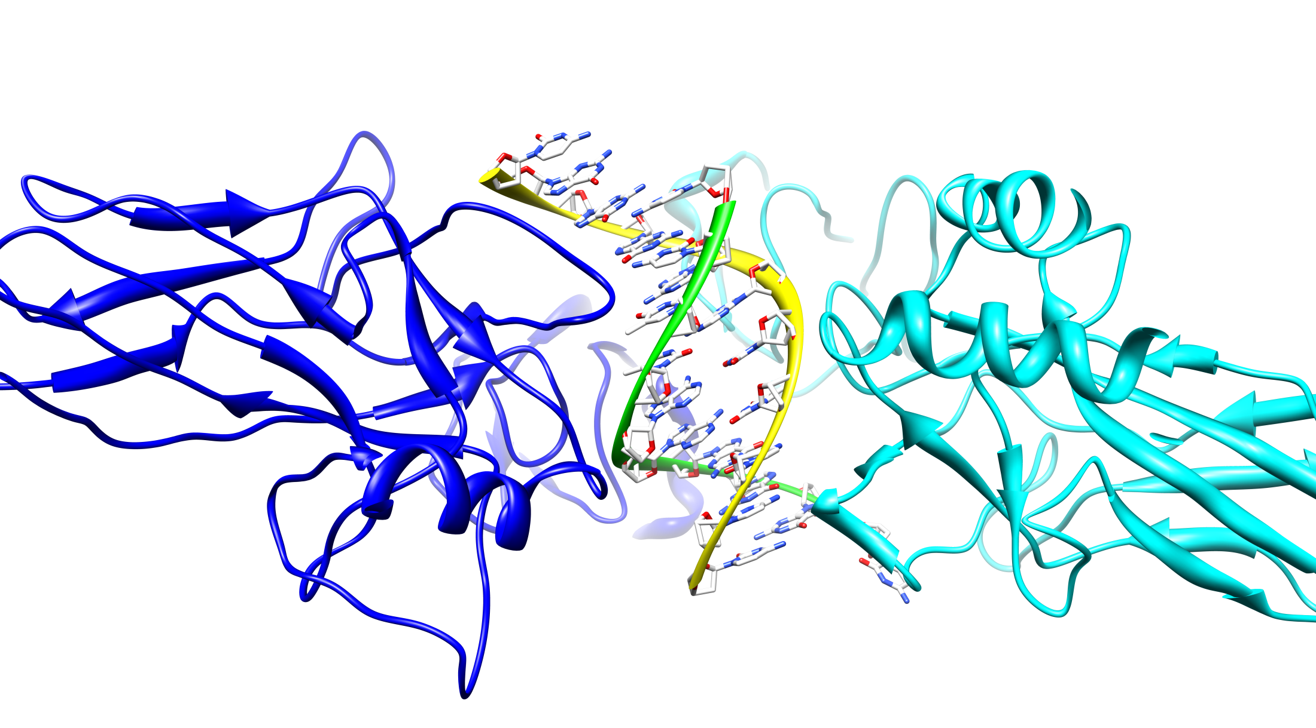
PDB 3DO7
Notes:
Now, lets take a look on this protein-DNA complex
Identify binding residues
Binding mode classification → functional/structural group
The interaction is majorly contributed by hydrogen bonding between amino acids and nucleic acids.
Binding residues and binding mode
characteristics

Slide 3
Introduction
Proteins that interact with DNA are involved in a number of fundamental biological activities such as DNA replication, transcription, recombination, and repair.
A reliable identification of DNA-binding sites in DNA-binding proteins is important for functional annotation, site-directed mutagenesis, and modeling protein–DNA interactions.
Insights into the mechanism of protein-DNA binding and recognition have come from extensive analysis of protein-DNA interfaces.
Most, if not all, proteins that interact with specific sites bind also nonspecifically to DNA with appreciable affinity.
Nonspecific interaction is an important intermediate step in the process of sequence-specific recognition and binding.
Notes:
DNA-binding proteins play an important role to

Slide 4
Introduction (cont’)
Transcription factors (TFs) are proteins that regulate gene expression, which serve as integration centers of the different signal-transduction pathways affecting a given gene.
TFs regulate cell development, differentiation, and cell growth by binding to a specific DNA site and regulating gene expression.
The tertiary structures of a large number of TFs are mostly disordered.
Sequence based analysis aimed at identifying the residues in a highly-disordered TF that play key roles in interaction with the DNA is essential for obtaining a comprehensive picture of how the TF functions.

Slide 5
Introduction (cont’)
Two types of binding mechanisms
  Sequence-specific (specific) binding
    A residue is regarded as involved in sequence-specific binding with the DNA, if one or more heavy atoms in its side-chain fall within 4.5 Å from the nucleobases of the DNA.
  Non-specific binding
    A residue is regarded as involved in non-specific binding with the DNA, if one or more heavy atoms in its side-chain fall within 4.5 Å from the nucleotide backbone of the DNA.
Notes:
The distance cutoff is a computational approximation to biological definition.
The biological definition is to measure the hydrogen bonding and van der Waals attractions.

Slide 6
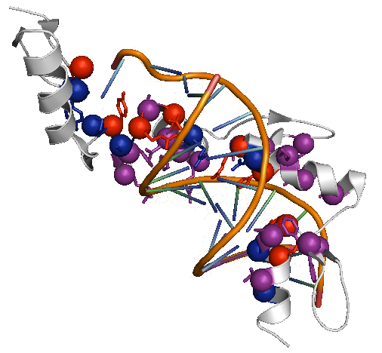
Specific Binding vs. Non-specific Binding
2PRT:A
Red: specific binding residues
Blue: non-specific binding residues
Purple: both
Notes:
Backbone is like a rail. Non-specific binding residues play a role to hold the DNA backbone. At the meanwhile, sequence-specific binding residues recognize the DNA nucleobase.

Slide 7
DNA-binding Mode
Luscombe et al. reported that protein-DNA interactions can be grouped into eight different structural/functional groups
  Zinc-coordinating
  Zipper-type
  Helix-turn-helix (HTH, including “winged” HTH)
  Other α-helix
  β-sheet
  β-hairpin/ribbon
  Others
  Enzymes
Luscombe NM, Austin SE, Berman HM, Thornton JM: An overview of the structures of protein-DNA complexes. Genome Biology 2000, 1(1):reviews001.001 - reviews001.037.

Slide 8
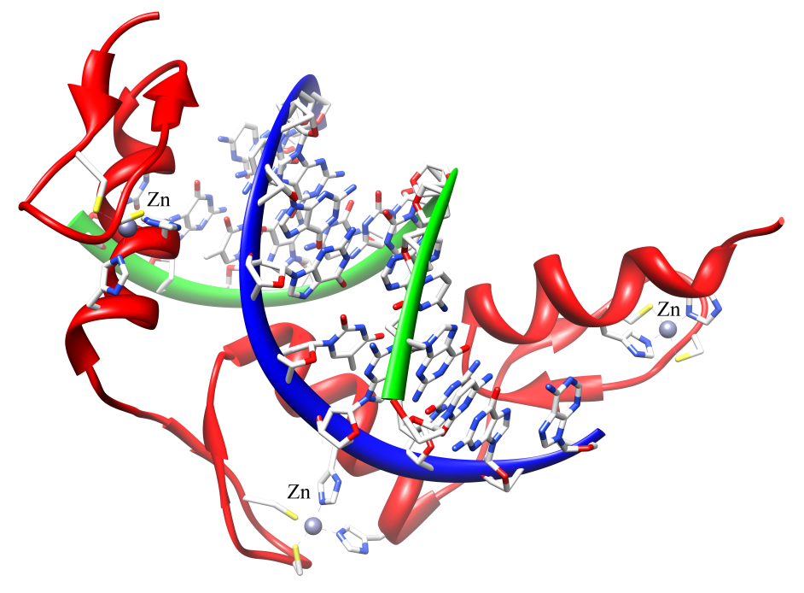
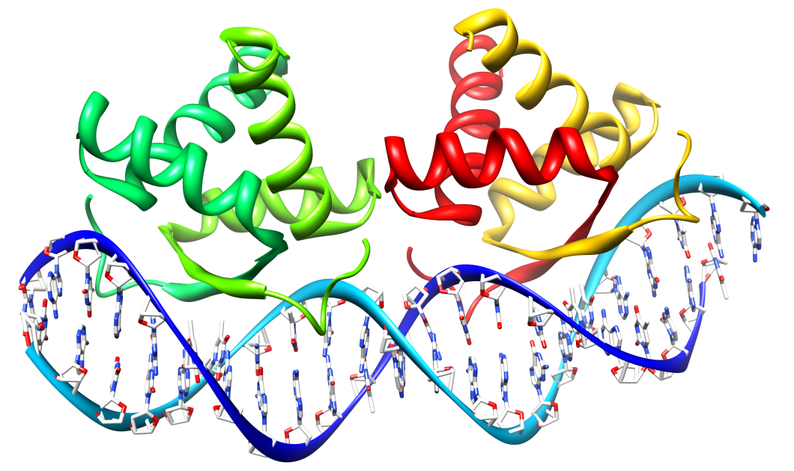
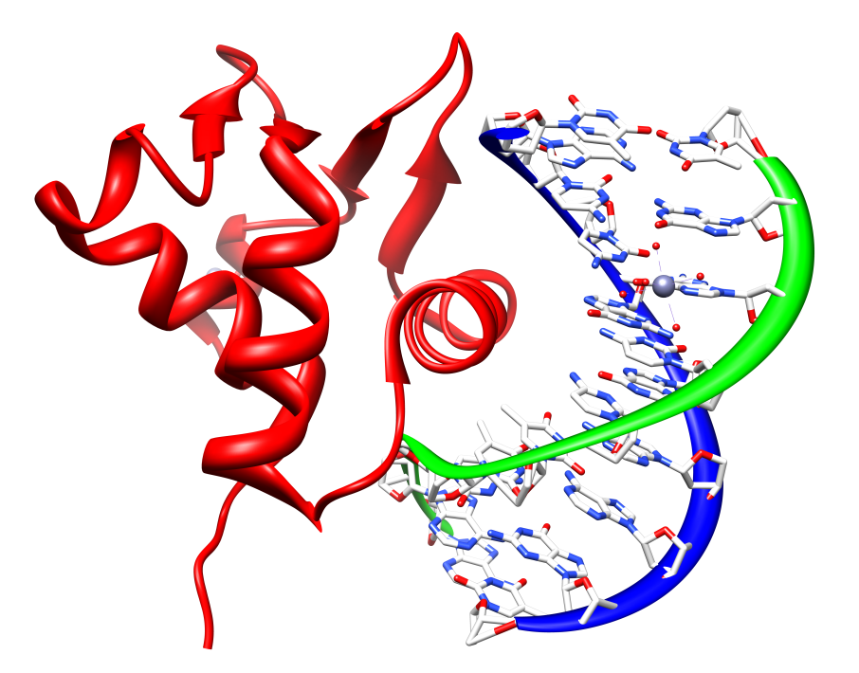
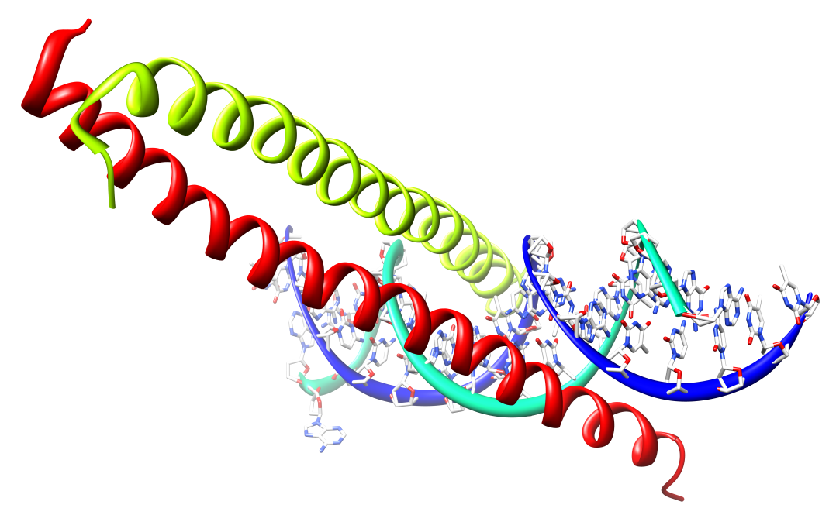
β-sheet, 1DBT
Zinc-coordinating, 1A1L
Zipper-type, 1YSA
HTH, 1BC8

Slide 9
Framework
query sequence
Sequence-specific binding residue prediction
Non-specific binding residue prediction
1st stage
Protein-DNA binding mode prediction
2nd stage

Slide 10
Method
Dataset
  253 TF-DNA complexes collected by Chu et al.
  Chu WY, Huang YF, Huang CC, Cheng YS, Huang CK, Oyang YJ: ProteDNA: a sequence-based predictor of sequence-specific DNA-binding residues in transcription factors. Nucleic Acids Res 2009, 37(Web Server issue):W396-401.
Classifier
  Libsvm package with the Gaussian kernel
  http://www.csie.ntu.edu.tw/~cjlin/libsvm/

Slide 11
Feature Set
1st stage
  Evolutionary profile - position specific scoring matrix (PSSM) computed by the PSI-BLAST package
  Sliding widow of neighborhood residues information – window size 11
  Labeling: 0: non-binding residues; 1: binding residues
2nd stage
  Predicted non-specific binding residues
    20 amino acids
    Secondary structure elements (α-helix, β-sheet, coil)
    # of binding residues
  Protein chain information
    Secondary structure elements (α-helix, β-sheet, coil)
    # of total residues in a protein chain
  Labeling: zipper-type, helix-turn-helix (HTH), zinc-coordinating, β-hairpin/ribbon, others

Slide 12
Performance Evaluation
In the experiments of the first stage, we repeated the same testing procedure 20 times with randomly and independently generated testing data sets.
The independent testing data set used in each run was derived from 30 TF chains randomly selected from the 253 TF-DNA complexes.
In order to eliminate possible bias present in our collection of TF complexes, we took steps to guarantee that no two TF chains used to generate the testing data set in the same run are homologous with a sequence identity higher than 20%.

Slide 13
Results and Discussion
Overall performance
Binding type | # of residues | TP | FP | TN | FN | Sensitivity | Specificity | Precision | Accuracy
Sequence-specific binding | 60466 | 1764 | 395 | 56553 | 1754 | 50.14% | 99.31% | 81.70% | 96.45%
Non-specific binding | 60466 | 4652 | 2454 | 49245 | 4115 | 53.06% | 95.25% | 65.47% | 89.14%
Specific+Non-specific | 60446 | 5651 | 2206 | 48321 | 4288 | 56.86% | 95.63% | 71.92% | 89.26%

Slide 14
Results and Discussion (cont’)
Performance breakdown in terms of secondary structure elements
Binding type | Secondary structure elements | # of residues | TP | FP | TN | FP | Sensitivity | Specificity | Precision | Accuracy
Specific | Helix | 32670 | 1322 | 279 | 20160 | 909 | 59.26% | 99.08% | 82.57% | 96.36%
 | Sheet | 5259 | 22 | 0 | 5077 | 160 | 12.09% | 100.00% | 100.00% | 96.96%
 | Coil | 22537 | 420 | 116 | 21316 | 685 | 38.01% | 99.46% | 78.36% | 96.45%
Non-specific | Helix | 32670 | 2197 | 1005 | 27458 | 2010 | 52.22% | 96.47% | 66.61% | 90.77%
 | Sheet | 5259 | 257 | 185 | 4524 | 293 | 46.73% | 96.07% | 58.15% | 90.91%
 | Coil | 22537 | 2198 | 1264 | 17263 | 1812 | 54.81% | 93.18% | 63.49% | 86.35%
Specific + Non-specific | Helix | 32670 | 2988 | 858 | 26783 | 2041 | 59.42% | 96.90% | 77.69% | 91.13%
 | Sheet | 5259 | 261 | 181 | 4472 | 345 | 43.07% | 96.11% | 59.05% | 90.00%
 | Coil | 22537 | 2402 | 1167 | 17066 | 1902 | 55.81% | 93.60% | 67.31% | 86.38%
The number of binding residues in β-sheet secondary structure elements is far fewer than the number of binding residues in either a-helix or coil elements.
As a result, our proposed method cannot learn sufficient clues in order to identify binding residues in β -sheet elements.

Slide 15
Results and Discussion (cont’)
Performance of protein-DNA binding mode prediction
Protein-DNA binding mode | # of protein chains | Sensitivity | Precision
zipper-type | 146 | 100.00% | 80.22%
helix-turn-helix (HTH) | 220 | 70.45% | 73.46%
zinc-coordinating | 166 | 68.07% | 88.98%
β-hairpin/ribbon | 38 | 34.21% | 52.00%
others | 30 | 93.33% | 50.91%
The prediction power of sequence-specific binding and non-specific binding residue on β -sheet structure is worse than that of α-helix and coil.
The reason we only use non-specific binding residues information as feature set is that non-specific binding residues play a role to stabilize the protein-DNA complex.

Slide 16
Results and Discussion (cont’)
Predictor | Sensitivity | Specificity | Accuracy | Precision | F-measure
Sequence-specific binding | 0.501 | 0.993 | 0.965 | 0.817 | 0.622
Non-specific binding | 0.530 | 0.953 | 0.891 | 0.655 | 0.586
Specific+Non-specific | 0.569 | 0.956 | 0.893 | 0.719 | 0.635
Ahmad and Sarai | 0.682 | 0.660 | 0.664 | 0.308* | 0.425*
Yan et al. | 0.410 | 0.871 | 0.780 | 0.439* | 0.424*
BindN (Wang and Brown) | 0.652 | 0.728 | 0.722 | 0.186* | 0.289*
DP-Bind (Hwang et al.) | 0.791 | 0.786 | 0.800 | –* | –*
*The numbers with an asterisk are those that have been derived from the numbers reported in the related studies.
Our proposed method is the only predictor listed in this table that has been designed to identify the residues involved in both sequence-specific and non-specific binding with the DNA, while all the other predictors do not distinguish between sequence-specific binding and non-specific binding.
It can be easily shown in mathematics that accuracy cannot be higher than sensitivity and specificity simultaneously, which is the case with the numbers reported by Hwang et al.
In terms of the F-score, our proposed method is capable of delivering superior performance in comparison with the related works.

Slide 17
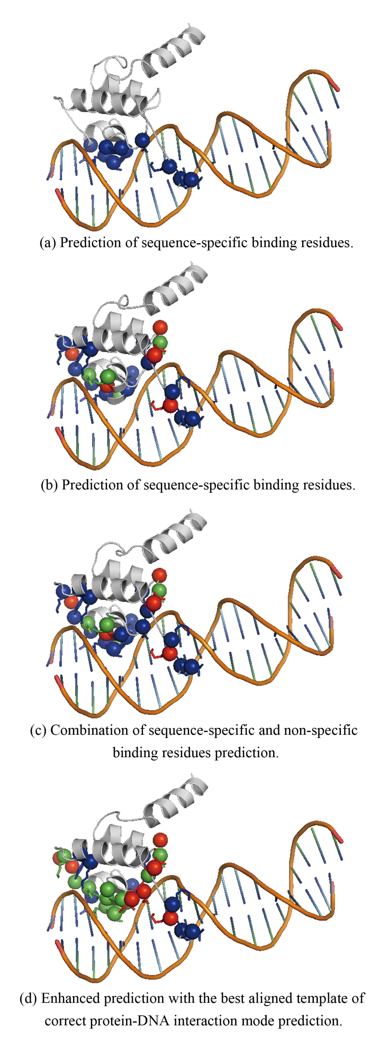
1LMB:A
Residues colored by red means false positive.
Residues colored by blue means false negative.
Residues colored by green means true positive.
It is obviously that correct binding mode prediction can greatly help the binding residues prediction, especially in difficult case.
However, this idea needs more investment to derive a systematic approach.

Slide 18
Modified Framework
query sequence
Sequence-specific binding residue prediction
Non-specific binding residue prediction
1st stage
Protein-DNA binding mode prediction
2nd stage

Slide 19
Conclusions
The tertiary structures of a large number of transcription factors are mostly disordered.
It is highly desirable to have a predictor capable of identifying those residues involved in sequence-specific binding and non-specific binding with the DNA.
Our proposed method has been able to deliver
  precision 81.70% and 65.47% in sequence-specific and non-specific binding residue prediction respectively
  deliver sensitivity 56.85% while combining prediction results of specific binding and non-specific binding.
Concerning a specific type of proteins, a specifically designed predictor should be able to deliver superior performance in comparison with a general-purpose predictor.

Slide 20
Thank you for listening.

Slide 21
Q & A

Slide 22
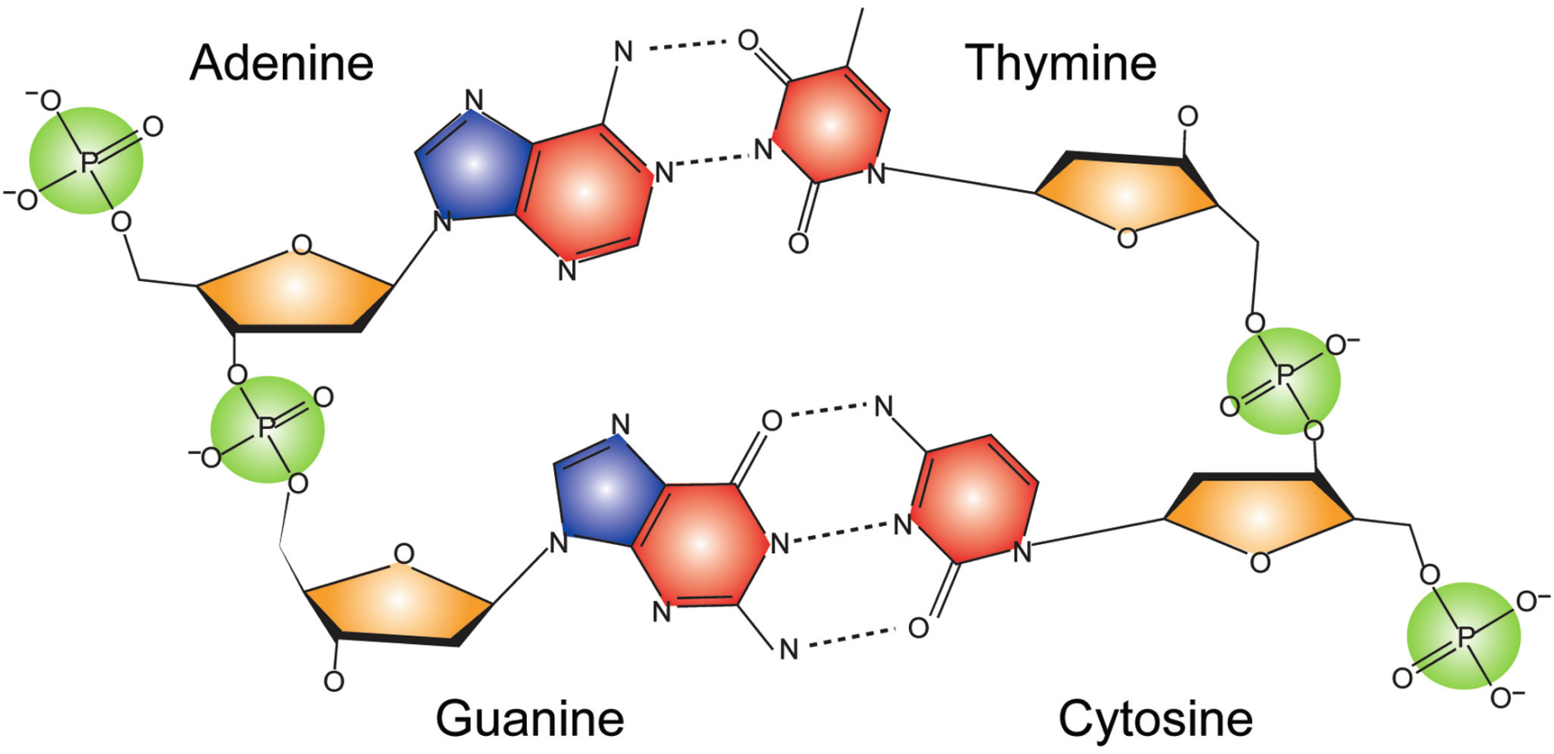
DNA Structure
nucleotide base
nucleotide backbone
(sugar phosphate backbone)
Image source: doi:10.1093/nar/gkn332

Slide 23
Why 4.5 Å?
The threshold of distance cut-off is based on hydrogen bonding and van der Waals attractions
  A hydrogen bond was defined as having a maximum donor–acceptor distance of 3.35 Å and maximum hydrogen–acceptor distance of 2.7 Å.
  Atoms were considered to form van der Waals contacts if the distance between them was 3.9 Å and the contact had not been defined as a hydrogen bond

Slide 24
Parameter Selection
1st stage
  Leave-One-Out cross validation
2nd stage
  Leave-One-Out cross validation
  Multi-class prediction using one-against-one approach
 | Cost (C) | Gamma (γ) | W₀ | W₁
Specific-binding | 2² | 2⁻⁵ | 1 | 1.5
Non-specific binding | 2⁰ | 2⁻⁵ | 1 | 2

Slide 25
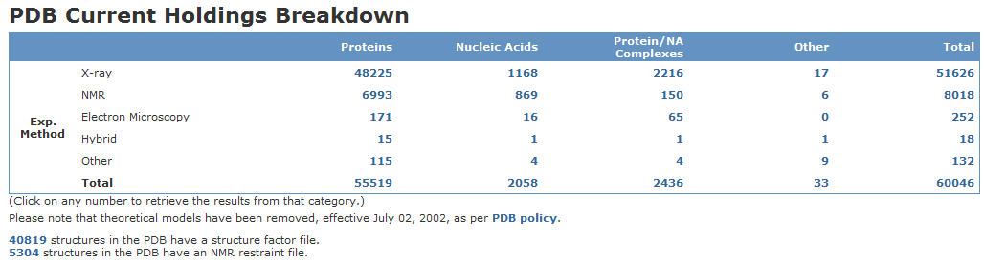
Data update: 2009/09/08

