Slide 1
Computational identification and experimental validation of PPRE motifs in NHE1 and MnSOD genes of Human
Gireedhar V; Kumar AP; Loo SY; Pervaiz S; Clement MV; and Sakharkar MK
Presenting author: Gireedhar Venkatachalam
International Conference on Bioinformatics (InCoB)

Slide 2
Brief overview
1) Introduction to PPAR (Peroxisome Proliferator Activated Receptor) and PPRE (Peroxisome Proliferator Response elements)
2) Aims and PPRE prediction
3) PPARγ, NHE1 and MnSOD in Breast cancer
4) Computational Prediction of PPREs in NHE1 and MnSOD
5) Experimental Validation of PPREs in NHE1 and MnSOD
6) Conclusion

Slide 3
Brief overview
1) Introduction to PPAR (Peroximsome Proliferator Activated Receptor) and PPRE (Peroximsome Proliferator Response elements)
2) Aims and PPRE prediction
3) PPARγ, NHE1 and MnSOD in breast cancer
4) Computational Prediction of PPREs in NHE1 and MnSOD
5) Experimental Validation of PPREs in NHE1 and MnSOD
6) Conclusion

Slide 4
PPAR AND PPREs
PPARs belong to the nuclear receptor super family and are ligand activated transcription factors, regulating a wide variety of genes
Three isoforms (α, β and γ) for PPAR
PPARs are involved in lipid metabolism and induces differentiation and inhibit proliferation in a variety of cancer cells
Co activators
or Co repressors
PPAR
RXR
Ligand
DBD
DBD
 | PPRE |  | TATA | TARGET GENE
Peroxisome Proliferator Respose element
C | A | A | A | A | C | T | A | G | G | T | C | A | N | A | G | G | T | C | A
Flanking |  |  |  |  |  |  | Hexamer 1 |  |  |  |  |  | Spacer | Hexamer 2
Direct Repeat 1
Notes:
Repressors NCOR, SMRT activators P3100

Slide 5
Brief overview
1 ) Introduction to PPAR (Peroximsome Proliferator Activated Receptor) and PPRE (Peroximsome Proliferator Response elements)
2) Aims and PPRE prediction
3) PPARγ, NHE1 and MnSOD-Breast cancer
4) Computational Prediction of PPREs in NHE1 and MnSOD
5) Experimental Validation of PPREs in NHE1 and MnSOD
6) Conclusion

Slide 6
Aim of the study
Recently it is shown that PPARs also bind to DR2 repeats (AGGTCA NN AGGTCA) (Fontaine et al.,2003; AP Kumar et al.,2004)
Flanking sequence plays a significant role in PPARs specificity and binding (Palmer et al., 1995)
Nuclear receptor- competitive binders (Harikrishna et al., 1998)
Notes:
Role of nuclear receptors in cancer therapy we thought it will be a very good idea to setup a database to incorporate the new findings

Slide 7
PPRE Prediction
Collection of PPRE database
  Contains 414 reported PPRE motifs from literature.
  The sequences reported only with experimental validation were added to this database.
  PPRE element in database - reported consensus, isoform specificity, in vivo and in vitro binding efficiencies and Pubmed IDs

Slide 8
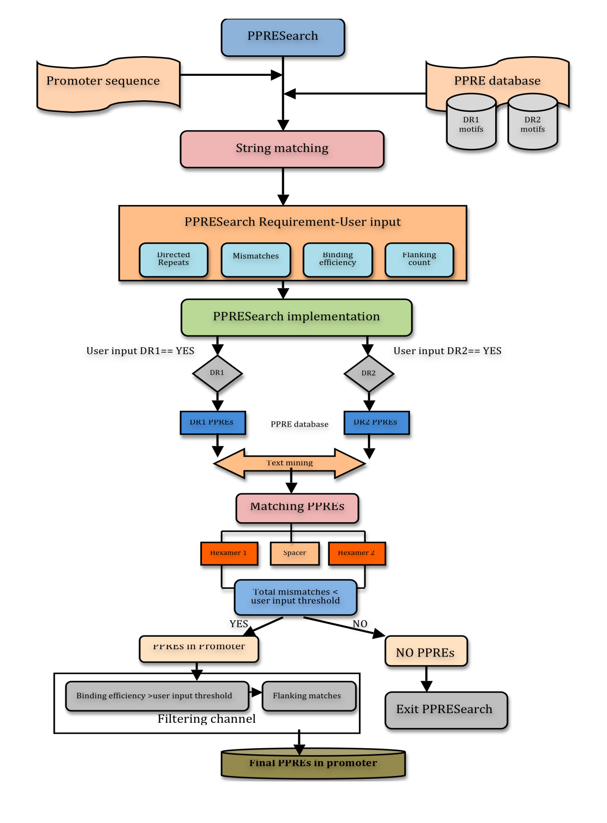
PPRE Prediction-Text mining

Slide 9

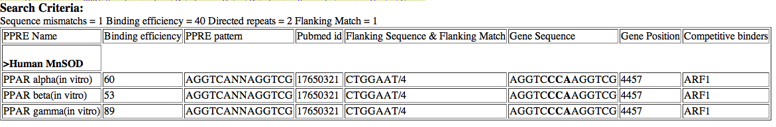
PPRESearch Webserver

Slide 10
Brief overview
1) Introduction to PPAR (Peroximsome Proliferator Activated Receptor) and PPRE (Peroximsome Proliferator Response elements)
2) PPRE prediction
3) PPARγ, NHE1 and MnSOD-Breast cancer
4) Computational Prediction of PPREs in NHE1 and MnSOD
5) Experimental Validation of PPREs in NHE1 and MnSOD
6) PPARγ as novel therapeutic approach in breast cancer therapy
Notes:
Numerous studies have shown PPAR gamma targets cancer. Shown decrease BCL2 repress cyclin b1 increase brac 1 increase PTEN inhibit ERB signalling. Even thought these genes are identified there is inconclusive evidennce these genes are direct responsbile for antitumor activity of PPAR gamma
Previo

Slide 11
Breast cancer - PPARγ, NHE1 and MnSOD
Breast cancer
?
?
NHE1 ( Sodium Hydrogen Exchange 1)
MnSOD (Manganese Superoxide dismustase)
Function :
NHE1 deficient cells- either fail to grow or show retarded growth ( Liu et al., 2008)
Function :
Downregulaion of MnSOD expression decreases cancer cells invasive property (Kattan et al., 2008)
?
PPARγ
?
Tumor breast tissue expresses PPARγ higher than normal breast epithelium
Notes:
Direct silencing of NHE1 and MnSOD leads to decrease tumor growth in long term colony forming assay.
Considering the abundance of PPARγ receptor and elevated NHE1 expression in a variety of cancer cells including breast cancer and their absolute dependence on MnSOD it is of interest to explore PPARγ agonists for selectively tailoring the expression of NHE1 and MnSOD.
pH_{i} and cell volume, the ubiquitously expressed NHE1 has been implicated in cell proliferation and transformation . Conversely, tumor cells deficient in NHE1 either fail to grow or show severely retarded growth
ROS stress seems to render cancer cells more dependent on MnSOD to protect them by maintaining cellular ROS balance. The importance of MnSOD became clearer when genetic knockout studies in mice indicate that MnSOD, but not other SODs, is essential for cell survival.
that forced suppression of MnSOD expression by siRNA leads to decrease in breast cancer cells invasive property [30]and to sensitization of ovarian cancer cells to anti-cancer drugs

Slide 12
Brief overview
1) Introduction to PPAR (Peroximsome Proliferator Activated Receptor) and PPRE (Peroximsome Proliferator Response elements)
2) PPRE prediction
3) Breast cancer-PPARγ, NHE1 and MnSOD
4) Computational Prediction of PPREs in NHE1 and MnSOD
5) Experimental Validation of PPREs in NHE1 and MnSOD
6) Conclusion

Slide 13
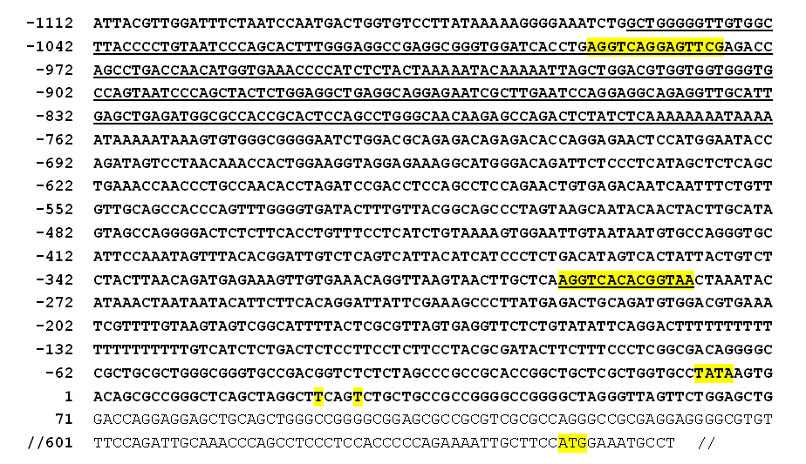
PPREs in NHE1
PPRE1
Sequence ID:
NCBI-GI: 27777632
NCBI-GeneID: 6548
Ensembl: ENSG00000090020
PPRE2
PPRE1
PPRE2
Notes:
Alu has other nuclear receptor next to it DR2(ER receptor and SP1) DR4 (L(liver x receptor )XR,TR,F(farcinoid) XR DR2 (PPAR and RAR)
ADD other nuclear receptors

Slide 14
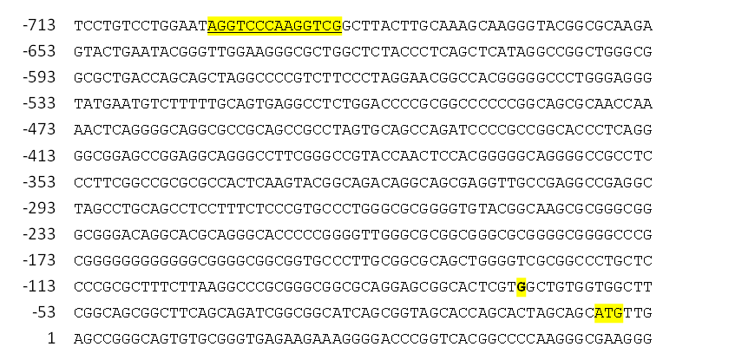
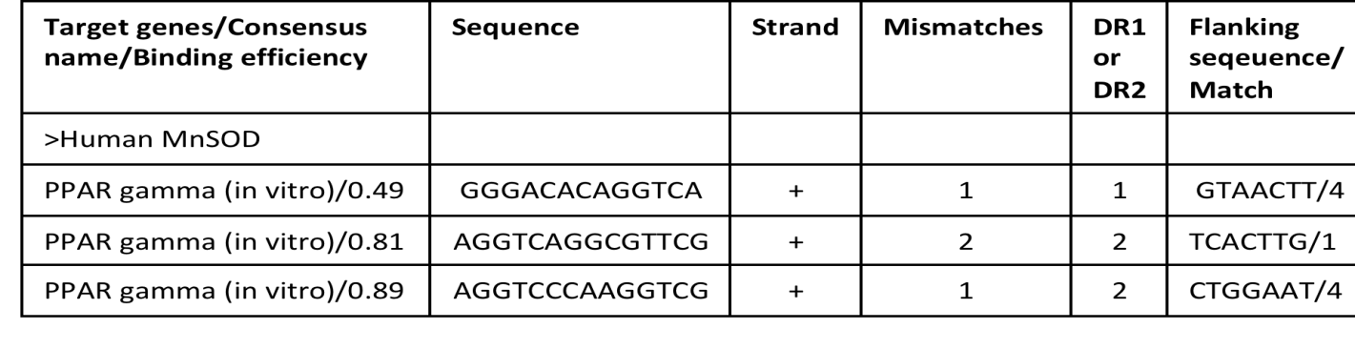
PPREs in MnSOD
PPRE1
-2742 TGCAGAGGACATCCTGAGCTGGCTGGAGTAACTTGGGACACAGGTCAAT
PPRE2
-1673 ACTTGAGGTCAGGCGTTCGAGACCATCCTGACCAACATAGTGAAACCCCGT
PPRE3
Sequence ID:
NCBI-GI: 67782305
NCBI-GeneID: 6648
Ensembl: ENSG00000112096
PPRE1
PPRE3
PPRE2

Slide 15
Brief overview
1) Introduction to PPAR (Peroximsome Proliferator Activated Receptor) and PPRE (Peroximsome Proliferator Response elements)
2) PPRE prediction
3) Breast cancer-PPARγ, NHE1 and MnSOD
4) Computational Prediction of PPREs in NHE1 and MnSOD
5) Experimental Validation of PPREs in NHE1 and MnSOD
6) Conclusion

Slide 16
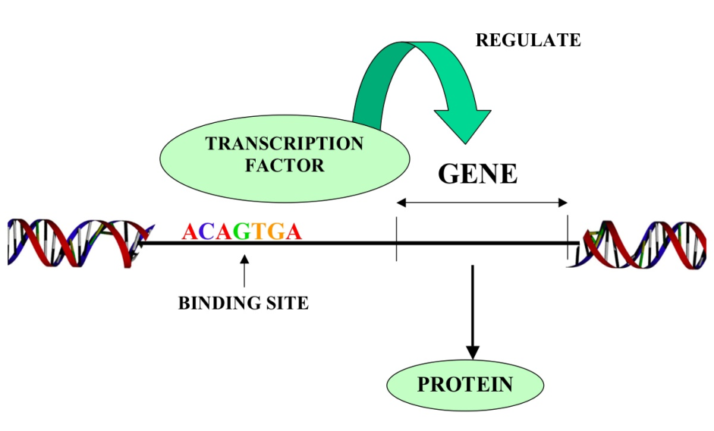
Experimental validation setup
Breast cancer cells (MCF7,MDA-MB-231,MDA-MB-468)
15d-PGJ₂
NHE1
PPAR gamma
Maintains pH
Nucleus
NHE1
MnSOD
mRNA,
protein level,
Promoter activity
and in vitro
binding assay
AGGTCA G AGGTCA
?
Cytoplasm
MnSOD
ROS Balance

Slide 17


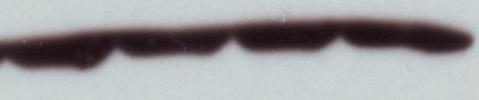



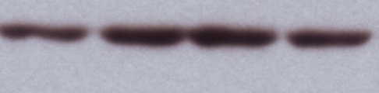

NHE1 and MnSOD repression upon PPARγ activation
120
100
3µM 15d-PGJ₂
5µM 15d-PGJ₂
80
5µM 15d-PGJ₂
10µM 15d-PGJ₂
NHE1 mRNA
60
MnSOD mRNA
% from untreated
40
20
0
MCF-7
MDA-MB-231
15d-PGJ₂/µM
15d-PGJ₂/µM
0 3 5 10
0 1 3 5
MnSOD
MCF-7
NHE1
MDA-MB-231
β-actin
β-actin
15d-PGJ₂/µM
15d-PGJ₂/µM
0 1 3 5
0 3 5 10
NHE1
MDA-MB-468
MnSOD
MDA-MB-231
β-actin
β-actin
NHE1
MnSOD
Notes:
Activation of PPAR gamma does regulate NHE1 and MNSod indeed down regulate by PPAR gamma MDA231 high level of PPAR gamma THAN MCF

Slide 18
PPRE1 - PPARγ binding site in NHE1
Human NHE1 promoter constructs
PPRE 1
PPRE 2
TGAGGTCAGGAGTTCGAG
CAAGGTCACACGGTAACT
TATA
CAT
-1374/+16
TATA
CAT
-850/+16
0.9
0µM
0.8
3µM
0.7
5µM
0.6
absorbance at 405nm/μg total protein
-1374 has PPRE1, and PPRE2
0.5
Human NHE1 promoter activity
-850 has only PPRE2
0.4
0.3
0.2
0.1
0
-1374
-850

Slide 19
PPARγ binding site in MnSOD
Human MnSOD promoter constructs
PPRE 1
PPRE 2
PPRE 3
CTTGGGACACAGGTCAAT
TGAGGTCAGGCGTTCGAG
ATAGGTCCCAAGGTCGGC
TATA
LUCIFERASE
-3400 to +24 pGL3
TATA
LUCIFERASE
-1605 to +24 pGL3
TATA
LUCIFERASE
-555 to +24 pGL3
0µM
3µM
5µM
Human MnSOD promoter activity
-3405 has PPRE1, PPRE2, and PPRE3
-1605 has PPRE2 and PPRE3
-555 has no PPRE1, PPRE2, or PPRE3

Slide 20

PPRE3-PPARγ binding site in MnSOD
0µM
3µM
PPARγ binding assay
5µM
Notes:
Predicted score

Slide 21
Brief overview
1) Introduction to PPAR (Peroximsome Proliferator Activated Receptor) and PPRE (Peroximsome Proliferator Response elements)
2) PPRE prediction
3) Breast cancer-PPARγ, NHE1 and MnSOD
4) Computational Prediction of PPREs in NHE1 and MnSOD
5) Experimental Validation of PPREs in NHE1 and MnSOD
6) Conclusion

Slide 22
Conclusion
We have constructed a better in silico approach to finding genes containing PPRE in their promoter region
Our approach helps us to identify both DR1 and DR2 sites
Importance of flanking sequence were incorporated.
It is our hope with this PPRESearch database, researchers in the field of PPARs would better identify new target genes which could then be translated into the clinic for intervention.

Slide 23
Thank you

Slide 24
Questions?

Slide 25
PPARγ as novel therapeutic approach in breast cancer therapy
15d- PGJ₂
represses
NHE1
cell proliferation
PPAR gamma
sensitizes
Breast cancer death
represses
MnSOD
Invasive property
sensitizes
Notes:
Change the conclusion shows PPREsearch

Slide 26
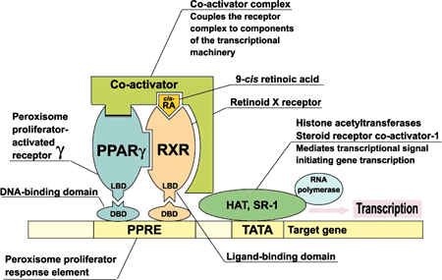
PPARs and PPRE
PPAR α, β, and γ isoforms share a highly conserved DNA binding domain that recognizes specific DNA sequences known as Peroxisome Proliferator Response Elements (PPREs)
PPAR/RXR complex then binds to PPRE composed of a
  Direct Repeat (DR) preferably spaced by one nucleotide (DR1) with a consensus sequence of AGGTCA-A-AGGTCA
  Direct Repeat (DR) preferably spaced by two nucleotide (DR2) with a consensus sequence of AGGTCA-GG-AGGTCA.

Slide 27
Transcription factor analysis
Transcription factor might be deﬁned as any molecule participating, alone or as part of a complex, in the binding to a gene’s enhancer response element or promoter, with the ultimate outcome being the up- or down-regulation of expression of that gene.
Transcription factors participate in stress pathways in cancer by causing the up- or down-regulation of speciﬁc genes.

Slide 28
Transcription factor analysis
Signal
Transcription factors
Pathways
Cellular processes affected
Gene expression up and downregulation
Targeting cancer
Target proteins

