Slide 1

School of Computer Engineering
Master of Science
(Bioinformatics)
presented by
A/P Kwoh Chee Keong
2009

Slide 2

About NTU – World Ranking
Rank 15th - Amongst Technology Universities *
Rank 61st - Globally *
*Source from The Times Higher Education Supplement (THES 2007)
Rank 4th - Globally in Engineering Publications ⁺
Rank 16th - Globally in Materials Science Publications ⁺
Rank 17th - Globally in Computer Science Publications ⁺
⁺Source from ISI Web of Knowledge

Slide 3
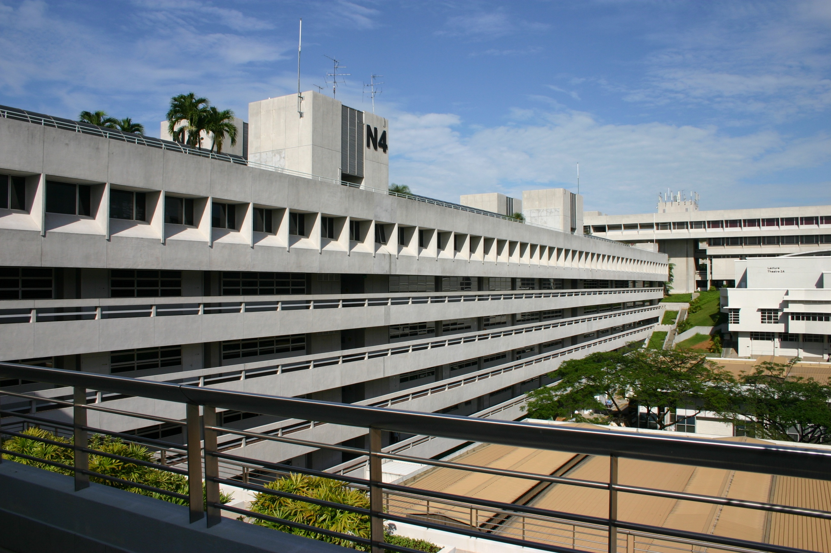
Our Mission
To achieve teaching excellence, world-class research and leadership development in computer engineering.
Our Vision
To foster an innovative and entrepreneurial community.
To prepare graduates for lifelong learning and leadership.
To conduct cutting edge research in collaboration with industry leaders and renowned institutions worldwide.

Slide 4

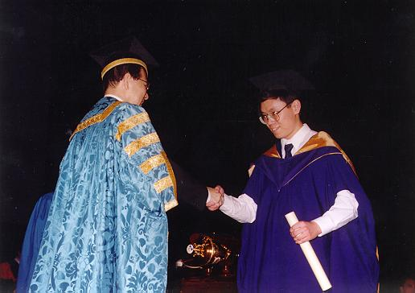
Graduate Studies
Master of Science Programmes

Slide 5

Graduate Studies
Master of Science (Bioinformatics )
2 years part-time programme or 1 year full-time
Coursework only or Coursework + Dissertation

Slide 6
Graduate Studies
Candidates are offered with 2 Options of Study:
Option 1 : Coursework and Dissertation(FT & PT)
Candidates are required to complete 8 subjects, with a combination of core subjects and electives, and submit a dissertation on a project.
Option 2: Coursework only (PT)
Candidates are required to complete 10 subjects, with a combination of core subjects, electives, and a compulsory subject entitled ‘Directed Reading' .

Slide 7
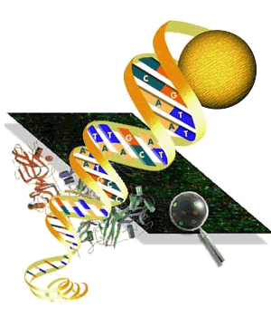

Graduate Studies
Master of Science (Bioinformatics)
Bioinformatics is the application of computer technology to the management of biological information and answer biological questions.
Our model: core training in technical field and specialty training in computational biology from a system’s perspective.

Slide 8

Graduate Studies
Master of Science (Bioinformatics)
It is designed for students who have relevant scientific and technical background (engineering or science degree).
The curriculum provides them with skills for the creation of excellent well-validated methods for solving problems in the domain of bioinformatics and related fields

Slide 9
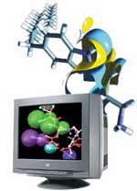
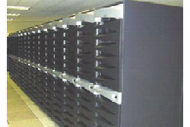
Graduate Studies
Master of Science (Bioinformatics)
Promising career options in the Life Sciences industry which is recognised as an important area of growth and socio-economic development.
Advanced research centre BIRC (BioInformatics Research Centre) provides the interdisciplinary environment and training for students of this programme.

Slide 10

Graduate Studies
Master of Science (Bioinformatics)
Entry Requirements
A relevant computer or engineering degree and basic programming skills.
Preference will be given to those with honors, and relevant working or postgraduate experience.
A TOEFL score of 570 for paper-based examination (or 230 for computer-based examination) is required for graduates of universities with non-English medium of instruction.

Slide 11
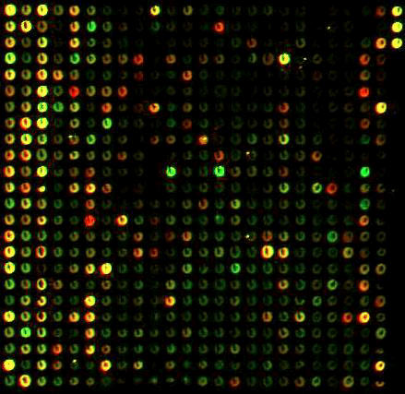
Basic Topics in Bioinformatics
Text Mining
Biology Literature
…
…
Gene expression & regulation
Genes
Proteins (Function)
DNA Sequences
Microarray data
Protein Sequences
AATTCATGAAAATCGTATACTGGTCTGGTACCGGC
TGAGAAAATGGCAGAGCTCATCGCTAAAGGTA
TCTGGTAAAGACGTCAACACCATCAACGTGTC
ACATCGATGAACTGCTGAACGAAGATATCCTG
TTGCTCTGCCATGGGCGATGAAGTTCTCGAGG
MKIVYWSGTGNTEKMAELIAKGIIESGKDV
DELLNEDILILGCSAMGDEVLEESEFEPFIE
KVALFGSYGWGDGKWMRDFEERMNGYG
PDEAEQDCIEFGKKIANI
Genomics
Transcriptomics
Proteomics

Slide 12



Slide 13
Mode of Assessment
Written Examination (Typically 3 hrs)
Individual Assignment
Group Assignment (~ 8 weeks)
  Collaborative project in small groups (~ 5 students)
  Produce a report on a given topic.
    Completed for peer-learning
    Broad, inter-disciplinary topics, not covered in lectures

Slide 14
MSc in Bioinformatics
The program starts and gives students enough time to learn about tool use and later on tool development.
The six core modules are: two biology modules; an introductory bioinformatics module, which train students to be proficient tool users; a statistics module; and two modules on algorithms for bioinformatics, which train students to put together new efficient tools besides being able to apply existing tools.

Slide 15
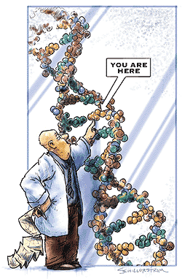
BI6101 Introductory Biology
Lectures
  Overview of the Life Sciences 3 hrs
  The Building Blocks of Life 3 hrs
  Molecular Genetics 9 hrs
  Cell Biology 6 hrs
  Biochemistry – Cellular Energetics 3 hrs
  Patterns of Inheritance (Classical Genetics) 3 hrs
  Developmental Biology 3 hrs
  Ecology and Evolution 6 hrs
Practical sessions
  Cell and Molecular Biology 3 hrs
  Genetics 3 hrs
  Unity and Diversity of Life (Ecology and Evolution) 3 hrs
  Human Physiology 3 hrs

Slide 16
BI6102 Introductory Bioinformatics
Part I: Sequence Alignment
Multiple sequence alignment of 7 neuroglobins
Notes:
The selected region is highly conserved with a generic globin.

Slide 17
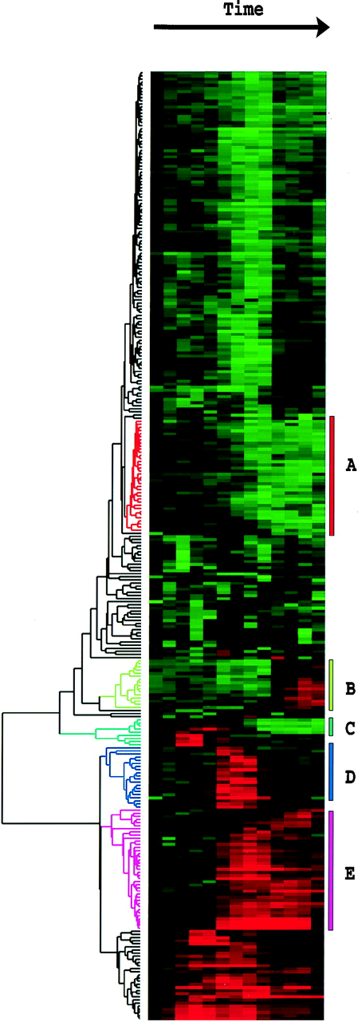
BI6102 Introductory Bioinformatics Part II: Microarray data clustering

Slide 18
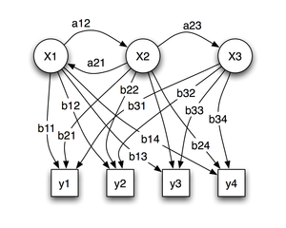
BI6103 Computational Biology
Biological and Mathematical foundations (6 hrs)
Probabilistic models of sequences (6 hrs)
Hidden Markov models and gene structure prediction (6 hrs)
Protein structure prediction (6 hrs)
Motif detection (3 hrs)
Detection of gene features (3 hrs)
Recognition of protein features (3 hrs)
Protein-protein interactions (3 hrs)
Revision (3hrs)

Slide 19
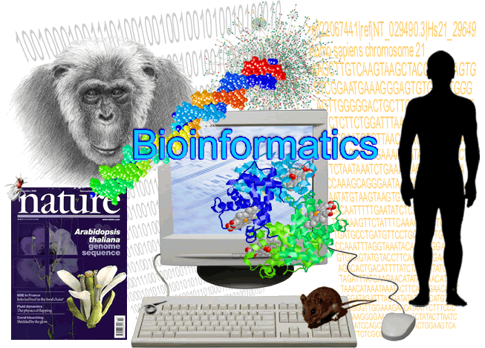
Graduate Studies
Master of Science (Bioinformatics)
Core subjects include:
Introductory Biology
Introductory Bioinformatics
Computational Biology
Advanced Biology
Biostatistcs
Algorithms for Bioinformatics

Slide 20
MSc in Bioinformatics
After taking all six core subjects the students are expected to be proficient in implementing, improving and creating new software tools and methods for analyzing and organizing data.
Once this core foundation is laid, the students can moved on to select more current and diverse topics in bioinformatics

Slide 21
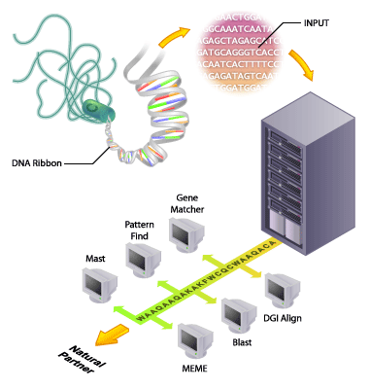
Graduate Studies
Master of Science (Bioinformatics)
Some electives include:
High Performance Computing for Bioinformatics
Methods and Tools of Proteomics
Database Systems
Special Topics in Bioinformatics
Directed Reading *

Slide 22
Recommended Timetable full-time candidate
Semester 1
Complete the courses:
  BI6101 Introductory Biology
  BI6102 Introductory Bioinformatics
  BI6104 Biostatistics
  BI6106 Algorithms for Bioinformatics
  One elective
Semester 2
Complete the courses:
  BI6103 Computational Biology
  BI6105 Advanced Biology, and
  One electives.
Full Year
Undertake the project and complete the project dissertation.

Slide 23
Recommended Timetable
Part-time candidate
Year 1
Semester 1: To complete the core courses
  BI6101 Introductory Biology
  BI6102 Introductory Bioinformatics
Semester 2: To complete the core courses
  BI6103 Computational Biology
  BI6105 Advanced Biology
  and elective
Year 2
Semester 1: To complete the core courses
  BI6104 Biostatistics
  BI6106 Algorithms for Bioinformatics
Semester 2: To complete
  (a) the remaining elective and the project dissertation,
Or
  (b) the remaining three electives.

Slide 24



Adjunct Professors
Due to the multidisciplinary nature of the program, the teaching faculty is drawn from the whole range of engineering and science schools in NTU
Furthermore, there are several adjunct faculty members from GIS, I2R, BII and the National Cancer Centre
  Who contribute significantly in teaching and supervision

Slide 25
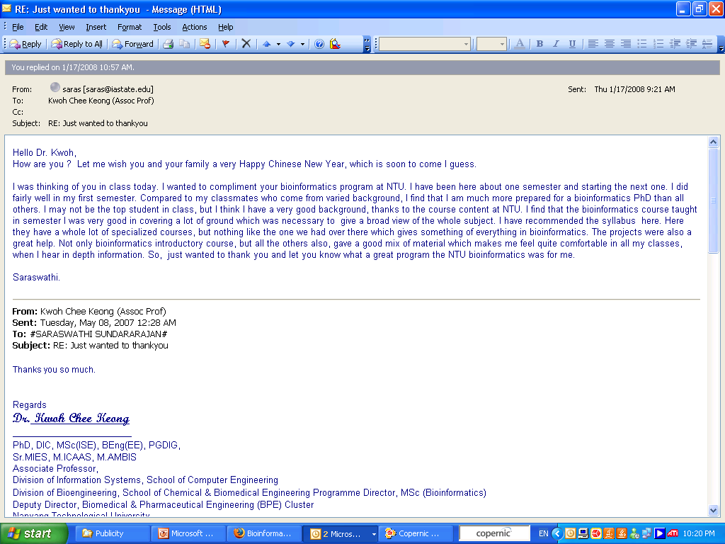

Slide 26


Q & A
Master of Science (Bioinformatics)

Slide 27
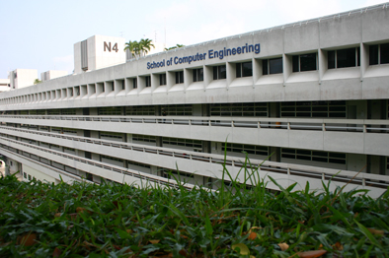
Thank you.
For more information on SCE, please visit www.ntu.edu.sg/sce

